Slide 1
Read and then delete this slide
This PSNC slide deck contains information on community pharmacy and the services it provides
It is designed to be used by LPCs/community pharmacists as the basis for a local presentation to
local patient groups
local government officers and councillors
GPs and CCGs
other groups that have an interest in community pharmacy

Slide 2
Read and then delete this slide
The presentation is consequently designed for audiences with a range of knowledge of what community pharmacies do. Before using the presentation you should:
edit it down to suit the audience and
add any local data/information to provide a local context

Slide 3
Read and then delete this slide
Resources to support your presentation include:
Introduction to community pharmacy
The community pharmacy – a guide for general practitioners and practice staff
NHS Community Pharmacy services – a summary
Engaging with primary healthcare professionals to improve the health of the local population
Local government and community pharmacy flyer

Slide 4
Read and then delete this slide
Need more help needed with a presentation? Contact:
alastair.buxton@psnc.org.uk
zoe.smeaton@psnc.org.uk
Last updated 22nd August 2013

Slide 5
Community Pharmacy: local healthcare

Slide 6
Presentation overview
Complete this section when you have edited the PowerPoint

Slide 7
Medicines
Medicines are the most common healthcare intervention, but:
30-50% not taken as intended
4-5% of hospital admissions due to preventable adverse effects of medicines

Slide 8
Pharmacist education
26 Schools of Pharmacy
4 year MPharm degree
Pharmaceutical Chemistry – origin and chemistry of drugs
Pharmaceutics – preparation of medicines
Pharmacology – actions and uses of drugs
Clinical Pharmacy, Social Pharmacy, Public Health…
Pre-registration year in practice
GPhC Exams
Registration & CPD

Slide 9
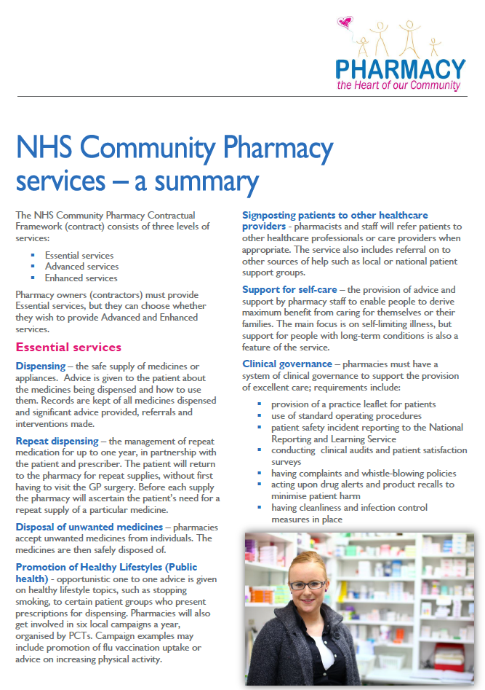
Pharmacy stats
Over 11,500 pharmacies in England situated in high-street locations, in supermarkets and in residential neighbourhoods
Independents (1-5 pharmacies) 38%
Multiples (6+ pharmacies) 62%
XXX in LPC Area
Most pharmacies have at least one private consultation area (at least 85%)

Slide 10
Community pharmacy & the NHS

Slide 11
Pharmacy and the NHS
Pharmacies are independent contractors
Each pharmacy enters into a ‘contract’ with the NHS
Market entry test – linked to PNA and JSNA
Three tiers of service
Essential services – all pharmacies provide
Advanced services – all pharmacies can provide
Locally commissioned services

Slide 12
Pharmacy and the NHS
Funding for community pharmacy service c. £2.5bn per annum (2011-12)
885 million NHS prescriptions dispensed in England by community pharmacies (2011-12)
Cost of medicines c.£8bn
The average pharmacy dispenses c.6,600 prescription items per month

Slide 13
Pharmacy and the NHS
NHS income for a typical community pharmacy accounts for 85-95% of their total turnover
A community pharmacy is one of the core businesses which can make a difference between a viable high street and one that fails commercially – thereby sustaining communities and building social capital

Slide 14
Use of Community Pharmacies
99% of the population – even those living in the most deprived areas – can get to a pharmacy within 20 minutes by car and 96% by walking or using public transport
An estimated 1.6 million visits take place daily, of which 1.2 million are for health-related reasons
Women, those aged over 35 and those with a long term health condition or disability are frequent users

Slide 15
Use of Community Pharmacies
84% of adults visit a pharmacy at least once a year, 78% for health-related reasons
Adults in England visit on average 14 times a year
Around 1 in 10 get health advice
Majority (>75%) use same pharmacy all the time
Those with LTCs or disabilities or living in rural areas are more likely to visit the same pharmacy

Slide 16
Pharmacy staff
Pharmacist
Medicines Counter Assistants/Healthcare Assistants
Dispensers
Registered Pharmacy Technicians
Delivery driver

Slide 17
The NHS Community Pharmacy Contract
[This section would be most appropriate for use with other HCPs. Delete this section if you use the next summary section instead]

Slide 18
Contract structure
Essential services
offered by all pharmacies
Advanced services
optional
accreditation requirements
Locally commissioned services

Slide 19
Essential services
Dispensing
Repeat Dispensing
Support for self-care
Signposting patients to other healthcare professionals
Healthy Lifestyles service (Public health)
Waste medication disposal
Clinical governance

Slide 20
Clinical governance / Quality
Identifiable CG lead
Practice leaflet
Patient satisfaction survey
Complaints procedure
Clinical audits
Patient Safety incident analysis and reporting
Standard Operating Procedures
Employment procedures
Maintenance of patient records

Slide 21
Advanced services
Medicines Use Review (MUR) and Prescription Intervention Service
Appliance Use Review
Stoma Appliance Customisation
New Medicine Service

Slide 22
Accreditation requirements
Premises accreditation
consultation area
Pharmacist knowledge

Slide 23
MUR service
Face to face with patient, using structured questions
An adherence centred review, which assesses patient’s problems with current medication and its administration
Patient’s knowledge of medication regimen is assessed and developed
Report to patient’s GP where necessary

Slide 24
MUR service target groups
High risk medicines
NSAIDs
Anticoagulants
Antiplatelets
Diuretics
Post-discharge from hospital
Respiratory disease
Asthma
COPD

Slide 25
The story so far…
2.8m MURs provided in 2012/13
c. 90% of pharmacies providing the service
Evaluation of South Central respiratory disease project:
40% of people with asthma showed better asthma control during the time studied
55% of COPD patients showed an improvement in symptom management
Analysis of data on emergency asthma and COPD admissions showed a positive association between the introduction of the project and changes in emergency hospital admissions

Slide 26
New Medicine Service (NMS)
It’s all about helping patients to get the most from their newly prescribed medicine
Based on proof of concept research
Provision commenced 1st October 2011

Slide 27
NMS – outline service spec
Three stage process
Patient engagement (day 0)
Intervention (approx. day 14)
Follow up (approx. day 28)
Follows the prescribing of a new medicine for:
Asthma or COPD
Diabetes (Type 2)
Antiplatelet / Anticoagulant therapy
Hypertension

Slide 28
The story so far…
89% of pharmacies providing the service
Provided to 1m+ patients by end May 2013
Initial assessment of NMS data from PharmOutcomes shows positive impact on adherence

Slide 29
Locally Commissioned Services
Minor ailments service
Emergency Hormonal Contraception
Care home service
Stop smoking
Needle & syringe exchange
Monitored dosage systems

Slide 30
Locally Commissioned Services
NHS Health Check
Supervised consumption
Contraception
Chlamydia screening & treatment
Other sexual health screening
Palliative care

Slide 31
Locally Commissioned Services
Vaccination (influenza etc.)
Alcohol screening and brief interventions
Weight management
Falls reduction
Independent and Supplementary prescribing

Slide 32
The vision for NHS Community Pharmacies
The path to improved
patient care

Slide 33
A Vision for 2016
Our aims and aspirations for the NHS community pharmacy service:
The community pharmacy service in 2016 will offer support to our communities, helping people to optimise use of medicines to support their health and care for acute and long-term conditions, and providing individualised information, advice and assistance to support the public’s health and healthy living.

Slide 34
A Vision for 2016
All pharmacies will provide a cost-effective and high quality range of services to their patients, encouraged by funding arrangements that motivate service provision, reward positive patient outcomes and offer sustainability to contractors
The value of pharmacy services to patients and the NHS and the wider savings which can be created by the effective use of pharmacy will be evidenced

Slide 35
A Vision for 2016
Pharmacies will be fully integrated into provision of primary care and public health services, and will have a substantial and acknowledged role in the delivery of accessible care at the heart of their community
Pharmacies will be able to deliver a wide range of NHS services to support their customers and patients, and be able to offer them services on equal terms to other primary care providers

Slide 36
A Vision for 2016
Patients will be confident that when they access services from a pharmacy, the pharmacist and other members of the pharmacy team will have the skills and resources necessary to deliver high quality services
Effective communications will ensure seamless integration with other NHS care providers
In some cases arrangements for provision of pharmacy services may include patient registration. All patients will have a free and unfettered choice of pharmacy

Slide 37
Four domains of services
Optimising the use of medicines
Supporting people to live healthier lives/public health
Supporting people
to self-care
Supporting people to live independently

Slide 38
The Third Pillar – supporting future NHS provision
Optimising the use of medicines
Supporting people
to self-care
Supporting people to live healthier lives/public health
Supporting people to live independently
Community Pharmacy
GP led primary care
Hospitals

Slide 39
Context and Commissioning
Transfer of service provision from secondary care to primary care is required
GP teams are likely to take on a wider role as the care coordinator for many patients
This is likely to drive demand to free up capacity in general practice to be re-deployed to this new service provision

Slide 40
Context and Commissioning
Community pharmacy can provide some services currently provided by general practice, e.g. management of certain LTCs in partnership with GPs
This creates capacity in general practice to take on more work from secondary care
To happen his requires review of secondary care funding flows (PbR)
National approach to commissioning maximises the value community pharmacy can deliver

Slide 41
1. Optimising the use of medicines
Dispensing and repeat dispensing
NHS Medicines Use Reviews
2.8m provided in 2012/13
NHS New Medicine Service
Safe disposal of unwanted medicines
The Vision narratives describes how this could develop…

Slide 42
Iterative approach to medicines optimisation service developments
Addition of elements to the Dispensing service, e.g. STOPP indicators
All pharmacies provide episodic MURs and NMS to all patients within defined cohort
New service to specific patient cohorts providing longitudinal medicines optimisation support, building on MUR and NMS
Management of single LTC, e.g. asthma, in partnership with patients and GP practice
Start
Current time – NMS and targeted MURs
Finish
Community pharmacy providing medicines optimisation support for all LTC patients and managing certain conditions in partnership with patients and GP practice
The different stages of service development may co-exist

Slide 43
2. Supporting people to self-care
Self-care advice
Self-limiting conditions
Long-term conditions
Signposting to other providers
Sales of over the counter medicines
Minor ailment services

Slide 44
3. Supporting people to live healthier lives
Advice on healthy lifestyle issues as part of NHS services (e.g. MUR and dispensing)
Six public health campaigns per year
And a range of locally commissioned services…

Slide 45
3. Supporting people to live healthier lives
Stop Smoking support
Alcohol screening and support
NHS Health Checks
Weight management services
Emergency contraception / Contraception
Chlamydia / Gonorrhoea / Hep B / HIV testing
Immunisation – flu, travel health, HPV etc.
Substance misuse – needle exchange and supervision of consumption of substitute medicines
Early detection of cancer

Slide 46
3. Supporting people to live healthier lives
Could some public health services be commissioned nationally? e.g. EHC
Healthy Living Pharmacy concept
Structured support team training for health and wellbeing advice
Key services and advice delivered
Public health campaigns
Positive results from evaluation

Slide 47
4. Supporting people to live independently
In addition to support to optimise the use of medicines…
Support with re-ordering repeat medicines / the NHS repeat dispensing service
Home delivery of medicines to the housebound
Appropriate provision of multi-compartment compliance aids and other interventions such as reminder charts to help people remember to take their medicines

Slide 48
4. Supporting people to live independently
Reablement services following discharge from hospital
Falls assessment / reduction services
Supply of daily living aids
Identifying emerging problems with peoples’ health
Signposting patients or their carers to additional support and resources related to their condition or situation

Slide 49
Community Pharmacy services
[Briefer description of services more appropriate for use with lay audiences]

Slide 50
Four domains of services
Optimising the use of medicines
Supporting people to live healthier lives/public health
Supporting people
to self-care
Supporting people to live independently

Slide 51
1. Optimising the use of medicines
Dispensing and repeat dispensing
NHS Medicines Use Reviews
2.8m provided in 2012/13
NHS New Medicine Service
Safe disposal of unwanted medicines

Slide 52
2. Supporting people to self-care
Self-care advice
Self-limiting conditions
Long-term conditions
Signposting to other providers
Sales of over the counter medicines
Minor ailment services

Slide 53
3. Supporting people to live healthier lives
Advice on healthy lifestyle issues as part of NHS services (e.g. MUR and dispensing)
Six public health campaigns per year
And a range of locally commissioned services…

Slide 54
3. Supporting people to live healthier lives
Stop Smoking support
Alcohol screening and support
NHS Health Checks
Weight management services
Emergency contraception / Contraception
Chlamydia / Gonorrhoea / Hep B / HIV testing
Immunisation – flu, travel health, HPV etc.
Substance misuse – needle exchange and supervision of consumption of substitute medicines
Early detection of cancer

Slide 55
3. Supporting people to live healthier lives
Healthy Living Pharmacy concept
Piloted in Portsmouth and subsequently tested in more than 20 other areas
Structured pharmacy team training on providing health and wellbeing advice to the public
Key public health services and proactive advice provided alongside public health campaigns
Positive early results

Slide 56
4. Supporting people to live independently
Support with re-ordering repeat medicines / the NHS repeat dispensing service
Home delivery of medicines to the housebound
Appropriate provision of multi-compartment compliance aids and other interventions such as reminder charts to help people remember to take their medicines
Reablement services following discharge from hospital

Slide 57
4. Supporting people to live independently
Falls assessment / reduction services
Signposting patients or their carers to additional support and resources related to their condition or situation
Supply of daily living aids
Identifying emerging problems with peoples’ health

Slide 58
Developing Community Pharmacy services for the benefit of patients

Slide 59
What is the LPC?
Body recognised in Statute
Represents views of community pharmacy contractors to NHS and supports contractors
Works with the NHS to coordinate local service provision
Elected by local pharmacy owners

Slide 60
Pharmacy services in xxxx
Insert information/data on locally commissioning services

Slide 61
Future potential for pharmacy
LPC to insert proposed local service developments, e.g.:
Minor ailments schemes to free up GP time
Medicines optimisation services to support people discharged from hospital
Flu vaccination service

Slide 62
Joint working
Include the target items you want to seek agreement to, e.g.:
The LPC can support development of Joint Strategic Needs Assessment (JSNA) and the Pharmaceutical Needs Assessment (PNA)
Discussions with the DPH and team on developing pharmacy services to help meet key public health objectives

Slide 63
Questions & Discussion
More information on community pharmacy services at
LPC website/psnc.org.uk

