Slide 1
Read and delete
This slide deck has been published by PSNC for LPC use at contractor meetings
It contains a range of slides covering the funding imposition and contract changes which can be selected as appropriate to the focus of your meeting
A more detailed slide deck on the Quality Payments scheme is available at http://psnc.org.uk/services-commissioning/essential-services/quality-payments/
A more detailed slide deck on the NUMSAS is available at http://psnc.org.uk/services-commissioning/urgent-medicine-supply-service/
Further information, which can be used as background reading prior to using the presentation, is available via http://psnc.org.uk/contract-it/cpcf-changes-201617-and-201718/
Last updated 26/2/17

Slide 2
Community pharmacy in 2016/17 and beyond – final package
psnc.org.uk/pharmacychanges #pharmacychanges

Slide 3
Overview
Changes to funding
Pharmacy Access Scheme
Quality Payment scheme
Pharmacy Integration Fund
NUMSAS
Other contract changes
Judicial Review
Questions

Slide 4
Funding imposition
2016/17
£2.687 billion (£113 million reduction)
4% reduction in funding (cf. 2015/16)
12% reduction from Dec 2016 - Mar 2017 cf. Nov 2016 levels
Original plan was for £170 million reduction
So eventual imposition was £57 million less than originally planned

Slide 5
Funding imposition
2017/18
£2.592 billion
£95 million reduction cf. 2016/17
£208 million reduction = a further 3.4% reduction cf. 2015/16
7.4% reduction cf. Nov 2016 levels
Beyond 2018 – Subject to future consultation

Slide 6
Single Activity Fee
Incorporates the:
professional fee
Practice Payment
Repeat Dispensing payment
monthly EPS payment
Other fees (unlicensed medicines, appliances, CDs, etc) are not included
One-off set up payment for EPS release 2 will cease at end of March
£1.13/item
Expected to rise in 2017/18 to £1.24/item

Slide 7
Establishment Payments
Will be phased out over a number of years
1st December 2016 – reduced by 20% compared to 2015/16 (equivalent to 6.7% reduction overall in 2016/17)
1st April 2017 – further reduced by 40% compared to 2015/16 levels
Proposed to cease by end of 2019/20

Slide 8
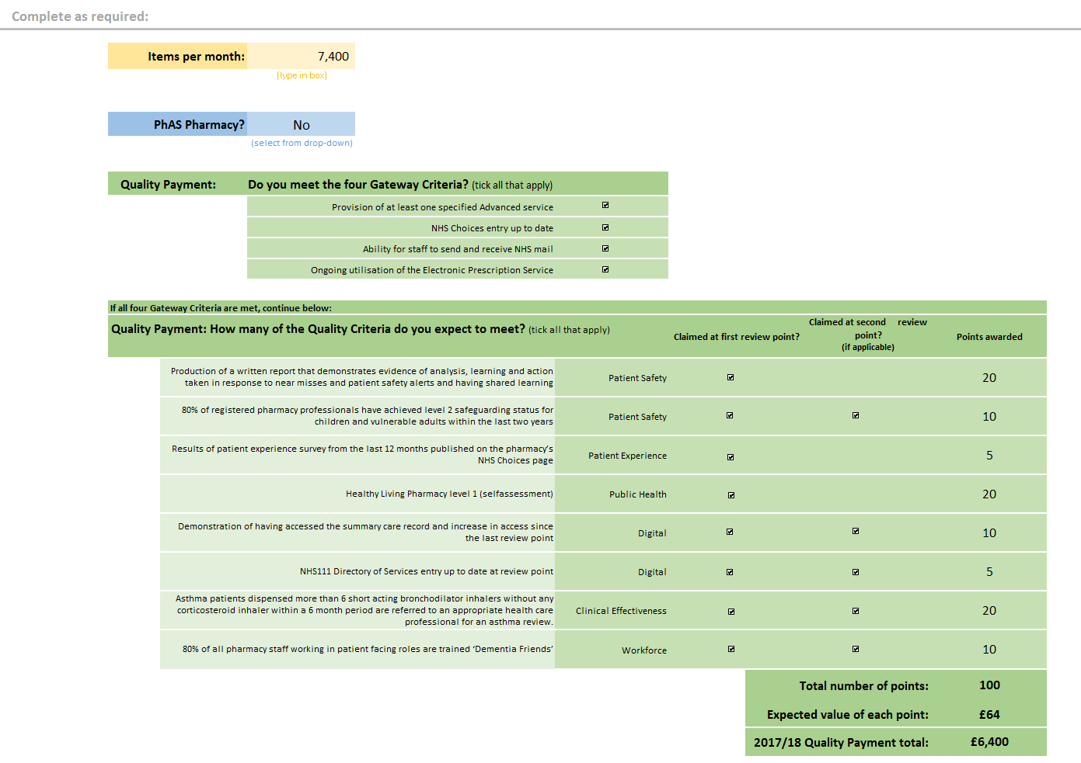
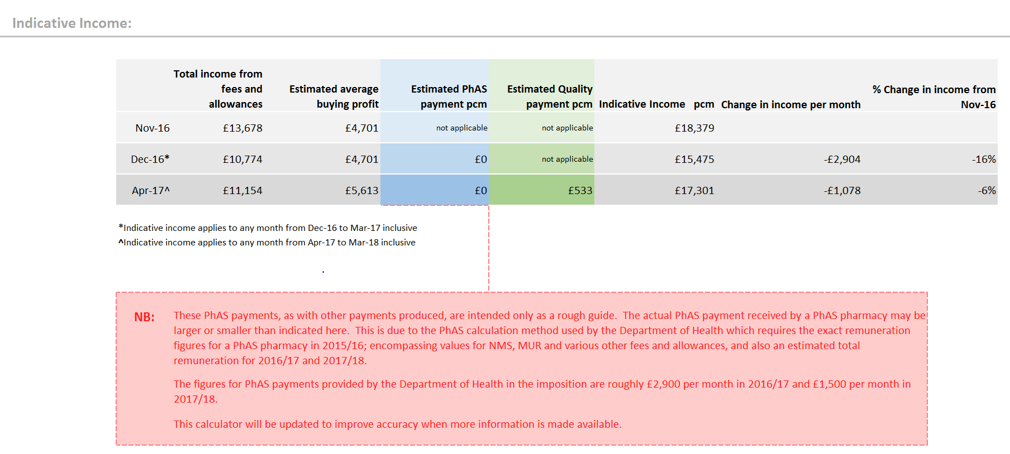
PSNC website: indicative income calculator
Quality Payment

Slide 9
Summary of funding changes & pharmacy cashflow impact
Funding cut £113m
Reduction in Establishment Payment by 20%
Introduction of Single Activity Fee @ rate of £1.13 per item
Introduction of Pharmacy Access Scheme
Ongoing margin recovery of £12m pcm
Funding cut £95m
Further reduction in Establishment Payment by 40%
Slight increase in Single Activity Fee @ rate of £1.24 per item
Reduction in average Pharmacy Access Scheme
Introduction of Quality Payments
Margin recovery of £12m pcm ends
1st Dec 16
Jan 17
1st Feb 17
1st Mar 17
1st Apr 17
May 17
Jun 17
1st Jul 17
Aug 17
Oct 16 advance payment
Sept 16 balancing payment
Dec 16 advance payment
Nov 16 balancing payment
Jan 17 advance payment
Dec 16 balancing payment
No changes to payments for contractors apart from usual fluctuations in AIV.
Dec 16 advance payment will be inflated as based on November’s AIV
Big Impact Month
For eligible pharmacies the first Quality Payment will be made in July 2017
Note: this payment is only made twice a year with April and Novembers balancing payments
Jan 17 advance payment will be lower as the AIV calculation will take into consideration the reduction in fees.
Dec 16 balance payment will be less than the value of the advance payment
Try the PSNC’s Cashflow & Indicative Income Calculator to see how these changes will impact your pharmacy by visiting
psnc.org.uk/fundingchanges and clicking on the
‘Impact on contractor income’ dropdown.
Notes:
9

Slide 10
Changes to reimbursement
Changes previously agreed by PSNC
non Part VIII products
Cat M changes
Changes to the margin survey to account for multiple suppliers of non-Part VIII and Cat C products
Splitting the discount scale
Changes to the way Cat A prices are set

Slide 11
Pharmacy Access Scheme (PhAS)
Aim – ensure that a baseline level of patient access to NHS community pharmacy services is protected
Funded from overall CPCF funding (bar near-miss review category)
PhAS pharmacies will receive an additional payment – will be protected from full effect of the reduction in funding
Payment will be based on the funding the pharmacy received in 2015/16
On average, roughly £11,600 in 2016/17 and £17,600 in 2017/18
This is roughly £2,900 per month in 2016/17 and £1,500 per month in 2017/18

Slide 12
Pharmacy Access Scheme (PhAS)
If eligible on the list, no need to apply to ‘join’ the scheme
A pharmacy is eligible if it meets three criteria:
Is more than a mile away from its nearest pharmacy by road walking distance
Was on the Pharmaceutical List on 1st September 2016
Not in the top 25% of pharmacies by dispensing volume (prof fees)
According to DH’s original list, 1,356 pharmacies would receive funding based on criteria
The list has subsequently been revised

Slide 13
Pharmacy Access Scheme (PhAS)
Distance-selling pharmacies are not included
LPS pharmacies are not included - although they may receive similar payments depending on the terms of their contract
Eligibility is fixed to pharmacies on the published list (subject to review cases)
Commenced on 1st December 2016 and runs to 31st March 2018 – unknown what will happen after this time period
Notes:
A review process has been included in the scheme to deal with any inaccuracies in DH’s calculations, or any unforeseen circumstances affecting access; like a road closure. Review will also be possible for cases where there may be a high level of deprivation, and pharmacies are slightly less than a mile from another pharmacy, but are critical to patient access.
The DH guidance on PhAS confirms applications for reviews will need to be made within three months of the start of the scheme (1st December 2016) and reviews will be administered by NHS England. Details of where to send requests for reviews to be released shortly.
Applications for review will be accepted from 1st November 2016 and NHS England will aim to complete a review within six weeks of receiving a request.

Slide 14
Pharmacy Access Scheme (PhAS)
A review mechanism (administered by NHS England) is in place
Aim - to allow for consideration of extenuating circumstances which may mean that access is not being protected in the way intended by the scheme
Full details via psnc.org.uk/phas
Grounds for review:
Inaccuracy, e.g. if the pharmacy postcode is incorrect or the distance from the next pharmacy is calculated incorrectly
Notes:
A review process has been included in the scheme to deal with any inaccuracies in DH’s calculations, or any unforeseen circumstances affecting access; like a road closure. Review will also be possible for cases where there may be a high level of deprivation, and pharmacies are slightly less than a mile from another pharmacy, but are critical to patient access.
The DH guidance on PhAS confirms applications for reviews will need to be made within three months of the start of the scheme (1st December 2016) and reviews will be administered by NHS England. Details of where to send requests for reviews to be released shortly.
Applications for review will be accepted from 1st November 2016 and NHS England will aim to complete a review within six weeks of receiving a request.

Slide 15
Pharmacy Access Scheme (PhAS)
Physical feature anomalies, e.g. a semi-permanent roadblock meaning two pharmacies are then more than 1 mile from each other
Can be requested beyond the initial 3 month review period, but within 3 months of the change in circumstances
Evidence of the anomaly must be submitted and will need to demonstrate, on a balance of probabilities, that the normal “1-mile rule” produces an unreasonable outcome in the particular circumstances of the case
Notes:
A review process has been included in the scheme to deal with any inaccuracies in DH’s calculations, or any unforeseen circumstances affecting access; like a road closure. Review will also be possible for cases where there may be a high level of deprivation, and pharmacies are slightly less than a mile from another pharmacy, but are critical to patient access.
The DH guidance on PhAS confirms applications for reviews will need to be made within three months of the start of the scheme (1st December 2016) and reviews will be administered by NHS England. Details of where to send requests for reviews to be released shortly.
Applications for review will be accepted from 1st November 2016 and NHS England will aim to complete a review within six weeks of receiving a request.

Slide 16
Pharmacy Access Scheme (PhAS)
If a semi-permanent road or bridge closure means that the nearest pharmacy is in fact more than a mile away, the first stage of the review will be passed successfully
If the problem is that the distance to the nearest pharmacy is in fact less than a mile but the journey is particularly difficult, NHS England will need evidence of the level of difficulty and the problems surmounting that difficulty
If a pharmacy satisfies the first stage of the test, to then qualify for the PhAS payment, the pharmacy would also have to demonstrate on a balance of probabilities that they were critical for access
Notes:
A review process has been included in the scheme to deal with any inaccuracies in DH’s calculations, or any unforeseen circumstances affecting access; like a road closure. Review will also be possible for cases where there may be a high level of deprivation, and pharmacies are slightly less than a mile from another pharmacy, but are critical to patient access.
The DH guidance on PhAS confirms applications for reviews will need to be made within three months of the start of the scheme (1st December 2016) and reviews will be administered by NHS England. Details of where to send requests for reviews to be released shortly.
Applications for review will be accepted from 1st November 2016 and NHS England will aim to complete a review within six weeks of receiving a request.

Slide 17
Pharmacy Access Scheme (PhAS)
In particular, it would need to demonstrate that a local population relies on that pharmacy and would be materially affected by its closing. The health needs of the population may be relevant to whether or not the local population is materially affected by the closure
Near misses
pharmacies between 0.8 and 1 miles from the next pharmacy; and
in the top 20% of areas when ranked by Index of Multiple Deprivation
the pharmacy will have to demonstrate on a balance of probabilities that they were critical for access
Notes:
A review process has been included in the scheme to deal with any inaccuracies in DH’s calculations, or any unforeseen circumstances affecting access; like a road closure. Review will also be possible for cases where there may be a high level of deprivation, and pharmacies are slightly less than a mile from another pharmacy, but are critical to patient access.
The DH guidance on PhAS confirms applications for reviews will need to be made within three months of the start of the scheme (1st December 2016) and reviews will be administered by NHS England. Details of where to send requests for reviews to be released shortly.
Applications for review will be accepted from 1st November 2016 and NHS England will aim to complete a review within six weeks of receiving a request.

Slide 18
Quality Payments scheme
Voluntary engagement – contractors don’t have to participate
Derived from a PSNC proposal
but the PSNC proposal was with full funding to recognise costs
to tackle the DH move to even greater Rx volume focussed funding
Payments will be made to community pharmacy contractors who meet certain quality criteria
Payments will be made in 2017/18
Implementation commenced in December 2016

Slide 19
Eligibility to participate
All pharmacies on the pharmaceutical list in England
including Distance Selling Pharmacies
including pharmacies receiving a Pharmacy Access Scheme (PhAS) payment
Does not include Local Pharmaceutical Services (LPS) contracts
but NHS England local teams and LPS contractors can theoretically include a similar concept in LPS contracts when they are reviewed

Slide 20
Funding
£75m value in 2017/18 (from the overall £2.592bn CPCF funding)
100 points maximum per contractor
Value of each point set at £64 = ‘max’ of £6,400
But potentially a reconciliation payment in final payment for March 2018 (end May 2018) to pharmacies that have participated in the scheme
The reconciliation payment received will depend on the number of points the contractor has achieved
£128 cap on points value

Slide 21
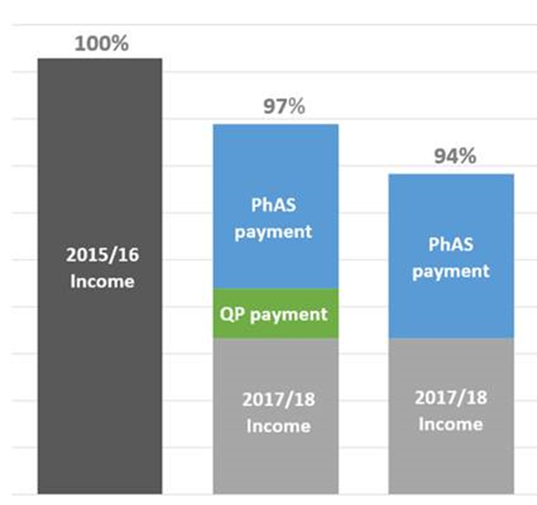
PhAS and Quality Payments
Pharmacies eligible for the Pharmacy Access Scheme will qualify for Quality Payments
When the ‘top-up funding’ that PhAS pharmacies receive is calculated, it is assumed that the contractor will achieve 100 points
The value of those points is deducted before the final PhAS payment is set

Slide 22
Claiming payment
2 review points during the year at which contractors assess which requirements they have met and how many points they have achieved:
28th April 2017
24th November 2017
Declarations will be made to the BSA in April and November – via a Smart Survey web-based form
payments made with the final payment for those months
i.e. end June 2017 and start of February 2018

Slide 23
Gateway criteria
Pharmacies must first meet four gateway criteria:
Offering MURs or the NMS or must be registered to provide the NHS Urgent Medicine Supply Advanced Service (NUMSAS)
NHS Choices entry up to date
Ability to send and receive email via NHSmail
Ongoing utilisation of EPS
There is no payment for passing the gateway criteria

Slide 24
Quality criteria
Domain | Criteria | Number of review points at which it can be claimed | Points at any one review point | Total points over the two review points
Patient Safety | Written safety report at premises level available for inspection at review point, covering analysis of incidents and incident patterns (taken from an ongoing log), evidence of sharing learning locally and nationally, and actions taken in response to national patient safety alerts | One | 20 | 20
Patient Safety | On the day of the review 80% of registered pharmacy professionals working at the pharmacy have achieved level 2 safeguarding status for children and vulnerable adults in the last two years | Two | 5 | 10
Patient Experience | On the day of the review, the results of the Community Pharmacy Patient Questionnaire from the last 12 months is publicly available on the pharmacy’s NHS Choices page | One | 5 | 5

Slide 25
Quality criteria
Domain | Criteria | Number of review points at which it can be claimed | Points at any one review point | Total points over the two review points
Public Health | On the day of the review, the pharmacy is a Healthy Living Pharmacy level 1 (self-assessment) | One | 20 | 20
Digital | On the day of the first review, the pharmacy can demonstrate a total increase in access to Summary Care Records between 1 December 2016 and 28 April 2017 in comparison to the previous 5 months; and on the day of the second review, the pharmacy can demonstrate a total increase to access to Summary Care Records between 1 May 2017 and 24 November in comparison to the previous 7 months | Two | 5 | 10
Digital | On the day of the review, the pharmacy’s NHS 111 Directory of Services entry is up to date | Two | 2.5 | 5

Slide 26
Quality criteria
Domain | Criteria | Number of review points at which it can be claimed | Points at any one review point | Total points over the two review points
Clinical Effectiveness | On the day of the review, the pharmacy can show evidence of asthma patients, for whom more than 6 short acting bronchodilator inhalers were dispensed without any corticosteroid inhaler within a 6 month period, are referred to an appropriate health care professional for an asthma review. | Two | 10 | 20
Workforce | On the day of the review, 80% of all pharmacy staff working in patient facing roles are trained ‘Dementia Friends’ | Two | 5 | 10
 |  | Total number of points: 100

Slide 27
PSNC’s view on the scheme
Direction of travel is right and some useful enablers for the future
Lack of specific funding is an issue, particularly for HLP
Advise contractors to carefully consider which elements of the scheme they engage with and the costs that they will incur in comparison to the funding available for each element
But we expect that most contractors will want to participate
Longevity of the scheme is unclear and will be influenced by NHS England’s response to the Murray Review
The fine details related to implementation should have been finalised by DH/NHS England before imposition

Slide 28
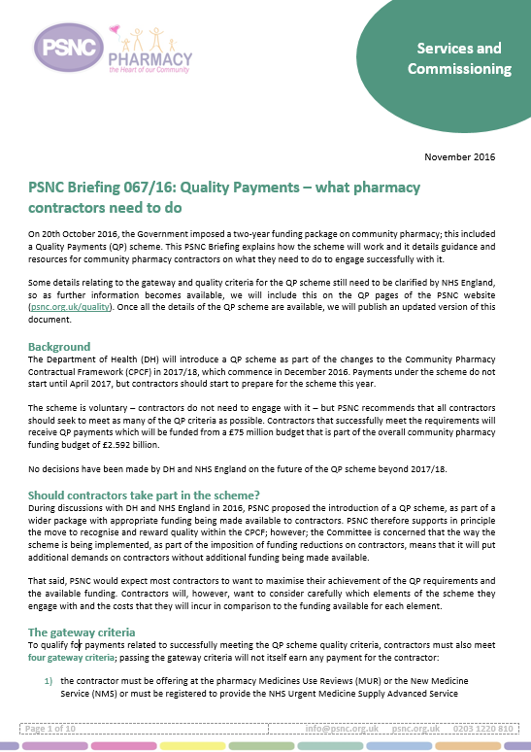
Next steps
Initial guidance on Gateway criteria was published by NHS England in December
Further guidance on quality criteria published at end of February 2017
PSNC Briefings and associated resources available at psnc.org.uk/quality
HLP Briefing and resources
Dementia Friends Briefing
Asthma Interventions Briefing
PharmOutcomes modules available to help track progress and make referrals/records for the asthma criterion

Slide 29
The Pharmacy Integration Fund
5 year fund – £300m???
2016/17 & 2017/18 value now £42m
Urgent care workstream – emergency supply, DoS improvement work, NHS 111 integration, deploying pharmacists in urgent care settings (from April 2017)
Care home workstream – deployment of pharmacists from April 2017 and workforce development
HEE workforce plan for pharmacy professionals in primary care

Slide 30
The Pharmacy Integration Fund
Educational grants for community pharmacists to access postgraduate clinical pharmacy education and training courses up to diploma level (from April 2017)
A programme of pharmacy technician clinical leadership development (from April 2017)
Medicines Digital Strategy work (Domain E) – NHS Digital
Transfer of care data from NHS 111 and hospitals to community pharmacies and post-event messaging

Slide 31
The Pharmacy Integration Fund
NHSmail 2 rollout to community pharmacy
Murray Review will inform future decisions on how the fund is deployed
Stakeholder reference group to be established in 2017

Slide 32
NHS Urgent Medicines Supply Advanced Service (NUMSAS) pilot
Advanced service from December 2016 – end March 2018
Only NHS 111 referrals – not walk-in patients
Service specification published at the end of November 2016
Funded from the Pharmacy Integration Fund, i.e. over and above the core funding

Slide 33
NHS Urgent Medicines Supply Advanced Service (NUMSAS) pilot
Record keeping requirements and IT support…
NHS England intend to publish guidance on the service
Started to rollout in December 2016…
PSNC has issued guidance for contractors, including our view on the cost of provision
Implications for local services…
Evaluation of service commencing in January 2017

Slide 34
Spreading MAS…
‘NHS England will test the technical integration and clinical governance framework for referral to community pharmacy from NHS 111 for people who need immediate help with urgent minor ailments’
‘Aim to develop an evidence-based, clinical and cost effective approach to how community pharmacists and their teams contribute to urgent care’
NHS England will encourage all CCGs to adopt this ‘joined-up approach’ by April 2018

Slide 35
Changes to market entry – consolidation of pharmacies
PSNC proposed changes to prevent a new pharmacy stepping in straight away if a chain closes a branch or two businesses merge
Regulations laid in December 2016 which provide some protection for pharmacies that consolidate, where this does not create a gap in provision

Slide 36
Judicial Review
PSNC sought a Judicial Review of the Secretary of State’s October decision
What is a Judicial Review?
Sought permission from the High Court to apply for the Judicial Review on the grounds that it believes the Secretary of State failed to carry out a lawful consultation
PSNC’s application raises a number of concerns about the consultation, including:
The DH’s failure to disclose the fact that it had carried out an indicative analysis of pharmacies’ profitability based on Companies House data as part of its Impact Assessment

Slide 37
Judicial Review
The delay in providing this analysis to PSNC after the publication of the Impact Assessment
The validity of the DH analysis including the sample size and the use of accounting returns, rather than economic returns, as the basis for the assessment of pharmacies’ economic viability and how they might be affected by the changes
The DH’s failure to analyse what the levels of pharmacy closures may be
The National Pharmacy Association is named as an interested party in PSNC’s application and has launched its own JR

Slide 38
Judicial Review
The High Court granted PSNC permission for a Judicial Review (21st December 2016)
The hearing was to be expedited and was due to be heard in the week commencing 6 February 2017
The Secretary of State sought a later hearing date
This matter was considered on 12th January 2017 – case now to be ‘rolled-up’ with the NPA case and heard week commencing 20th March

Slide 39
Judicial Review
Likely outcomes?
Implications for contractors…

Slide 40
Questions
psnc.org.uk/pharmacychanges

