Slide 1
Electronic Prescription Service
Electronic Repeat Dispensing (eRD)
October 2016

Slide 2
Agenda
Welcome & introductions
What is eRD?
Benefits
Common questions
Current utilisation
Local eRD strategy

Slide 3
Electronic Repeat Dispensing
Two thirds of prescriptions issued in primary care are repeat prescriptions.
This accounts for 80% of NHS medicine costs for primary care.
There are up to 410 million repeat prescriptions generated every year – equivalent to an average of more than 375 per GP per week.
330 million or 80% of all repeat prescriptions could eventually be replaced with repeat dispensing.
This could save 2.7 million hours of GP and practice time.
Since July 2009 it has been possible to use repeat dispensing via EPS.
Called Electronic Repeat Dispensing (eRD) to differentiate it from paper based Repeat Dispensing.

Slide 4
eRD fundamentals
Prescriber issues batch of EPS prescriptions in one go for suitable patients with repeat medication, for up to 12 months.
Pharmacy responsible for carrying out checks with patient before dispensing each issue.
Patient reviewed regularly by pharmacy and has flexibility throughout the regime.

Slide 5
eRD and the Local Digital Roadmap

Slide 6
eRD and the Community Pharmacy Contractual Framework

Slide 7
Benefits for the NHS
Stated benefit
GP practice use of Electronic Repeat Dispensing reduces the volume of paper and GP signing time (one digital signature per batch) over repeat prescribing.
Rationale
The introduction of EPS Release 2 simplifies the repeat dispensing process particularly in terms of volume of paper and requirement for only one GP electronic signature as opposed to many paper signatures.
GP time saving equal to £3.36 per patient
Benefit value to NHS £93.2 million
Benefit per item 12.05 pence
The prescriber will save £2.48 every time they have to cancel an item.
80% of all repeats could be replaced with eRD.

Slide 8
Benefits for the patient
Pharmacy nomination can be changed in the middle of a repeat dispensing regime.
Reduction in unnecessary visits to the GP practice.
Ability to request multiple issues of medication in advance after clinical assessment by pharmacist i.e. holidays.
Potential reduction in out of hours requests for routine medication.
Patient doesn't need to remember to order their prescription.
Patient cannot lose their prescription.

Slide 9
Benefits for the GP practice
Reduction in workload in re-signing requested repeat prescriptions.
Reduction in the amount of requests/queries coming into the practice.
Cancellation at any point during the regime at item or at prescription level.
New medication can be added to the regime.
Reduction in medicines waste.

Slide 10
Benefits for the Pharmacy
Improved stock control.
Increased efficiency.
Effective time management.
Reduction in managed repeat workload.
Fewer trips to collect prescriptions from GP practice.

Slide 11
Community pharmacy …..the four questions
Have you seen any health professional (GP, nurse or hospital doctor) since your last repeat was supplied?
Have you recently started taking any new medicines either on prescription or that you have bought over the counter?
Have you been having any problems with your medication or experiencing any side effects?
Are there any items on your repeat prescription that you don’t need this month?

Slide 12
Prescribing an eRD batch
When a prescriber issues an electronic prescription for repeat dispensing this will contain the following information:
total quantity per issue
the intended duration of each issue of the prescription
how many times the repeatable prescription can be issued before the patient/medication should be reviewed.
2 per day x 28 day duration = quantity of 56
13 issues = 1 year’s supply

Slide 13
Pharmacy second issue is downloaded automatically and has 7 days to prepare before due date
Pharmacy
third issue is downloaded automatically and has 7 days to prepare before due date
Pharmacy
last batch is dispensed and informs patient this is the last issue
Day 21
Day 49
Last Issue
Issue 1
Issue 2
Cont….
Day 1
Day 28
Day 56
Last Issue
GP
signs eRD prescription and uploads to Spine
Patient
collects second issue
Patient
collects third issue
Patient
collects last issue and contacts GP
Pharmacy downloads and prepares medication
Pharmacy
sends dispense notification
Pharmacy
sends dispense notification
GP conducts review if required and issues next eRD prescription
Patient collects
The prescriber can track the progress of the prescription using the Prescription Tracker and can cancel items at any point during the regime
Pharmacy
sends dispense notification.

Slide 14
eRD and the Prescription Tracker
Prescription ID
search
www.hscic.gov.uk/eps/tracker
Add to Favourites
NHS number
Add to Favourites
https://www.digital.nhs.uk/electronic-prescription-service/rx-tracker

Slide 15
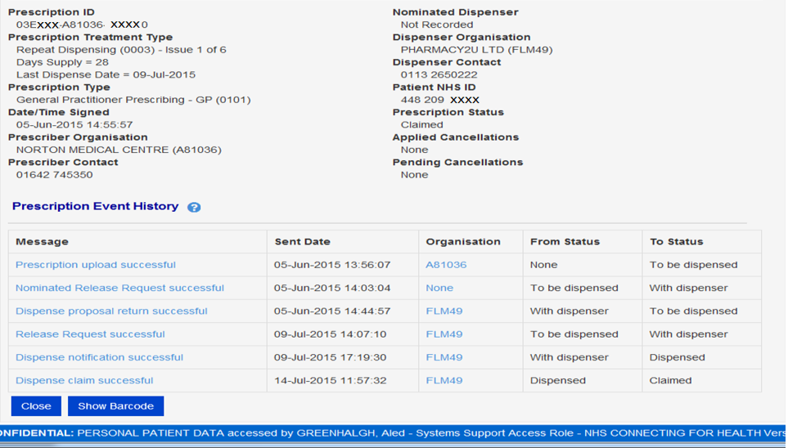
Prescription and Dispensing Details

Slide 16
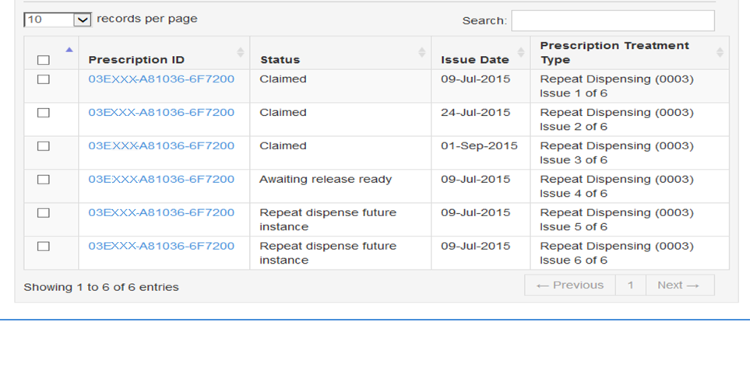
The status of the prescription changes as is passes from Spine to pharmacy to patient
EPS Prescription Tracker shows each issue individually
All issues have the same Prescription ID

Slide 17
Common questions

Slide 18
Patient consent
Patients are required to give consent for repeat dispensing - formal written consent is not required.
Currently an EPS nomination needs to be in place.
Patient consent given for eRD can be codified in the patients’ notes.
CTV3 code: XaKRX –
"Patient consent given for Repeat Dispensing information transfer"
Pharmacists can gather consent and inform the surgery.

Slide 19
Patient nomination change
Patients can change their nominated pharmacy before the end of the repeat dispensing period.
Any outstanding issues which have not been downloaded will be available to download by the new nominated pharmacy.

Slide 20
Patient changes practice or dies
Any outstanding repeat dispensing issues should be cancelled.
Make it part of deduction checks.
When Personal Demographic Service is notified of death - the Spine will automatically cancel outstanding prescriptions.

Slide 21
Prescriber changes practice
Where the prescriber is the responsible party and the author and they then move to work at another practice, any outstanding repeat dispensing issues must be cancelled and re-issued by another prescriber, otherwise the cost centre is transferred with the prescriber.
eRD prescriptions would move with the prescriber and be charged to their new practice.

Slide 22
Medication changes
Options:
cancel ALL outstanding items on the Spine and replace with a new batch
cancel individual item(s)
‘bridge the gap’ with a one-off script – if other medications are running out next week generate a one-off script until ready to start a new eRD batch for all items.
Good practice to communicate with pharmacy about changes.

Slide 23
RA token
Issuing an RA token to the pharmacy is no longer necessary when starting a repeat dispensing prescription.
A token can still be printed if requested by the patient.
Your system may still default to print one.
EMIS can “Store” the automatic RA for it to be deleted later.

Slide 24
Suitable patients
Patients with long term conditions.
Medication expected to remain stable between reviews, eg 3m, 6m, 12m.
eRD can be used to prompt reviews.

Slide 25
Medications unsuitable for eRD
Controlled drugs schedule 2 and 3
Medications requiring frequent review such as methotrexate and lithium
Unlicensed medicines

Slide 26
Preparing repeats for eRD
Check the issue duration / interval is correct for each repeat template.
Synchronise all items to be issued in the same eRD batch.
Ensure the number of authorised issues and/or review dates match up.
Consider issuing items in separate batches – eg CD 4 or 5, or PRN items (irregular issue duration).
Use the patients’ usage history to calculate PRN intervals e.g. 4 issues in 12 months = 84 days between issues.

Slide 27
How to get started
Ensure all prescribers are aware of eRD
eLearning.
Run an eRD workshop
create your surgery's eRD strategy (include admin team and clinical team)
review current eRD performance and set a target
involve local pharmacy.
Identify potential patients
at medication review
opportunistically
by advertising in the surgery.
Target specific conditions/regimes
Hypertension, diabetes.

Slide 28
Hints and Tips to increase utilisation
Medicines management technician to work with practices
Practice staff and pharmacies to identify and communicate with patients suitable for eRD.
integrate eRD into your local prescribing incentive scheme
Incentivising pharmacies to identify suitable patients - explain the process and gain patient consent.
Hold practice meetings involving medicines management, LPC, local CSU project lead with lead GPs and prescription clerks to devise local eRD plans.

Slide 29
Maximise eRD
Ad-hoc
prescribers choose eRD by default when suitable
Admin teams highlight suitable patients when processing repeats.
Target patients by group
already on paper repeat dispensing or on regular regimes
by specific condition/medication.
Referral
involve pharmacy to identify suitable candidates
self referral from the patient.

Slide 30
National RD by age group

Slide 31
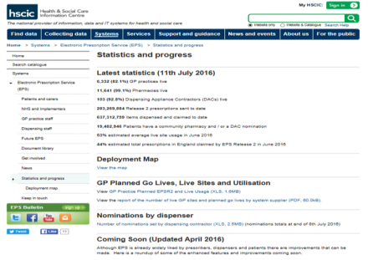
Tracking eRD progress
You can check your progress at the NHS Digital website:
https://digital.nhs.uk/eps/stats

Slide 32
Implementing an eRD strategy?
Starting point
current eRD performance
general awareness of eRD
system knowledge.
The size of the prize – use the benefits calculator.
Strategy
eRD in the consulting room
patient selection/communication
admin processes
training
pharmacy involvement/referral.
Set a realistic target

Slide 33
eRD champion profile
Two eRD champions from the practice team should attend the eRD training - ideally one prescriber and one member of the admin team.
They need to:
have access to patients
be an established and confident EPS user
be willing and able to cascade training
be willing to complete eLearning
be able to be the "go to" person for any eRD issues
be able to engage and manage relationships with local pharmacies
understand the repeat prescription process
have the ability to influence the practice team to adapt new processes to promote eRD

Slide 34
eRD champion workshops
Two hour face to face session with two EPS champions from each practice.
Covering:
background
benefits
patient selection
system specific training - step by step eRD processes
accessing system reports
eRD toolkit
common scenarios
self assessment and setting an eRD target
surgery level eRD strategy options
next steps.

Slide 35
Next steps
Complete the NECSU eLearning
Share the eLearning link with colleagues
https://learning.necsu.nhs.uk/nhs-digital-electronic-repeat-dispensing-elearning/
Review the eRD Toolkit
Set realistic eRD targets for the practice as a whole
Host an eRD Workshop, invite prescribers, admin team and local pharmacies.

Slide 36
Questions and further information NHS Digital EPS website http://systems.digital.nhs.uk/eps Have you signed up for the NHS Digital GP or Pharmacy bulletins?

