Slide 1
Read and delete this slide…
This slide deck is for use by LPCs and others who are talking to local PCN and healthcare leaders about the way in which community pharmacy can contribute to PCNs. You can pick and choose the elements of the presentation that suit the needs of your event/discussion.
Information and resources on PCNs can be found at:
https://www.england.nhs.uk/primary-care/primary-care-networks/
http://www.psnc.org.uk/pcn
Questions or comments on this presentation can be addressed to: services.team@psnc.org.uk
Last updated: 10th July 2019

Slide 2
The community pharmacy offer to Primary Care Networks Name of presenter Job title Name of LPC

Slide 3
Who we are – the Local Pharmaceutical Committee (LPC)
Represent the views of community pharmacy contractors (owners) to the NHS
Provide advice to community pharmacy contractors and others wanting to know more about local pharmacy
Support the development, commissioning and implementation of locally commissioned services ​
​Members elected or appointed by local pharmacy owners​
Add link to LPC website
Notes:
PSNC denomination ( the national negotiator )

Slide 4
Presentation overview – amend accordingly
Community pharmacy services
what pharmacies offer now at a national and local level
Healthy Living Pharmacies
The potential of pharmacies within your PCN
potential role in helping with the Network DES
What next? How PCNs can engage with community pharmacy

Slide 5
Community pharmacy
Over 11,600 pharmacies in England situated in high-street locations, supermarkets and residential neighbourhoods
Independents (1-5 pharmacies) 38%
Multiples (6+ pharmacies) 62%
XXX pharmacies in the PCN area (please note, if presenting to more than one PCN, add figure for each PCN area)

Slide 6
Community pharmacy…
Overall 89.2% of the population is estimated to have access to a community pharmacy within a 20-minute walk and an estimated 99.8% of people from the most deprived areas live within just a 20-minute walk of a community pharmacy
1.6 million visits daily. Community pharmacists and their staff generally see patients more regularly than any other healthcare provider – no need for an appointment
Over 90% of pharmacies have a private consultation room
Notes:
Here are some of the reasons why community pharmacy is a great location to commission services from…

Slide 7
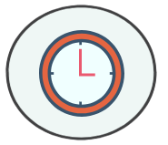
Community pharmacy…
Many pharmacies are open during the evening and at weekends
Pharmacy staff reflect the social and ethnic backgrounds of the community they serve, and they are accessible to deprived individuals who may not access conventional NHS services
It takes five years to qualify as a pharmacist, including a four-year master’s degree with training on the safe use of medicines
85-95% of a pharmacy’s total income is from the NHS

Slide 8
What are community pharmacies currently doing to support PCN priorities?

Slide 9
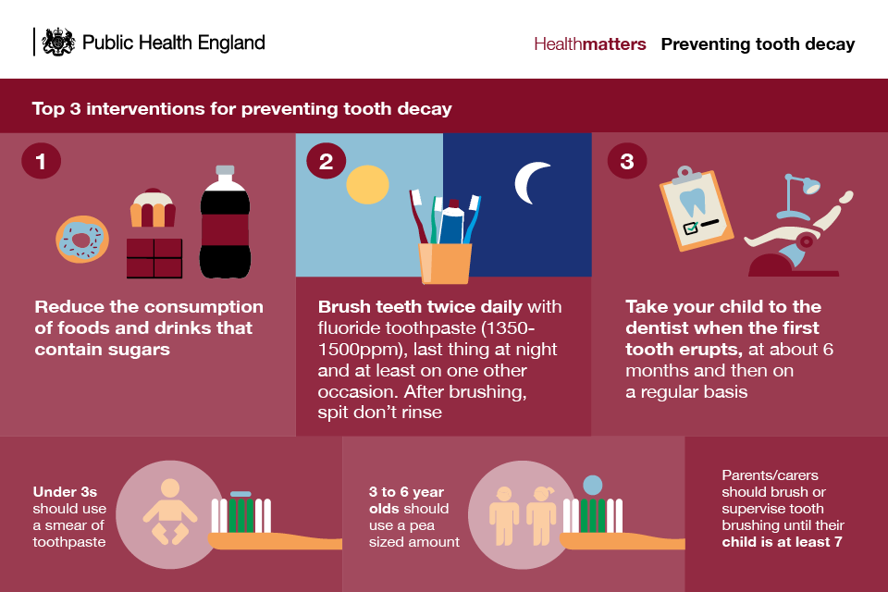
Nationally commissioned services which support PCN priorities
Support for self-care
Signposting
Public health (promotion of health lifestyles)
proactive advice to people getting prescriptions dispensed
six nationally chosen public health campaigns

Slide 10
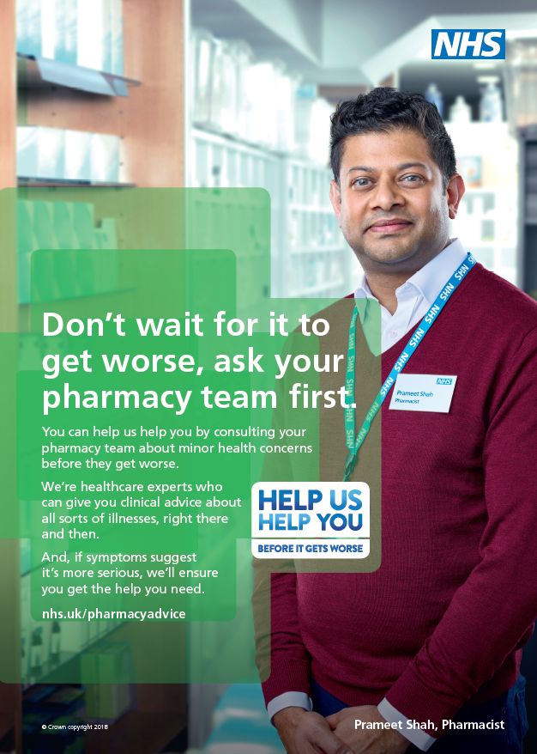
Public health campaigns
Campaigns support NHS England’s operational and public health priorities
Campaign topics so far in 2019:
Help Us Help You pharmacy campaign
Children’s oral health/Smile Month
Upcoming campaign topics for 2019/20:
Antimicrobial resistance
Stoptober
Help Us Help You winter campaign
Alcohol

Slide 11
IT – Electronic Repeat Dispensing
It is estimated that up to 330 million, or 80%, of all repeat prescriptions could eventually be replaced with electronic Repeat Dispensing (eRD)
This could save 2.7m hours of GP and practice time which is worth approximately £90m to the NHS
The community pharmacy eRD service offers potential benefits to prescribers, practices and patients for the safe and efficient continued supply and management of regular medicines
Potential benefits for GP practice teams:
reduction in workload issuing and re-authorising repeat prescriptions
reduced medicines waste – unused repeat prescriptions can be cancelled at any time by the GP
earlier detection of medicines-related problems

Slide 12
Nationally commissioned services which support PCN priorities
Medicines Use Review (MUR) Service
over 3.46m MURs conducted in 2018/19 across England
XXX MURs conducted in 2018/19 in PCN area (insert figure if available)
New Medicine Service (NMS)
approx. 908,000 NMS conducted in 2018/19 across England
XXX NMS conducted in 2018/19 in PCN area (insert figure if available)
Seasonal Influenza Vaccination Service
over 9,000 pharmacies (78%) provided the service in 2018/19
over 1.4m people vaccinated in 2018/19 across England
XXX people vaccinated in 2018/19 in PCN area (insert figure if available)

Slide 13
What is a Healthy Living Pharmacy (HLP)?
An accredited hub to promote health, wellbeing and self-care; provide services to prevent ill health or provide treatment through locally commissioned services
With at least one FTE qualified health champion to lead on prevention of ill health
There are now xxx HLPs in this PCN area (insert figure)

Slide 14
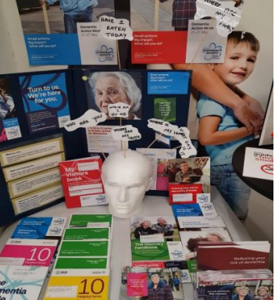
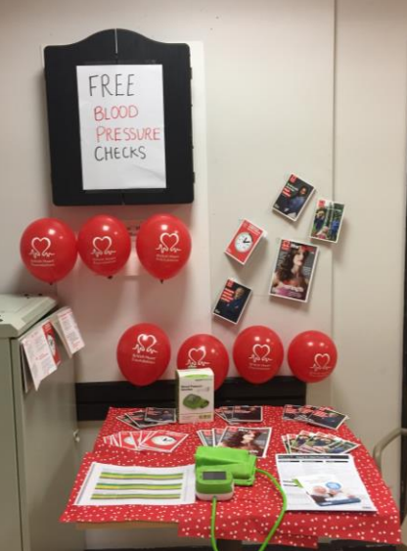
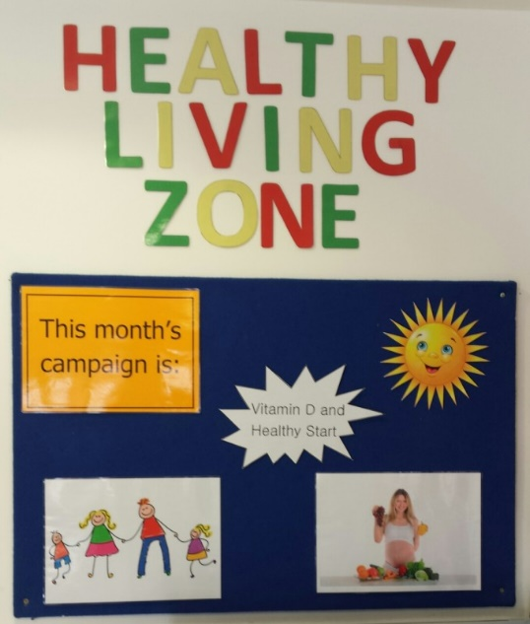
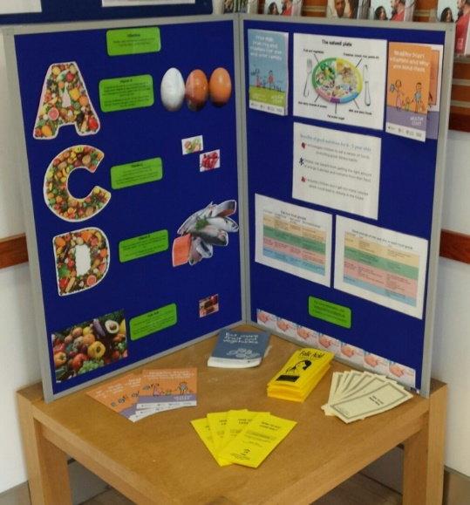
HLPs in action
The number of contacts each day through community pharmacies exceeds those elsewhere in primary care, presenting real opportunities to maximise the benefits of both regular and opportunistic contacts
HLPs also undertake outreach events in their local communities
Notes:
Picture taken from: https://psnc.org.uk/wp-content/uploads/2017/12/HLP-NEWSLETTER-WINTER-2017-FINAL.pdf

Slide 15
HLPs in the local community
LPCs could add some examples, photos, etc on this slide to show some of the positive work that HLPs have been doing in the local area

Slide 16
HLP national evaluation

Slide 17
Local commissioned services which support PCN priorities
LPCs can enter details here of any locally commissioned services that support PCNs to deliver the DES specifications e.g. AF case finding service, hypertension case finding service, NHS health checks, etc

Slide 18
What is the potential role of community pharmacy to support PCN priorities?
Notes:
Some examples of services that could be commissioned are detailed on the following slides.

Slide 19
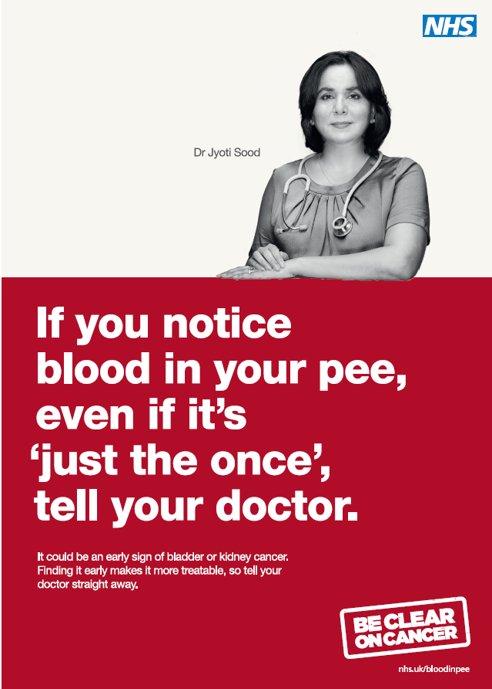
Supporting early cancer diagnosis
How can community pharmacy support early diagnosis?
Public health campaigns focused on cancer, e.g. Be Clear on Cancer
Tackle low public awareness of signs and symptoms – opportunity for pharmacy teams to spot red flags and refer to general practice
Opportunity for PCNs to agree fast-track referrals?

Slide 20
Supporting early cancer diagnosis
A study of 33 pharmacies in Northern England reported:
642 patients presenting with cancer alarm symptoms over a six-month period
the most common was a cough lasting >3 weeks
followed by unexplained dyspepsia lasting >3 weeks
Direct referral for chest X-ray (Doncaster, SW London and Cheshire)
patients who have one or more of the symptoms below and are current/ex-smokers or patients who have two or more symptoms and have never smoked:
shortness of breath/breathless more than normal
cough/haemoptysis
fatigue/lethargy
weight loss/poor appetite

Slide 21
Hypertension and atrial fibrillation case finding
Know Your Numbers service (Liverpool)
in total 1154 interventions were delivered
14.5% were found to have previously undiagnosed hypertension
PHE Blood Pressure Pilot (Wakefield)
in total, 2,019 were tested in pharmacies
one in five (20%) were found to have high blood pressure readings but had not been previously diagnosed – of those, 69% went on to attend their local practice
Care City’s One Stop Atrial Fibrillation Pathway (London)
nearly 700 patients were tested across 21 pharmacies
direct referral patients for specialist review at local hospital
110 were referred for specialist review

Slide 22
Other ways that community pharmacy can play its part in PCNs
Urgent care
Digital Minor Illness Referral Service
NHS Urgent Medicine Supply Advanced Service
Medicines optimisation and safety
working collaboratively with clinical pharmacists in PCNs
supporting the QOF Quality Improvement domain on prescribing safety

Slide 23
What next? How PCNs can engage with community pharmacy
PCN leaders/clinical directors - engage with us, the LPC
The LPC can support engagement with the community pharmacies in the PCN area
Consider joint projects to support the development of local relationships, e.g. Walk in my Shoes, optimising business as usual processes such as electronic Repeat Dispensing
Plan how efforts on public health and wellbeing could be coordinated across pharmacy, general practice and others, e.g. common campaign topics

Slide 24
Further information
Insert LPC website link and contact details

Slide 25
Questions and discussion

