Slide 1
Read and then delete this slide
This PSNC slide deck contains information on community pharmacies and the services they provide
It is designed to be used by LPCs/community pharmacists as the basis for a local presentation to:
local patient groups
local government officers and councillors
GPs, CCGs
STPs, ICS, PCNs
other groups that have an interest in community pharmacy

Slide 2
Read and then delete this slide
The presentation is consequently designed for audiences with a range of knowledge of what community pharmacies do. Before using the presentation you should:
edit it down to suit the audience and
add any local data/information to provide a local context
Find more resources to support your presentation at: https://psnc.org.uk/psncs-work/communications-and-lobbying/

Slide 3
Read and then delete this slide
Need more help needed with a presentation?
Contact commsteam@psnc.org.uk
Last updated: September 2019

Slide 4
Community Pharmacy: local healthcare

Slide 5
Presentation overview
Complete this section when you have edited the PowerPoint

Slide 6
Community pharmacy: an introduction
11,600 pharmacies in England situated in high-street locations, in supermarkets and in residential neighbourhoods
Independents (1-5 pharmacies) 38%
Multiples (6+ pharmacies) 62%
XXX in LPC Area

Slide 7
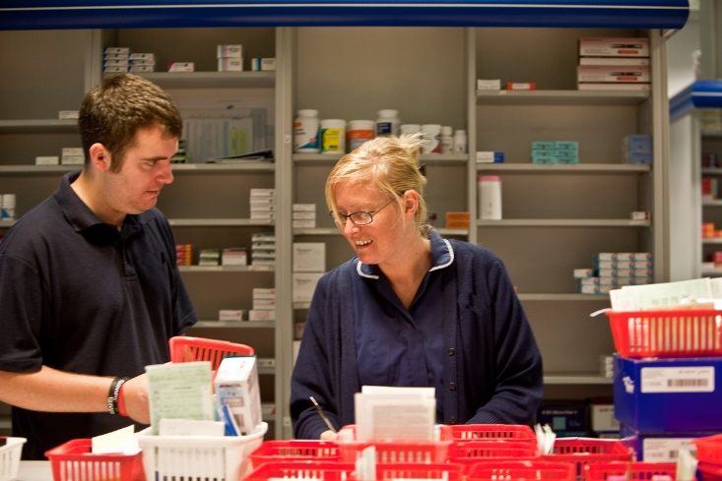
Community pharmacy staff
Pharmacist
Medicines Counter Assistants/Healthcare Assistants
Dispensers
Registered Pharmacy Technicians
Delivery driver

Slide 8
Community pharmacy statistics
89% of the population can reach their local community pharmacy within a 20 minute walk
Pharmacies in England dispense over a billion prescription items
An estimated 1.6 million visits take place daily, of which 1.2 million are for health-related reasons

Slide 9
Community pharmacy statistics
Over 90% of pharmacies now have a private consultation room
Community pharmacies are accessed by people who may not access other NHS services, helping to reduce health inequalities
It takes five years to qualify as a pharmacist, including a four-year master’s degree with training on the safe use of medicines

Slide 10
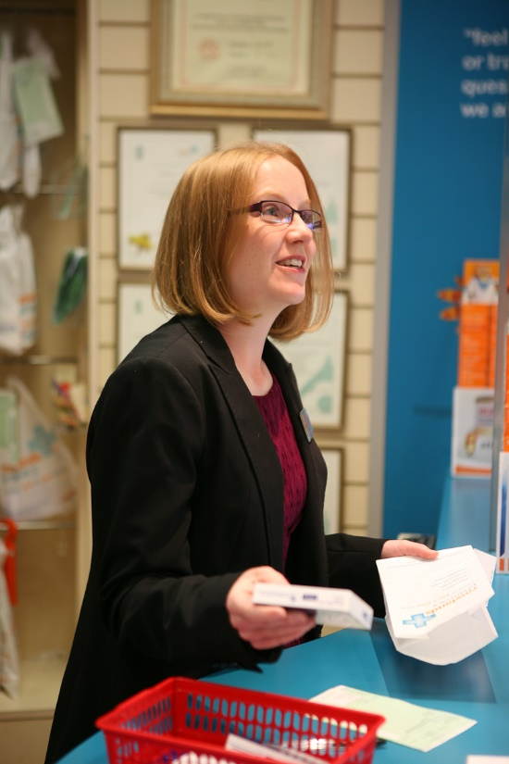
Community pharmacy and the NHS
NHS income for a typical community pharmacy accounts for 85-95% of their total turnover
Pharmacy owners are ‘contracted’ by the NHS to provide a range of services, including the dispensing of medicines
Pharmacies also provide services that are commissioned locally by Clinical Commissioning Groups and Local Authorities

Slide 11
The value of community pharmacy
Community pharmacies contributed a net value of £3bn to the NHS, public sector, patients and wider society in England in 2015 through just 12 services.
This included:

Slide 12
The NHS Community Pharmacy Contractual Framework (CPCF)

Slide 13
What is the CPCF?
Framework for NHS community pharmacy services
It sets out what services they must provide…
… as well as funding arrangements
Some services are essential, others optional
Also allows for localised commissioning to meet local needs

Slide 14
CPCF services structure
Local
Advanced
Essential

Slide 15
Essential Services
Dispensing and Repeat Dispensing
Support for self-care
Signposting patients to other healthcare professionals
Public health (healthy lifestyle promotion)
Waste medication disposal
Clinical governance

Slide 16
Essential Service: clinical governance
Identifiable CG lead
Practice leaflet
Patient satisfaction survey
Complaints procedure
Clinical audits
Patient safety incident analysis and reporting
Standard Operating Procedures
Employment procedures
Maintenance of patient records

Slide 17
Advanced Services
Medicines Use Review (MUR) (to be decommissioned from April 2021)
Appliance Use Review
Stoma Appliance Customisation
New Medicine Service (NMS)
Flu Vaccination Service
Community Pharmacist Consultation Service (new)

Slide 18
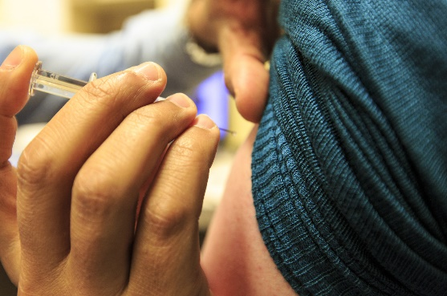
Advanced Services: requirements
Premises accreditation – consultation area. More than 95% of pharmacies now have a private consultation room
Pharmacist knowledge/ additional training

Slide 19
Locally commissioned services – examples
Minor ailments service
Emergency hormonal contraception
Care home service
Stop smoking
Needle and syringe exchange
Monitored dosage systems
Supervised consumption
Sexual health screening
Vaccinations
Alcohol screening and brief interventions
Weight management
Falls reduction
Independent and supplementary prescribing

Slide 20
CPCF 2019/20 – 2023/24

Slide 21
Five-year agreement
In July 2019, Government agreed a five-year settlement for community pharmacy
Fixes funding at £2.592bn per year from 2019/20 through to 2023/24
Sets out the expansion of clinical service delivery through pharmacies, in line with the aims of the NHS Long Term Plan

Slide 22
Ambitions of the five-year agreement
Pharmacies will adapt to provide new services
The settlement will:
“Expand and transform the role of community pharmacies and embed them as the first port of call for minor illness and health advice in England.”
Matt Hancock, Secretary of State

Slide 23
Two new national services in 2019/20
The Community Pharmacist Consultation Service (CPCS)
Hepatitis C testing service
Capacity being released through the decommissioning of MURs

Slide 24
NHS Community Pharmacist Consultation Service
Helping people with minor illnesses and those needing urgent supplies of medicine
Patients will be referred from NHS 111
Pharmacist will provide healthcare advice or assess whether an emergency supply of medicine is appropriate
Onward referrals will be made if needed
GPs are notified electronically

Slide 25
NHS Community Pharmacist Consultation Service
Integrates community pharmacy into the urgent care system
Increasing patient awareness of what community pharmacy can do – emphasising its role as ‘first port of call’
Reducing pressure on GPs and urgent care providers
Supporting patients to self-manage their health

Slide 26
NHS Community Pharmacist Consultation Service
National rollout from 29th October 2019
Future pilots will test expansion with referrals from:
GPs
NHS 111 online
Urgent Treatment Centres
Possibly A&E

Slide 27
Clinical service development: Hepatitis C
Hepatitis C testing to be introduced in 2019/20
Testing will be made available to people using needle and syringe programmes
The service will support Government’s new national Hepatitis C elimination programme

Slide 28
Also in 2019/20: Pharmacy Quality Scheme
Further developing and improving the quality of the pharmacy service
10,678 community pharmacies participated in February 2019
All declared that they:
Offered at least one Advanced Service
Had an up-to-date NHS website entry
Published a patient questionnaire on the pharmacy’s performance
Could send and receive NHSmail
Had adequate IT equipment

Slide 29
Pharmacy Quality Scheme​
In 2019/20, the scheme will go even further by encouraging pharmacies to:
Prepare for engagement with Primary Care Networks
Complete online sepsis training and training on look-alike, sound-alike (LASA) errors
Reduce the volume of Sugar Sweetened Beverages sold to
10% or less
Identify diabetes patients who require foot and eye checks
Complete a dementia friendly environment standards checklist
Undertake audits on prescribing safety including around lithium,
valproate and NSAIDs

Slide 30
Pharmacy Quality Scheme
10,609 had patient-facing staff signed up as Dementia Friends
10,452 had produced a reflective safety report
10,421 had staff trained in risk management
10,404 had identified high risk asthma patients and referred them for review

Slide 31
April 2020: Healthy Living Pharmacies (HLPs)
From April 2020, all pharmacies will need be accredited as a Healthy Living Pharmacy (HLP)
Local hubs to promote health, wellbeing and self-care
Providing services to prevent ill-health
HLPs must have at least one qualified health champion

Slide 32
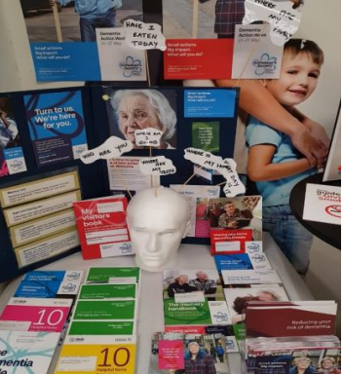
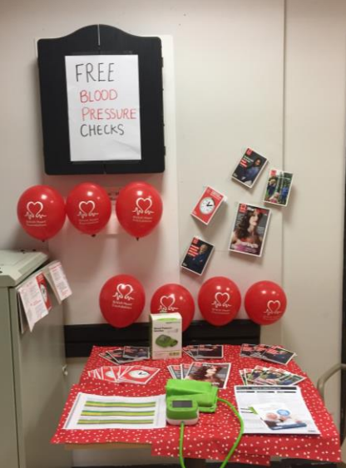
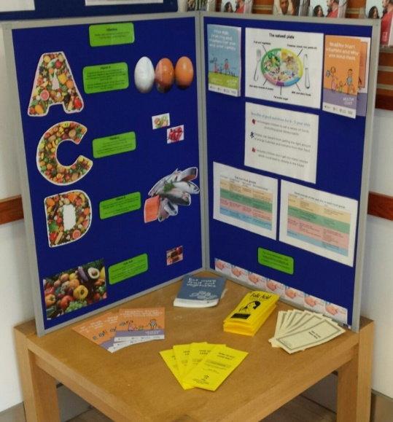
HLPs in action
The number of contacts each day through community pharmacies exceeds those elsewhere in primary care
There are real opportunities to maximise the benefits of both regular and opportunistic contacts
HLPs also undertake outreach events in their local communities
Notes:
Picture taken from: https://psnc.org.uk/wp-content/uploads/2017/12/HLP-NEWSLETTER-WINTER-2017-FINAL.pdf

Slide 33
HLP national evaluation

Slide 34
Future clinical service development
A range of pharmacy services will be piloted which may, if successful, be commissioned nationally
The Pharmacy Integration Fund and the PCN Testbed programme are NHS development initiatives that will be used to provide the necessary funding for pilots

Slide 35
Clinical service development: Prevention services that will be piloted
Detection of undiagnosed cardiovascular disease
Point of care testing around minor illness to support efforts to tackle antimicrobial resistance
Stop smoking referrals from secondary care
Vaccination and immunisation
Routine monitoring of patients on repeat medication
Support for PCN services, e.g. on early cancer diagnosis and in tackling health inequalities

Slide 36
Clinical service development: Medicines Optimisation services
From 2020/21, further developments will include:
A new medicines reconciliation service to ensure changes in medication made in secondary care are implemented when patient discharged into the community
Considering expansion of the New Medicine Service expansion
A new service to improve access to palliative care medicines to be piloted

Slide 37
Challenges for pharmacy
Workload: there is a need to make dispensing more efficient to free up staff to provide services instead
Premises: consultation rooms are now vital and more technology will be needed
Funding: flat funding will make changes harder; many pharmacies are under serious financial stress

Slide 38
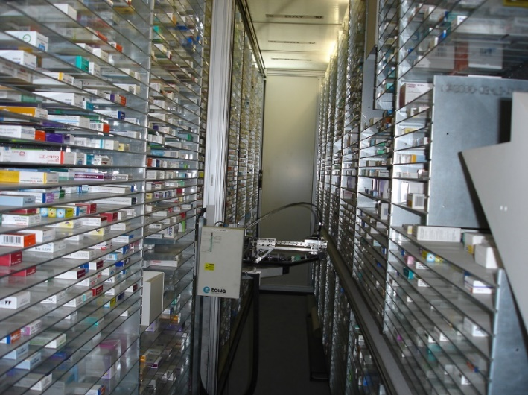
Enabling the changes
Legislative changes to enable:
all pharmacies to benefit from hub and spoke dispensing and increased use of automation
better use of skill mix
use of original pack dispensing
support for owners wishing to consolidate
Notes:
The agreement makes clear that technology is considered to be an enabler to free up pharmacists’ time to provide services and for dispensing to become more efficient. There are a number of relevant issues here including hub and spoke dispensing between legal entities which PSNC successfully opposed in 2016.
So why accept it now. First, the introduction of technology is as stated inevitable so we cannot hold it off for ever and should seek to influence its introduction.
Second, as we recognised in 2016, there are efficiencies to be gained by hub and spoke dispensing currently undertaken currently by bigger contractors – this includes activity saving in the pharmacy which frees up pharmacists time in community pharmacies – so it could potentially help with the introduction of new services.
Third, Government has agreed to ensure that the whole sector – including Independents – can benefit from hub and spoke dispensing – so we should be able to influence how it is introduced in the NHS – perhaps through appropriate NHS regulations.
Perhaps the contentious issue is whether hub and spoke dispensing for Independents and between legal entities really will provide efficiencies or cost savings.

Slide 39
Developing community pharmacy services for the benefit of patients

Slide 40
The Local Pharmaceutical Committee
Body recognised in Statute
Add link to LPC website
Represents and supports community pharmacy contractors (owners)
Works with NHS to coordinate local service provision
Elected by local pharmacy owners

Slide 41
Pharmacy services in xxx
Insert information/data on locally commissioning services

Slide 42
The future for pharmacy
Insert proposed local service developments
The LPC can support development of Joint Strategic Needs Assessment (JSNA) and the Pharmaceutical Needs Assessment (PNA)
Discussions with PCN leaders on developing pharmacy services to help meet key public health objectives

Slide 43
Questions and discussion
More information on community pharmacy services at
LPC website or psnc.org.uk

