Slide 1
Read and delete
This PSNC template presentation on the CPCS is for use by LPCs and others organisations when running local events on the service for community pharmacy contractors and their teams.
Further information on the service is available at psnc.org.uk/cpcs
Presenters should first read the service specification, the CPCS Toolkit and the CPCS FAQs, all of which can be accessed via the above page on the PSNC website. The content of these documents/resources provides the key information and additional background knowledge for anybody giving this presentation at a contractor event.
Presenters may also want to watch to the PSNC and NHSE&I joint webinar on the service, as this presentation is derived from the PowerPoint used during the webinar.
Questions or comments on this presentation can be addressed to Pharmacy.Services@psnc.org.uk
Last updated: 18th September 2019

Slide 2
The NHS Community Pharmacist Consultation Service (CPCS)

Slide 3
Presentation overview
Introduction
Overview of the service and patient flow
Registration to provide the service
IT and record keeping
Training and development
Funding and payment claims
Getting ready to provide the service
Q&A

Slide 4
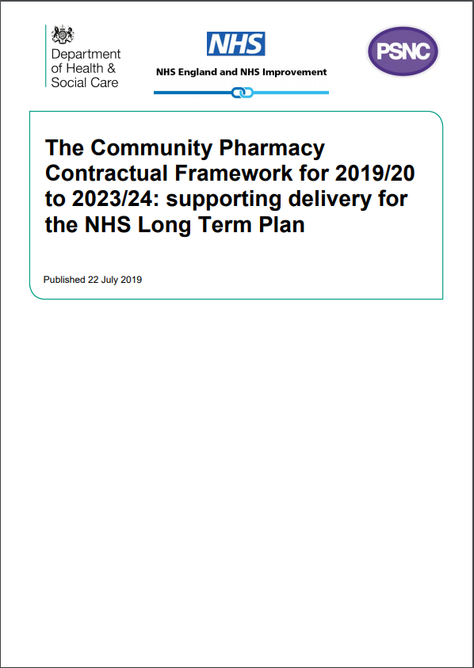
Introduction
The 5-year CPCF sets out a clear vision for community pharmacy services, in line with proposals in the Community Pharmacy Forward View
The CPCS is the most important service development within the 5-year agreement
Implementing this service well has high importance /strategic importance to:
Patients
NHSE&I, DHSC and HMT
Other healthcare professionals
Community pharmacy

Slide 5
Introduction
The NHS Community Pharmacist Consultation Service is the first clinical service of the new 5-year CPCF to be mobilised
It is an Advanced service where patients contacting NHS 111 are referred to a community pharmacist for a consultation regarding lower acuity conditions or urgent repeat prescriptions
The new service brings together the learning from the NUMSAS and DMIRS pilots into one service

Slide 6
Introduction
Patients will be referred from NHS 111, following an assessment by a call advisor, when they would previously have been directed to a GP
This releases capacity in other areas of the urgent care system such as A&E and general practices, freeing up capacity for the treatment of patients with higher acuity conditions
Onward referrals may be necessary to other urgent care services or the patient’s own GP

Slide 7
Introduction
The service commences on 29th October 2019
In the pilots, patients liked the service and valued the consultation in a confidential environment
The service will support:
the integration of community pharmacy into the urgent care system
increasing patient awareness of the role of community pharmacy as the ‘first port of call’ for low acuity conditions and for medicines access and advice
patients to self-manage their health more effectively

Slide 8
Development of the service
Over the course of the 5-year CPCF, the service will be monitored and evaluated
The range of symptom types included in the service will be reviewed to consider expansion, if safe, effective and it will improve patient experience
By 2020/21, the learning from the GP CPCS pilots will be evaluated and a decision taken about whether to include “streaming” from general practice into the CPCS

Slide 9
Other CPCS pilots
Online access for urgent medicines supply via CPCS is currently being tested across the north west via 111 Online
A future pilot of a minor illness online pathway via 111 Online is under consideration
These will be evaluated before consideration of national roll out

Slide 10
Service prerequisites
Consultation room
From 1st April 2020, the pharmacy must have IT equipment accessible within the consultation room
NHS Summary Care Record (SCR) access
Shared NHSmail account: nhspharmacy.location.pharmacynameODScode@nhs.net
Up to date Directory of Services (DoS) details
Access to the CPCS IT system provided by NHSE&I
SOP including key contact details
Update to your business continuity plan

Slide 11
The Directory of Services and CPCS
DoS is a web-based database of health and social care services, e.g. GPs, pharmacies, A&E
Every pharmacy has
one DoS entry for its core/standard service provision
extra entries for other services such as CPCS
DoS integrates with NHS Pathways – the clinical assessment tool used by NHS 111 call advisers – to give access to real time information about services

Slide 12
The Directory of Services and the CPCS
The assessment by the call adviser gathers information that identifies the specific clinical skills and defined timescale needed by the patient
At the end of the assessment (if an emergency ambulance is not required), an automatic search is carried out on the DoS to locate an appropriate service in the patient’s local area that offers the clinical skills needed within the timeframe required

Slide 13
The Directory of Services and the CPCS
DoS will automatically identify when a pharmacy is due to close and will not select a pharmacy that is due to close within 30 minutes of sending a referral
However, if a patient can wait until your pharmacy is open, the referral may be sent when your pharmacy is closed for you to process once the pharmacy is open
Referrals from NHS 111 will not contain medication details as the call advisors are not clinically trained
e.g. call advisers will not identify if the request is for a Controlled Drug

Slide 14
The Directory of Services and the CPCS
It is critical that the information on DoS is accurate to allow NHS 111 to refer patients appropriately to community pharmacies
Contractors can ensure their DoS information is up-to-date by using the DoS Profile Updater
This should include Bank holiday opening hours

Slide 15
Patient calls NHS 111 or IUC CAS with a request for medicine or appliance
The Call may be transferred to a clinician or handled by a call advisor.
(N.B. Call advisors are non-clinical)
CPCS
Urgent medicines
patient flow
Patient triaged to Community Pharmacy
Patient offered choice of 2 community pharmacies providing CPCS.
Ideally the patient must be able to attend in the pharmacy in person.
Telephone number of the pharmacy given to the patient by NHS 111 or IUC CAS
And advised to phone pharmacy within 30 minutes
Message sent to Community Pharmacy electronically
Sent via the CPCS IT system*
(NHSmail to be used as a backup in case of system failure)
Pharmacy hasn’t received
referral?
Pharmacy checks IT system
Pharmacist phones NHS 111
(N.B. Patient not asked to contact 111)
Patient telephones the pharmacy
Assessment of request and ability
to attend pharmacy
Patient doesn’t contact
The pharmacy?
Pharmacy makes one attempt
to contact the patient as a minimum.
Emergency Supply
to be made
Pharmacist assessment that
supply required and is legal
No Supply
Pharmacist assessment that
Emergency supply
not required/ allowed or
not possible
Post Event
Message to GP
via CPCS IT system*
Emergency Supply
Patient (or representative)
Attends pharmacy
to complete supply
Another reason for
no supply
EPS Rx dispensed
Patient buys item
Supply not necessary
Supply not clinically appropriate
Referral to
GP OOH
Emergency Supply
required but not possible
for legal reason
(e.g. controlled drugs)
Medicine/ appliance not stocked
Forwarded onto a pharmacy
With stock of item(s)
required
* CPCS IT system – two providers at this time (PharmOutcomes and Sonar)

Slide 16
Patient calls NHS 111 or IUC CAS with a minor illness
The call may be transferred to a clinician or handled by a call advisor.
(N.B. Call advisors are non-clinical)
CPCS
Minor illness
patient flow
Patient triaged to Community Pharmacy
Patient offered choice of 2 community pharmacies providing CPCS.
Ideally the patient must be able to attend in the pharmacy in person.
Telephone number of the pharmacy given to the patient by NHS 111 or IUC CAS
And advised to phone pharmacy
Message sent to Community Pharmacy electronically
Sent via the CPCS IT system*
(NHSmail to be used as a backup in case of system failure)
Pharmacy hasn’t received
referral?
Pharmacy checks IT system
Pharmacist phones NHS 111
(N.B. Patient not asked to contact NHS 111)
Patient doesn’t contact
the pharmacy?
Pharmacy makes one attempt
to contact the patient as a minimum.
Patient telephones the pharmacy or attends in person
Pharmacist consults with the patient
& gives appropriate advice around self care and prevention
Pharmacist MUST check
NICE CKS to identify any risk factors
USE ESCALATION PATHWAY IF PATIENT NEEDS HIGHER ACUITY CARE
Pharmacist to call NHS 111 (Out of Hours service) OR
Support patient with urgent appointment at own GP (In hours service) OR
Call 999 if more urgent
The patient may often not require any medication.
Self care advice is sufficient
Patient requires referral to a locally commissioned
service
Patient requires OTC medication support & self care advice
Patient requires higher acuity
care – escalate
Patient is supplied on a local MAS
Patient can purchase an OTC medicine
The Pharmacist will complete the consultation on the CPCS IT system*
Pharmacist will supply any relevant patient information leaflets from www.nhs.uk
Post Event
Message to GP
via CPCS IT system*
Patient is always advised:
“IF SYMPTOMS DO NOT IMPROVE OR BECOME WORSE, THEN EITHER COME BACK TO SEE ME OR SEEK ADVICE FROM YOUR GP”
* CPCS IT system – two providers at this time (PharmOutcomes and Sonar)

Slide 17
Registration to provide the service
Previous registrations for NUMSAS or DMIRS will not carry forward
The NUMSAS and DMIRS services will cease on 28th October and the CPCS starts on 29th October 2019
Registration is via the NHSBSA Manage Your Service (MYS) portal
Pharmacies not currently using MYS will need to register
see details on the PSNC website
Contractors which have multiple pharmacies can use a bulk registration approach

Slide 18
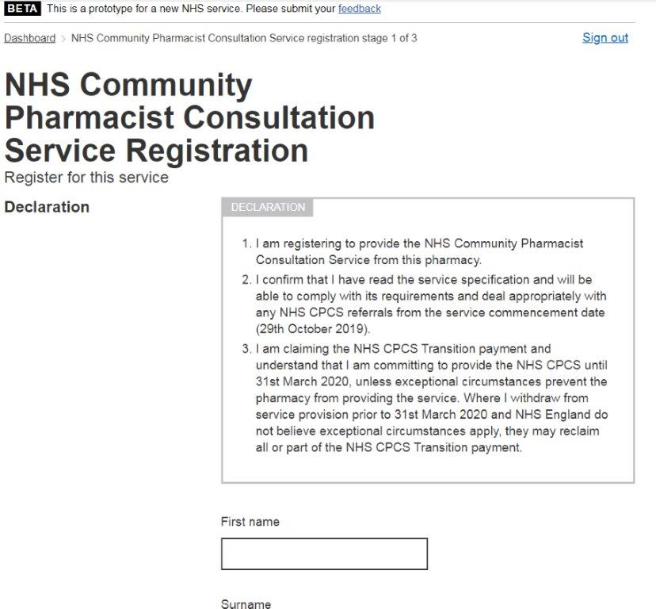
Registration to provide the service
Registration for the CPCS opened on 2nd September 2019
It includes a declaration for the pharmacy contractor regarding their readiness to provide the service

Slide 19
Setting new CPCS DoS entries ‘active’
Once pharmacies are registered to provide the service, the local DoS team will be notified by the national DoS team (who receive regular updates from the NHSBSA)
CPCS services will then be enabled on DoS and made ‘live’ on 29th October 2019 at the inception of the service
At the point of go-live, existing NUMSAS and DMIRS service entries will be switched off
Following go-live, any pharmacies that subsequently register to provide the service will be made live by the local DoS team - this may take a few days to be completed
29th October

Slide 20
The CPCS IT system
At present Sonar and PharmOutcomes are accredited to use ITK messaging
The CPCF agreement document states:
‘Subject to a value for money procurement outcome, the PhIF will be deployed to deliver the requisite IT functionality over 2019/20 and 2020/21.’
NHSE&I regional teams are working on procurement of this IT functionality

Slide 21
The CPCS IT system
The systems will support:
receipt of referrals from NHS 111
maintaining the clinical record of service provision
printing EPS tokens (where required)
sending post-event messages to patients’ general practices
payment claims
service management and evaluation
IT equipment in the consultation room required from 1st April 2020
Contractors will have to purchase IT systems/functionality from April 2021

Slide 22
Checking the CPCS IT system
The CPCS IT system must be checked regularly during opening hours to pick up referrals in a timely manner
And the shared NHSmail mailbox must be checked when a pharmacy opens and before it closes each day
When a pharmacy has received a referral, but not been contacted by the patient
within 30 minutes (urgent medicines) or
12 hours (minor illness)
the pharmacy must attempt to contact the patient
If there is no contact from the patient the next day, the referral may be closed

Slide 23
Record keeping
Where an urgent medicine/appliance supply is made, it must be recorded in:
the POM register (if a POM)
the CPCS IT system
the PMR
Where a CPCS consultation is for a minor illness, it must be recorded in:
the CPCS IT system

Slide 24
Service availability and ongoing provision
The service must be available throughout the pharmacy’s full opening hours (i.e. core and supplementary)
Temporary withdrawal from the service due to unforeseen circumstances must activate the relevant section in the business continuity plan
The NHS 111 provider and local IUC CAS must be notified using the NHS DoS provider and commissioner helpline as soon as possible, to stop referrals being made to the pharmacy

Slide 25
Service availability and ongoing provision
The local NHSE&I team must also be informed by the pharmacy contractor
In the event of ongoing or repeated service issues, the local NHSE&I team may request the DoS team to stop referrals to the pharmacy until the issue is resolved
Contractors who wish to stop providing the service must notify NHSE&I at least one month in advance via the MYS platform

Slide 26
Training and development
The necessary knowledge and skills to provide the service are core competencies for all pharmacists, but pharmacists will want to ensure that they:
are able to explain the service to patients and carers
have an up to date understanding of the Human Medicines Regulations
are able to communicate with and advise patients appropriately and effectively on low acuity conditions
are able to assess the clinical needs of patients, including the identification of red flags
are able to act on the referrals received and make appropriate referrals to other NHS services and healthcare professionals

Slide 27
Training and development
A CPCS self-assessment tool is available from CPPE to help pharmacists to assess their learning needs
Continuing professional development sessions covering consultation and physical assessment skills will be available through CPPE from October 2019
these are not mandatory for service provision
Health Education England will be commissioning further training in 2020, with funding from the Pharmacy Integration Fund

Slide 28
Reporting incidents and governance of the service
Feedback on the CPCS should initially be shared with the local NHSE&I contract team who will co-ordinate ongoing review of the service, working with IUC representatives
The pharmacy should report any incidents related to the referral process or operational issues with respect to the service to the NHS 111 provider and any local IUC CAS via the local health professionals’ line
This feedback may be shared via the local Integrated Urgent Care governance group as part of an overview of the service and its performance

Slide 29
Reporting incidents and governance of the service
This feedback may be used to manage how the service integrates with other local urgent care services
This may include handling patients who use the service inappropriately and dealing with them on a system wide basis
The pharmacy is required to report any patient safety incidents in line with the Clinical Governance Approved Particulars for pharmacies

Slide 30
Funding
Transition payment supplement:
sign up by 1st December - £900
sign up by 15th January - £600
commitment to provide the service until 31st March 2020
withdrawal before this date without good cause may lead to claw-back of some or all of the payment
A Consultation fee of £14 will be paid for each completed referral
No Consultation fee can be claimed where the pharmacist receives a referral, but cannot make any contact with the referred patient

Slide 31
Completed referrals
For urgent medicines supply, a referral is completed when the pharmacist has a consultation with the patient (by telephone or face-to-face) and
confirms no supply is required
the patient is given advice
the patient purchases the required product OTC
the patient is referred on to another healthcare provider
an EPS prescription is downloaded and dispensed
an item is not available, and the patient is referred to a second pharmacy (both pharmacies can claim a consultation fee in this last scenario)
For minor illness consultations, a referral is completed when the pharmacist has a consultation with the patient (telephone or face-to-face) and has provided advice to the patient

Slide 32
Reimbursement of medicines/appliance costs
The cost of medicines or appliances supplied under the CPCS urgent supply provision (NOT the minor illness provision) will be reimbursed using the basic price specified in Drug Tariff
No other elements of the Drug Tariff in relation to reimbursement of medicines or appliances apply to this service
An allowance at the applicable VAT rate will be paid to cover the VAT incurred when purchasing the medicine or appliance
The cost of medicines or appliances supplied via the service will be recharged to Clinical Commissioning Group budgets and all other costs will be paid by NHSE&I

Slide 33
Payment claims
All payment claims will be managed through the MYS portal
This will directly link with the CPCS IT system to help with the collation and submission of claims at the end of each month
There is no paper-based claiming process for the service
Only EPS tokens that record the patient declared exemption need to be created and sent to the NHSBSA as part of the contractor’s monthly batch – these should be separated from other tokens, and clearly marked as ‘CPCS’
These will just be used for patient exemption accuracy checking

Slide 34
Promoting the service
This service must not be actively promoted directly to the public by either the pharmacy contractor or the NHS
However, promotion of community pharmacy as the ‘first port of call’ for low acuity conditions will continue, e.g. via the Help Us Help You campaign

Slide 35
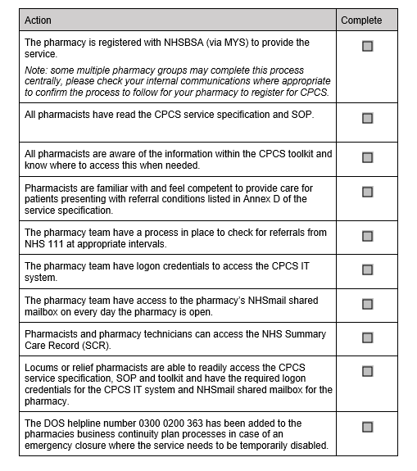
Getting ready to provide the service
Read and understand the Service Specification and the Toolkit
Make sure you understand the service flow and the role of the community pharmacy in urgent care
Create your SOP for the service, including key contact details (templates are available)
Ensure you have access to SCR, NHSmail and the CPCS IT system
Pharmacists - consider what CPD or refreshing of skills could help you provide the service
the CPPE CPCS self-assessment tool can help you do this

Slide 36
Getting ready to provide the service
All pharmacy team members involved in provision of the service must be appropriately trained on the operation of the service. Consider:
holding a briefing session for your team
providing them with the one-page CPCS Service Overview on how the service will work (Annex A of the Toolkit)
discussing as a team how you can work together to make the service a success
making sure team members and locums are clear on the daily activity required, such as checking for referrals
making sure team members and locums know how to identify a walk-in patient who may have been referred from NHS 111

Slide 37
Getting ready to provide the service
Consider locums’ ability to provide the service when making bookings
it is of critical importance that locum and relief pharmacists are made aware that the pharmacy is providing the service before they work at the premises
they MUST understand the service specification and SOP, and be able to provide the service
they need to have SCR access and know how to use the CPCS IT system
Pharmacists – consider registering for the CPD sessions when these are held in your area

Slide 38
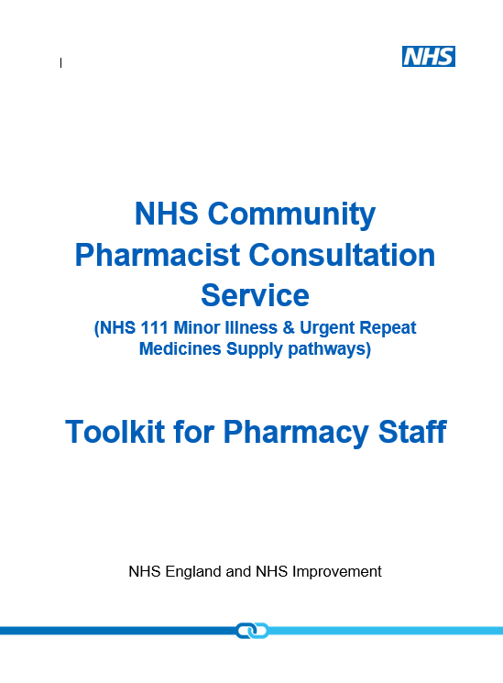
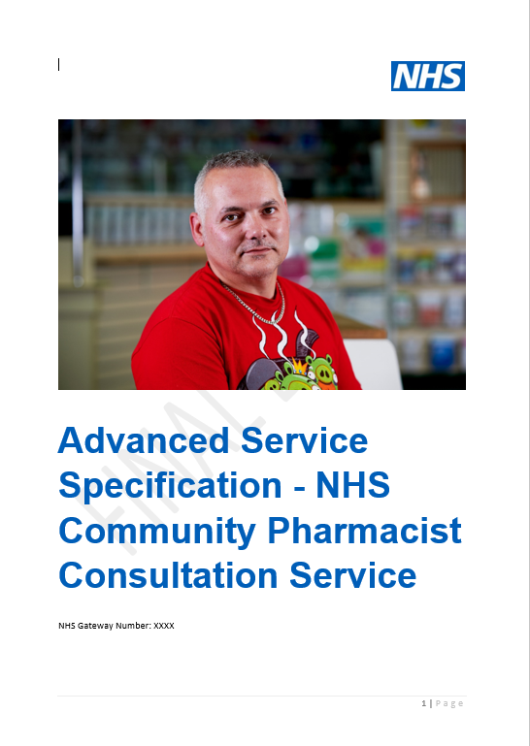
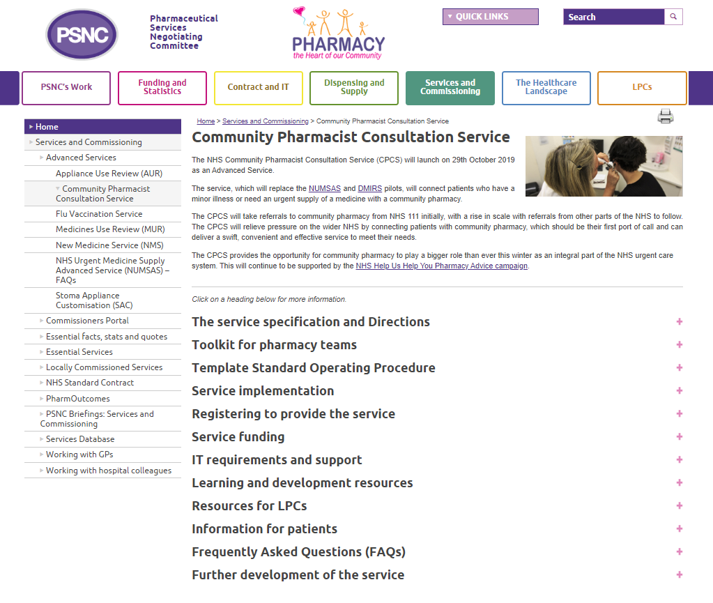
Resources for pharmacy teams
Service specification
CPCS Toolkit including
service overview
implementation checklist
Template SOP
All resources can be accessed via psnc.org.uk/cpcs

Slide 39
Questions

