Slide 1
Valuing difference and inclusive behavior in local leadership

Slide 2
RPS Inclusion & Diversity and Wellbeing
Amandeep Doll
Head of Professional Belonging

Slide 3

RPS I&D Strategy
Published on 22nd June 2020
Developed/co-created with members/profession for members/profession – it will evolve
‘No one should be left behind’
Intersectionality and a sense of belonging
Tackling hard/difficult issues and bringing about action and change
Collaboration/partnership needed
RPS to lead – impact/delivery essential
Need to be agile and alive to changing environment

Slide 4
Strategic priority I: Create a culture of belonging
Strategic priority II: Champion inclusive and authentic leadership
Strategic priority III: Challenge inclusion & diversity barriers
Our Pledge
Notes:
to focus on the action needed to implement the RPS’s pharmacy inclusion and diversity strategy

Slide 5
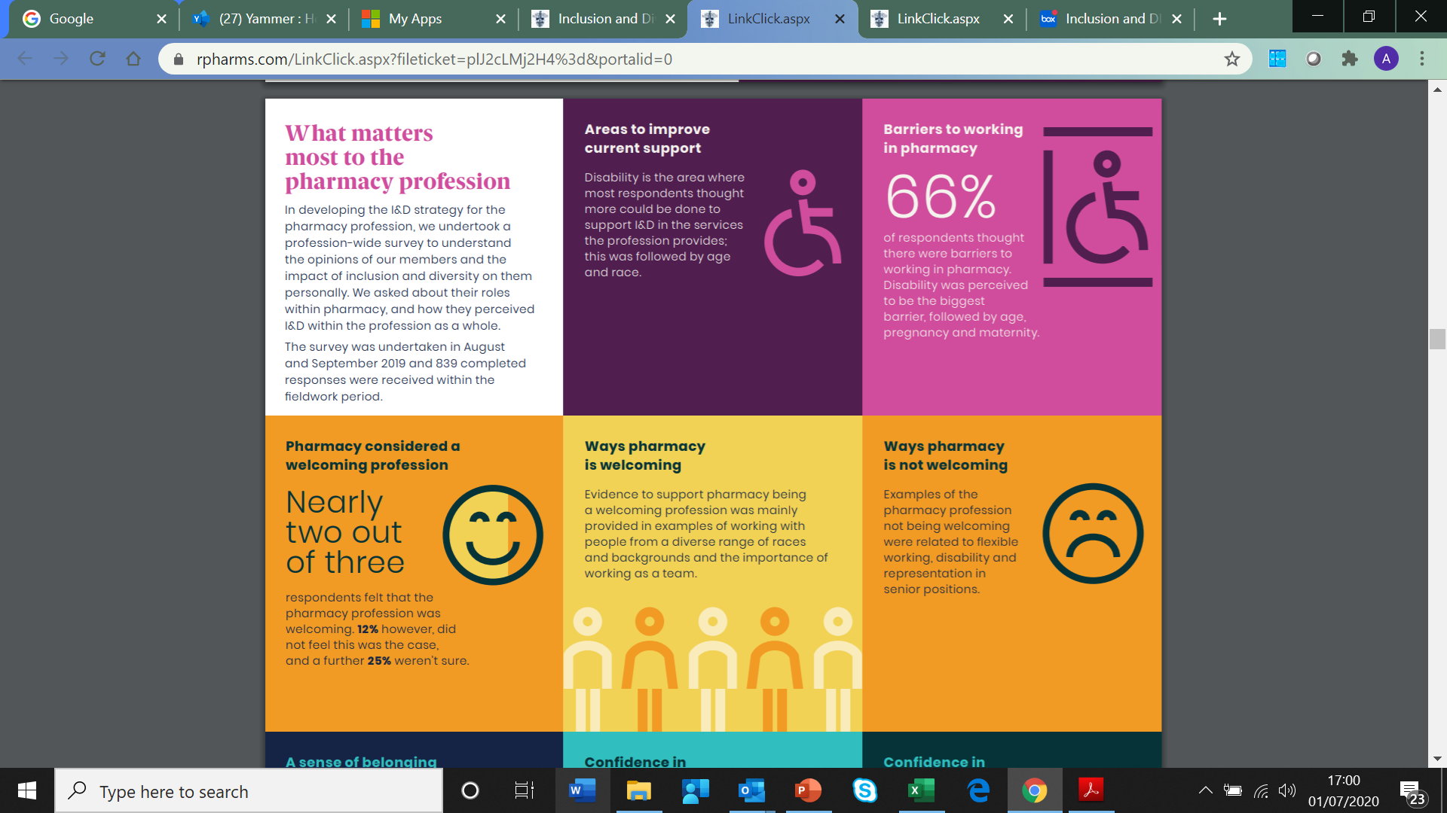

Slide 6
Why is Inclusion and Diversity important for the profession?
We are a diverse profession – something to celebrate!
A lack of representation of the diversity in the profession and the communities we serve across all levels – particularly senior leadership
Over-representation of Black, Asian and Minority Ethnic groups in GPhC Fitness to Practice cases
Differential attainment gap for undergraduate and pre-registration students for Black, Asian and Minority Ethnic Groups
People not feeling comfortable in disclosing their disability status
The appropriate support is not given to individuals with disabilities – lack of accessibility and adoption for needs
Members of the LGBTQIA+ community not feeling like they can be their authentic selves
Language used at the moment is not inclusive
Women take on more of the caring burden and working flexible resulting in an exclusion to progression.
Individuals with long term conditions or caring responsibilities are not always supported to work flexibly.

Slide 7
Inclusion & Diversity is important for patient care
Everyone deserves the same opportunities to lead a healthy life, no matter where they live or who they are
England – there is a 19 year gap in healthy life expectancy between most and least affluent areas of the country.
Learning disability:
    Males have a life expectancy at birth of 66 years. 14 years lower than general population.
    Females have a life expectancy of 67 years. 17 years lower than general population.
Trans people face a range of barriers when accessing most mainstream health services and often avoid accessing services at all.
Black women are four times more likely to die in pregnancy than white women in the UK

Slide 8
Pharmacists and their teams can play an active role in addressing health inequalities for patients and public
Improving Inclusion and Diversity amongst the profession will in turn improve patient care
Us working together
Public
Profession
1. Representation in decision making
2. Staff engagement
Notes:
1. Representation in decision making will ensure that BAME staff have influence over decisions that affect them and also represent the communities they are serving
2. Engagement with staff and staff networks is being strengthened and prioritised to enable us to hear and learn from your lived experience, share guidance and of course, hear from you what actions we need to take and what support we can provide nationally for the communities they are serving
We will hearing from patients and public about what their needs are and how they should be addressed
to focus on the action needed to implement the RPS’s pharmacy inclusion and diversity strategy

Slide 9
Authentic Leadership
Inclusive in your approach when working with their teams
Ensuring team members are actively including in decision making
Creating a culture of belonging
Treat your colleagues fairly and without prejudice, discrimination or bias.
Create a culture where people can raise issues with you and they trust you
  Celebrating the diversity in your team - better understand each-others’ cultures and preferences.
  Allyship
  Champion inclusion and diversity, creating a culture where we can all be our authentic selves and feel valued.
  Be aware of your unconscious bias
  Ask questions and educate yourself
  Consider the language being used in polices and assumptions being made

Slide 10
Workforce Wellbeing Survey
Surveys undertaken in 2019 and 2020
The pressures already in the system and places where pharmacists work were amplified by the COVID-19 pandemic
Key findings:
  Wellbeing
  Burnout
  Quality and safety
  Retention
  Support
Notes:
Total of 959 responses (>1400 responses in 2019)
•The majority of the respondents, over ¾ practiced in England and just over half of them practiced in community
•Around 2/3 of respondents were employed full-time (including self-employed), while 1/3 were employed part-time (including self-employed).
•The majority of respondents were female. And the largest age group were between 30 and 59 years old.
•75% of respondents identified as white, while 23% of the sample represented Black, Asian, Minority Ethnic groups*
The findings appear to suggest that the mental health and wellbeing of the workforce is at best adequate, with existing pressures exacerbated by the COVID-19 pandemic
40% wellbeing ok in last year. 33% stated it was not good
72% said their work had negatively impacted their mental health and wellbeing with reasons including workload, inadequate staffing, long hours and a lack of work-life balance
The risk of burnout among respondents was high and closely linked to lack of work enjoyment, frequency of sick leave, concerns around service quality and making mistakes at work, as well as workforce retention
89% were at high risk of burnout (Oldenburg Burnout Inventory tool) cf to 80% in 2019
Conversely 55% enjoyed or really enjoyed their work; a third of respondents didn’t enjoy or really didn’t enjoy their work (those were at higher risk of burnout)
19% had taken a day to a month or more off work in last year due to mental health/wellbeing issues. A third had wanted to time off but not felt able to (fear, stigma, risk of discrimination)
The majority of respondents tended to worry how their mental health and wellbeing impacted the quality of the service they offered and how frequently they worried about making mistakes.
A third of respondents had considered leaving their job in the last year,
Another third had considered leaving the pharmacy profession
The risk of leaving the profession was highest for those working in general practice and community pharmacy and was associated with high risk of burnout
Uptake to support services was generally low. Some respondents were concerned about confidentiality and others believed that actual or perceived causes of poor mental health and wellbeing were not being addressed by these services.
Although 2/3 of respondents were aware of employer or NHS-funded occupational services; only 14% had accessed these. Awareness of support services was lower for Black, Asian and Minority Ethnic respondents.
44% respondents would not feel comfortable accessing employer support – discrimination, future career progression.
There was also a feeling that there should be a focus on the prevention of cause and other support services outside employment should be available.

Slide 11
THEMES FROM WELLBEING WORK
GOAL
BARRIERS
Recognition
Prevention: working to create the right working conditions for good wellbeing
Protected time to support development and learning (all areas of practice)
Appropriate levels and skill mix of staff
Prioritisation of workforce wellbeing in the workplace
Impact
Poor rates of workforce retention
Increased sick-leave
Workforce at high risk of burnout
Concerns about service quality and risk of making mistakes
Environment & Culture: working to create a culture conducive to good wellbeing
Protected break time to support wellbeing / productivity
Work / life balance
Flexible working options
Stigmatisation of mental health
Support from colleagues and managers
Support: increasing awareness of and access to wellbeing support
Awareness of wellbeing support
Cultural awareness in the workplace
Improving confidence to access wellbeing services (confidentiality, discrimination, reputation risk, career progression).

Slide 12
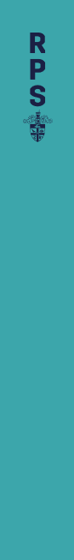
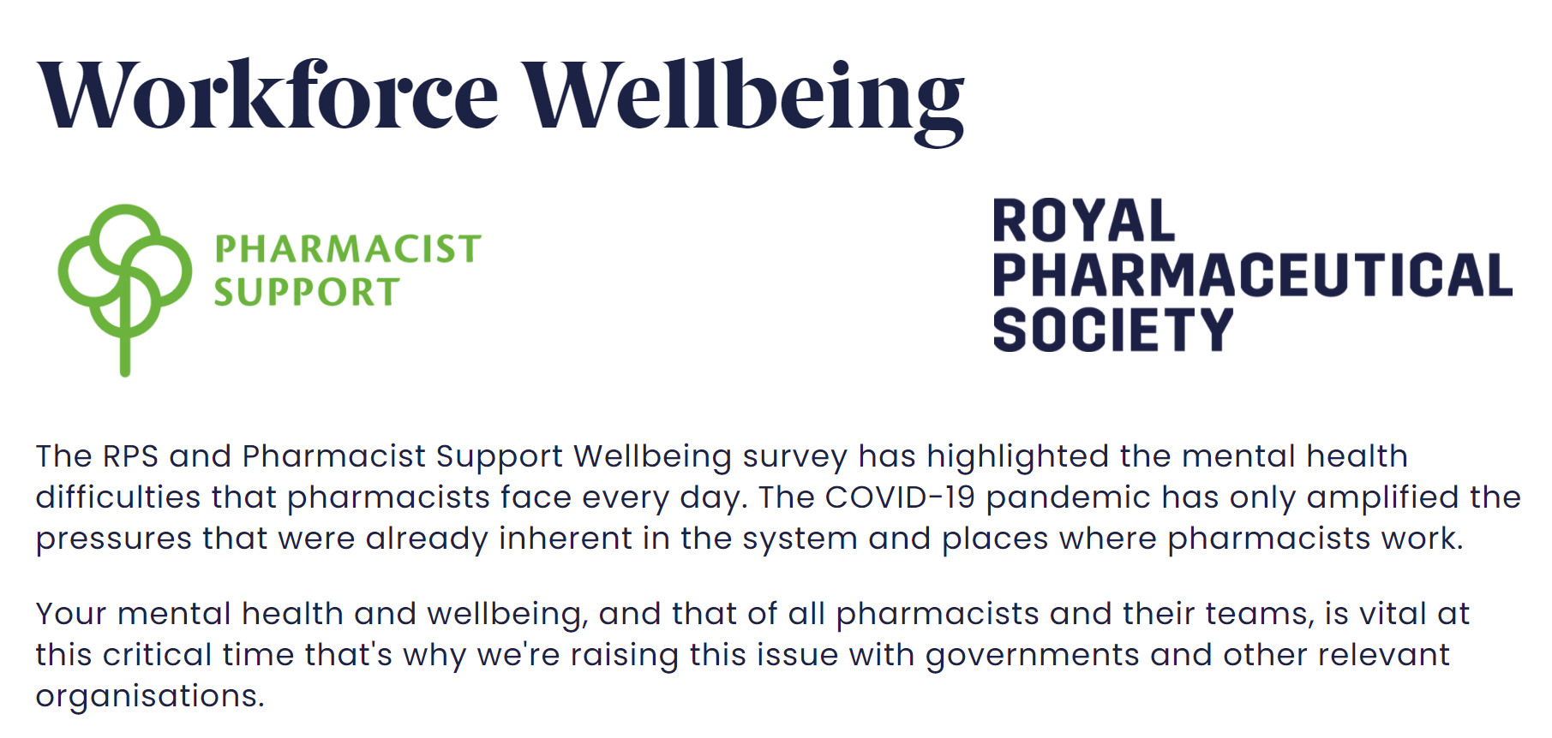
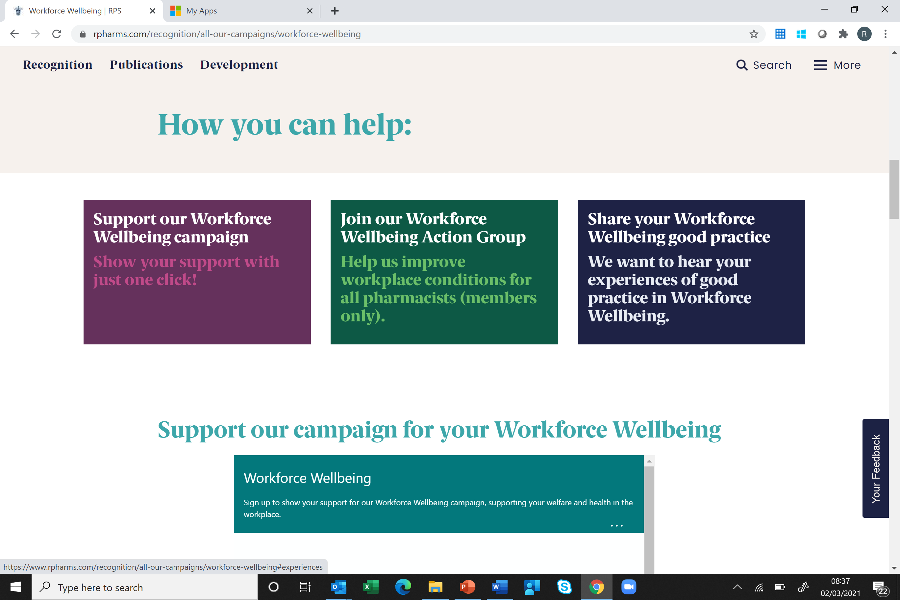
What is RPS doing on wellbeing?
Campaign work on making positive change
  Nearly 1000 signed up to support our campaign
  >100 members as part of Workforce Wellbeing Action Group
  Capturing and sharing best practice
  RPS Inclusion and Diversity Strategy
  Advocating for the profession
Support
  Raising awareness
  Virtual Events/Workshops
  Resources/tools
  Informal drop in chats
  RPS Networks
  Peer discussions series
  Signposting
Workforce Inclusion and Wellbeing Pledge
Engagement and collaboration with key stakeholders to discuss actions and enable change

Slide 13
RPS Inclusion and Wellbeing Pledge
Set out an aspiration for the profession on:
  How to be inclusive of all across our profession
  Celebrate diversity within the profession
  Create a culture of belonging for everyone
  Create an environment where people feel like they can be their authentic selves
  Support pharmacy teams’ health and wellbeing
  Create a culture to empower people to speak up about their wellbeing needs
We want this pledge to:
Support the profession to be more inclusive and contribute to positive mental health and wellbeing in the workplace.
Nourish and sustain a safe working culture
Making positive change happen will also need the support from organisations across the profession
Help promote supportive working environments for pharmacists and pharmacy teams.

Slide 14
Workforce Inclusion and Wellbeing Pledge Considerations
Create a safe space for individuals to have conversations about their wellbeing and Inclusion and Diversity
Raise concerns about their wellbeing, discrimination and prejudice without a fear of consequences.
Help employers and employees feel less isolated at work
Work with your team and highlight an area that you can work on to ensure individuals can be their authentic selves

Slide 15
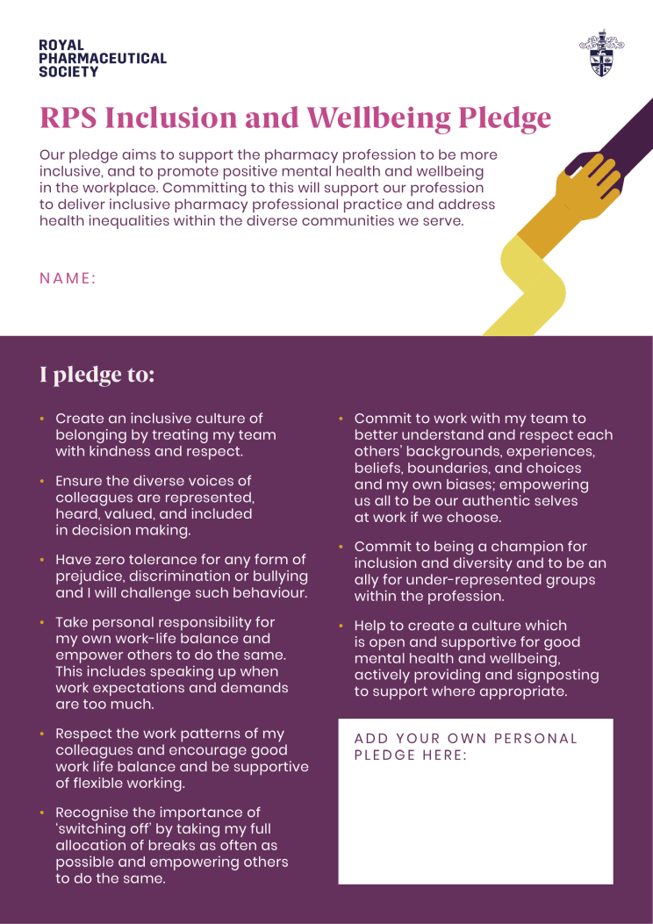

Slide 16
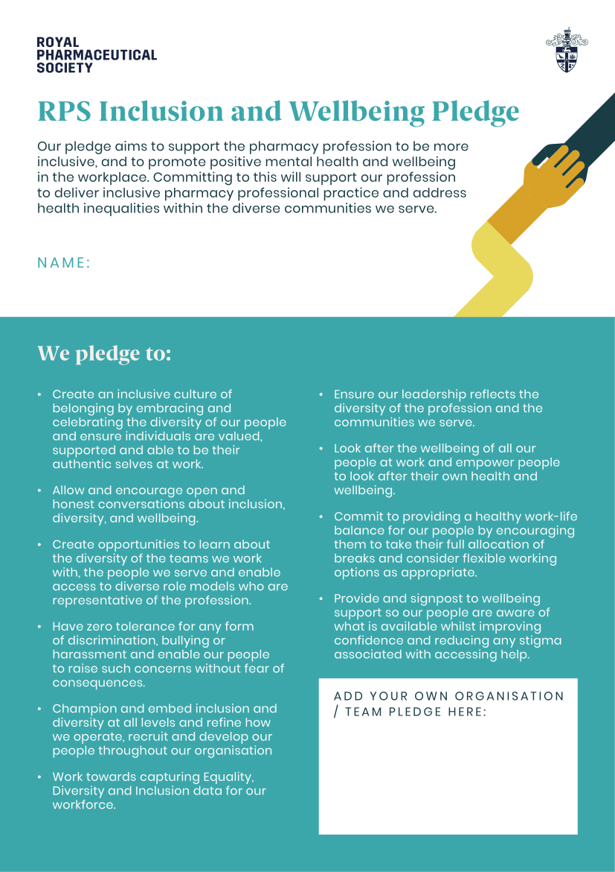

Slide 17
How can you get inv0lved!
Sign the RPS Inclusion and Wellbeing Pledge to demonstrate your commitment to creating a sense of belonging and good wellbeing across the profession
Work with your team and highlight an area that you can work on to ensure individuals can be their authentic selves
Are you looking after your own wellbeing and empowering others to do the same?
Send us your case studies of good practice for us to share
Access our resources and information to support your development on I&D and Wellbeing
Join ABCD and WWAG Groups

Slide 18
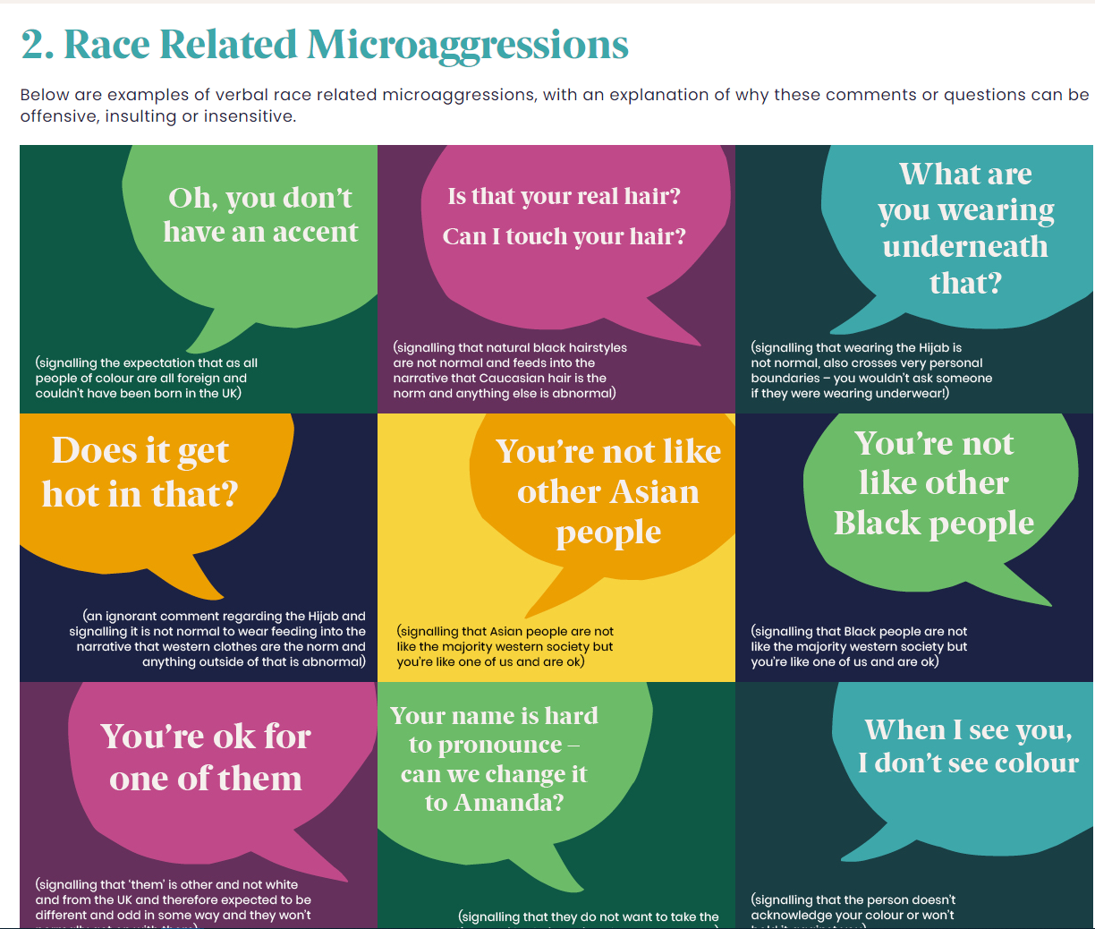
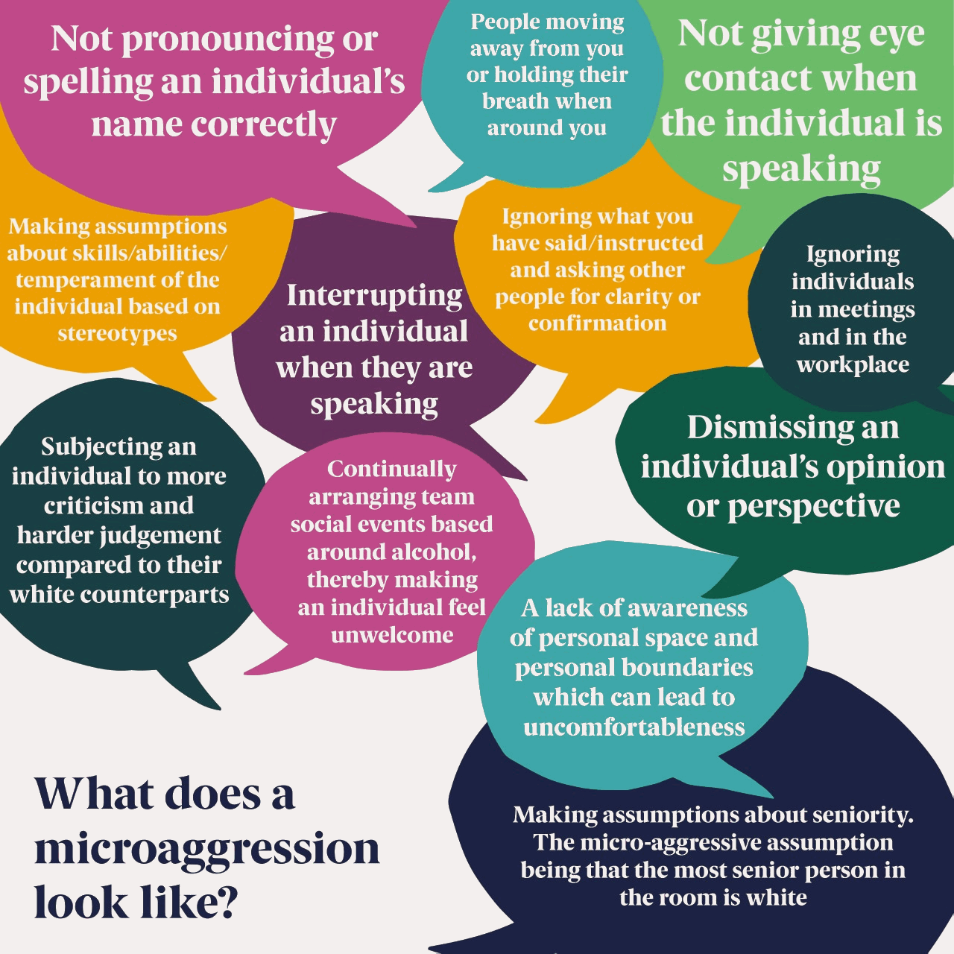
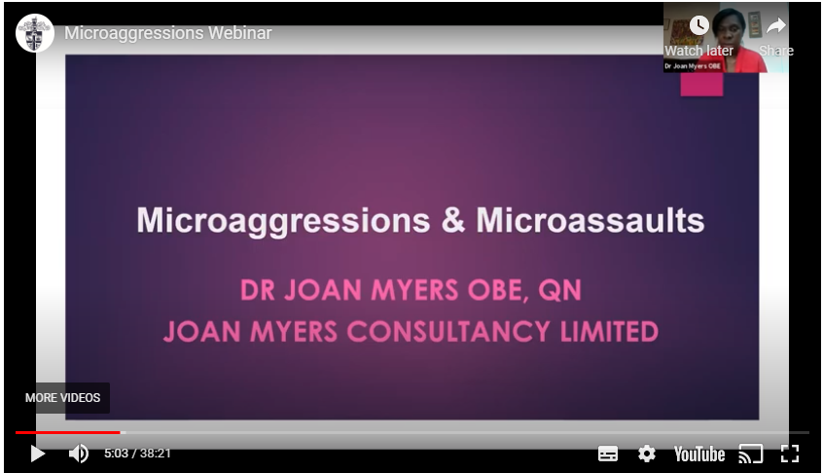
With volunteers from our ABCD group we developed and launched our Race microaggressions reference
We also ran a workshop with Dr Joan Myers for members and non-members

Slide 19

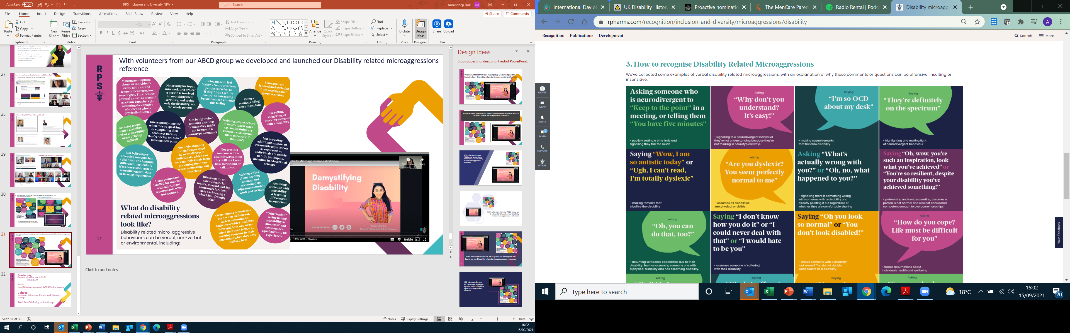
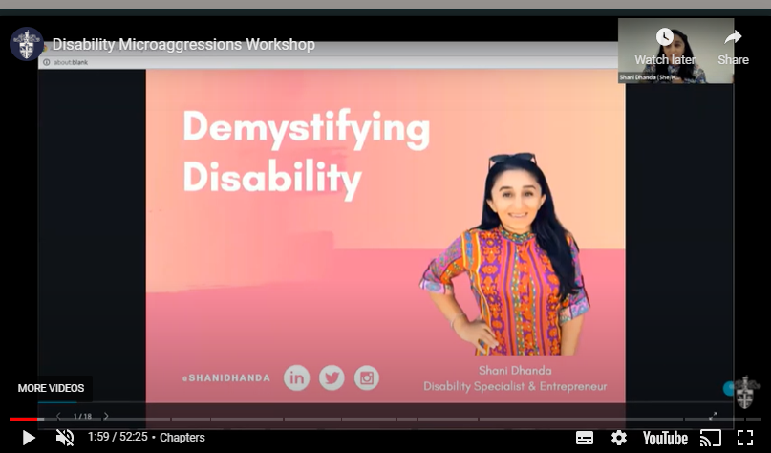
With volunteers from our ABCD group we developed and launched our Disability related microaggressions reference

Slide 20
Contact us:
Twitter: @APharmacistDoll
@HeidiDW
Email:
IandD@rpharms.com or WWB@rpharms.com
Join us:
Action in Belonging, Culture and Diversity Group
Workforce Wellbeing Action Group

Slide 21
CCA LPC Equality, Diversity & Inclusion
PSNC LPC Conference - September 2021

Slide 22
What we did
~350 CCA LPC members across the country
Voluntary and anonymous survey to gather data
Analysed the findings and discussed proposed actions to take with the CCA Board
Committed to CCA actions and made suggestions for LPCs

Slide 23
What we found
Half of all CCA LPC members
Over 90% of LPCs represented
Average of 7 years’ LPC experience
15 different ethnic groups represented

Slide 24
Next steps and our commitments
Continue to collect and monitor EDI information
Update the CCA nominations process to only include candidates’ initials
Suggestions for LPCs
  Discuss and objectively review your current ways of working
  Make sure your meetings are accessible
  Keep up to date on other national work on EDI

Slide 25
Q&A
Do you have any suggestions for what LPCs could do differently to make how they operate more inclusive?
Are there any examples of best practice to share across the network?

