Slide 1
Read and then delete this slide
Alongside the guidance and resources available at psnc.org.uk/Hypertension, PSNC Briefing 041/21 provides detailed information on the Hypertension Case-Finding Advanced Service and it provides information for speakers using this PowerPoint presentation.
Questions or comments on this presentation can be addressed to services.team@psnc.org.uk
Last updated: 11th October 2021

Slide 2
The Community Pharmacy Hypertension Case-Finding Advanced Service

Slide 3
Overview
Background
Policy context
Service description and documentation
BP meters to be used in the service
Pre-commencement activity
Patient eligibility
Providing the service
Funding and claiming payment
Working in your localities
Questions

Slide 4
Background
Cardiovascular disease (CVD) is one of the leading causes of premature death in England
Affects 7 million people and accounts for 1.6 million disability adjusted life years
Hypertension is the biggest risk factor for CVD
Top five risk factors for all premature death and disability in England
~5.5 million people have undiagnosed hypertension in England
CVD is a key driver of health inequalities and accounts for around 25% of the life expectance gap

Slide 5
Background
Early detection of hypertension is vital
Evidence that community pharmacy can provide a key role in detection and subsequent treatment of hypertension
Community pharmacy engagement has the potential to improve outcomes and reduce the burden on general practices
Levels of detection are expected to have fallen over the past year due to the impact of COVID-19 on routine blood pressure monitoring

Slide 6
Policy context
NHS Long Term Plan (LTP) - NHS commitment to reducing morbidity and mortality due to CVD
LTP commitment for community pharmacy, working with others, to provide opportunities for the public to check on their health through tests for high BP
Cardiovascular Disease Prevention System Leadership Forum - ambition for hypertension:
80% of the expected number of people with high BP are detected by 2029, and that 80% of the population diagnosed with hypertension are treated to target
At the time the LTP was published, Public Health England estimated fewer than 60% of people with hypertension had been diagnosed

Slide 7
Policy context
NICE guideline NG136 sets out the criteria for the diagnosis and management of hypertension in adults
Ambulatory blood pressure monitoring (ABPM) is the clinically preferred method for diagnosing hypertension
Part of 5-Year CPCF agreed to test a model for detecting undiagnosed CVD in community pharmacy and pilot in 2020/21 through PhIF
Pilot commenced in December 2020

Slide 8
Policy context
Pilots
35 pharmacies from 6 PCNs in 4 geographies:
Darlington & Durham PCN
Urban Health and Dudley & Netherton PCNs
Chesterfield & Dronfield PCN
Newham Central and North Newham PCNs
Sites include rural and urban areas, areas of high ethnicity and areas of mixed deprivation/affluence
Evaluation is due to complete reporting late Autumn 2021
Public Perceptions: Ipsos survey and interviews (1651 participants)
91% comfortable with BP check in a community pharmacy

Slide 9
Service Description
The service is an Advanced service
It commenced on 1st October 2021
Two stages:
Stage 1 - identify people at risk of hypertension – ‘Clinic check’
Stage 2 - 24-hour ambulatory blood pressure monitoring (ABPM)
Contractors must be able to provide both stages
Currently only provided by pharmacists

Slide 10
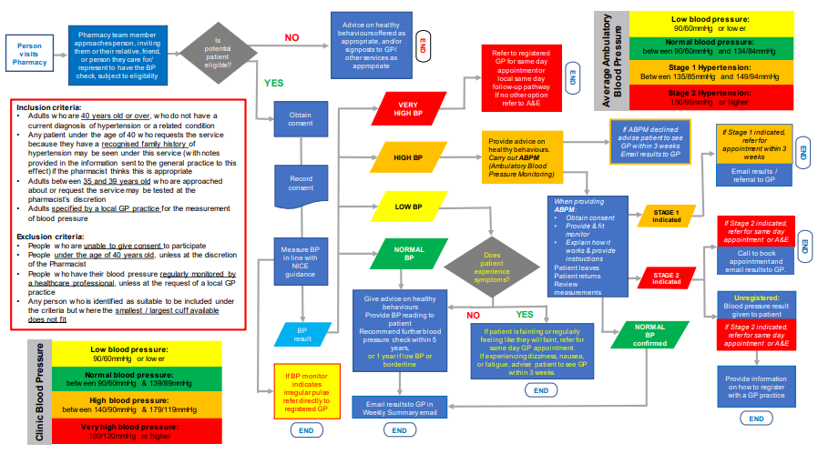
Service description – service pathway

Slide 11
Advice on healthy behaviours offered as appropriate, and/or signposts to GP/ other services as appropriate
Average Ambulatory Blood Pressure
Low blood pressure:
90/60mmHg or lower
Pharmacy team member approaches person, inviting them or their relative, friend, or person they care for/ represent to have the BP check, subject to eligibility
Is potential patient eligible?
NO
Person visits Pharmacy
END
Normal blood pressure:
between 90/60mmHg and 134/84mmHg
Refer to registered GP for same day appointment or
local same day follow-up pathway
If no other option refer to A&E
Stage 1 Hypertension:
Between 135/85mmHg and 149/94mmHg
YES
END
VERY HIGH BP
Stage 2 Hypertension:
150/95mmHg or higher
Inclusion criteria:
Adults who are 40 years old or over, who do not have a current diagnosis of hypertension or a related condition
Any patient under the age of 40 who requests the service because they have a recognised family history of hypertension may be seen under this service (with notes provided in the information sent to the general practice to this effect) if the pharmacist thinks this is appropriate
Adults between 35 and 39 years old who are approached about or request the service may be tested at the pharmacist’s discretion
Adults specified by a local GP practice for the measurement of blood pressure
Exclusion criteria:
People who are unable to give consent to participate
People under the age of 40 years old, unless at the discretion of the Pharmacist
People who have their blood pressure regularly monitored by a healthcare professional, unless at the request of a local GP practice
Any person who is identified as suitable to be included under the criteria but where the smallest / largest cuff available does not fit
Obtain consent
If ABPM declined advise patient to see GP within 3 weeks
Email results to GP
If Stage 1 indicated, refer for appointment within 3 weeks
Provide advice on healthy behaviours.
Carry out ABPM (Ambulatory Blood Pressure Monitoring)
HIGH BP
END
Record consent
Email results / referral to GP
LOW BP
When providing ABPM:
Obtain consent
Provide & fit monitor
Explain how it works & provide instructions
Patient leaves
Patient returns
Review measurements
STAGE 1 indicated
If Stage 2 indicated, refer for same day appointment or A&E
Measure BP in line with NICE guidance
NORMAL BP
Does patient experience symptoms?
END
Call to book appointment and
email results to GP.
STAGE 2 indicated
Give advice on healthy behaviours
Provide BP reading to patient
Recommend further blood pressure check within 5 years,
or 1 year if low BP or borderline
Unregistered:
Blood pressure result given to patient
NO
YES
BP result
If patient is fainting or regularly feeling like they will faint, refer for same day GP appointment.
If experiencing dizziness, nausea, or fatigue, advise patient to see GP within 3 weeks.
NORMAL BP confirmed
If Stage 2 indicated, refer for same day appointment or A&E
Clinic Blood Pressure
Low blood pressure:
90/60mmHg or lower
Normal blood pressure:
between 90/60mmHg & 139/89mmHg
If BP monitor indicates irregular pulse refer directly to registered GP
Provide information on how to register with a GP practice
END
High blood pressure:
between 140/90mmHg & 179/119mmHg
Email results to GP in Weekly Summary email
Very high blood pressure:
180/120mmHg or higher
END
END
END

Slide 12
Key service documentation
Service specification
Service pathway
PSNC Briefing 041/21: Guidance on the Community Pharmacy Hypertension Case-Finding Advanced Service

Slide 13
BP meters to be used in the service
Purchase or rent a meter for each service stage – clinic BP & ABPM
Must be validated by the British and Irish Hypertension Society
Considerations before purchasing / renting at: psnc.org.uk/hypertension
Don’t forget your ancillaries (larger cuff sizes etc.)

Slide 14
Pre-commencement activity
Premises requirements​
Pharmacy must have a consultation room which meets the Terms of Service requirements
Additional requirements:
when measuring blood pressure, the patient must be able to rest their arm on a table / bench at a suitable height
IT equipment accessible within the room

Slide 15
Pre-commencement activity
Training requirements
Currently the service is to be provided by a pharmacist
Familiar with the NICE guideline Hypertension in adults: diagnosis and management [NG136]
Read and understood the service specification
Completed the recommended training on how to use the blood pressure monitoring equipment

Slide 16
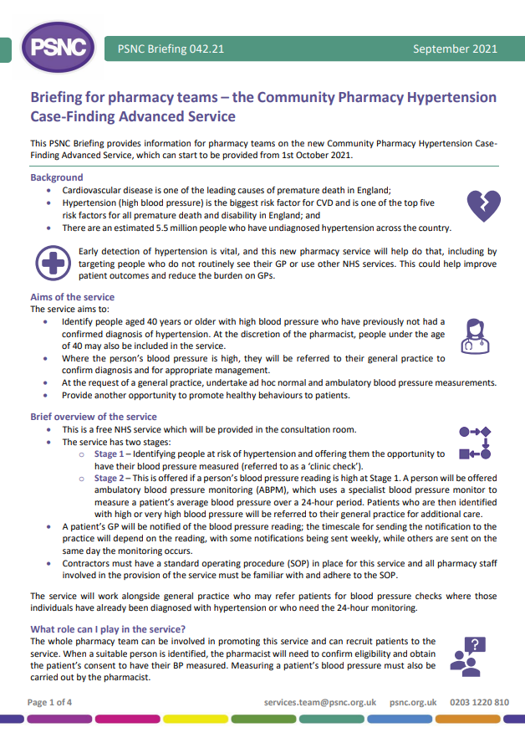
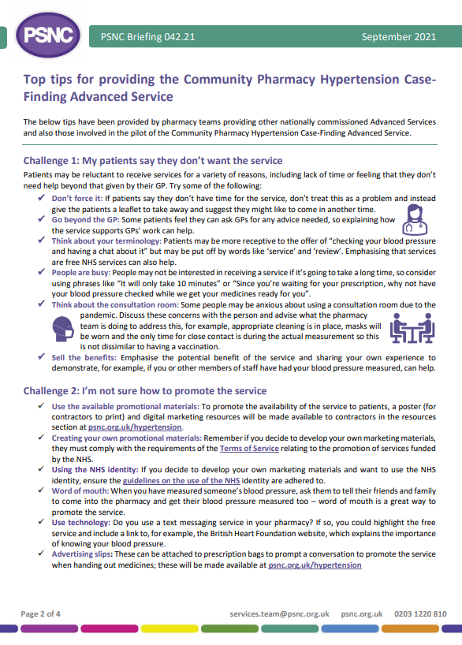
Pre-commencement activity
Training requirements
Additional optional CPD available via CPPE
Pharmacy Team Training
Whole pharmacy team approach to promotion and recruitment
PSNC Briefing 042/21: Briefing for pharmacy teams – the Community Pharmacy Hypertension Case-Finding Advanced Service

Slide 17
Pre-commencement activity
Signing up to the service
Registration via MYS
Set up fee paid
Standard Operating Procedure
Must have in place
All participating staff familiar and follow
Must include process for maintenance and validation of equipment

Slide 18
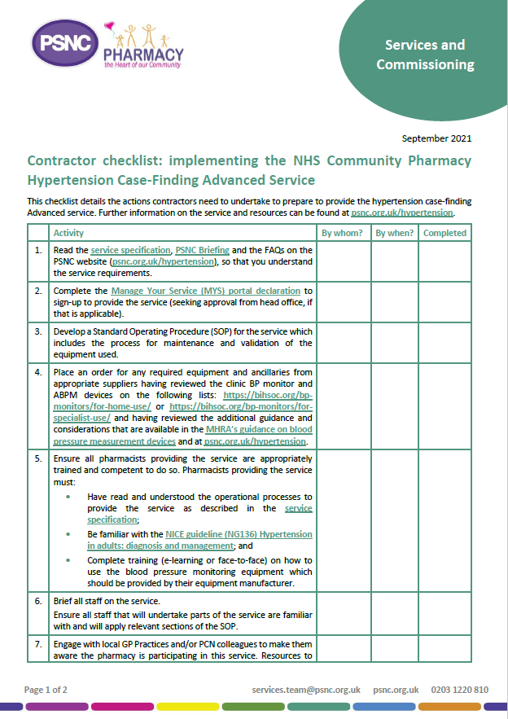
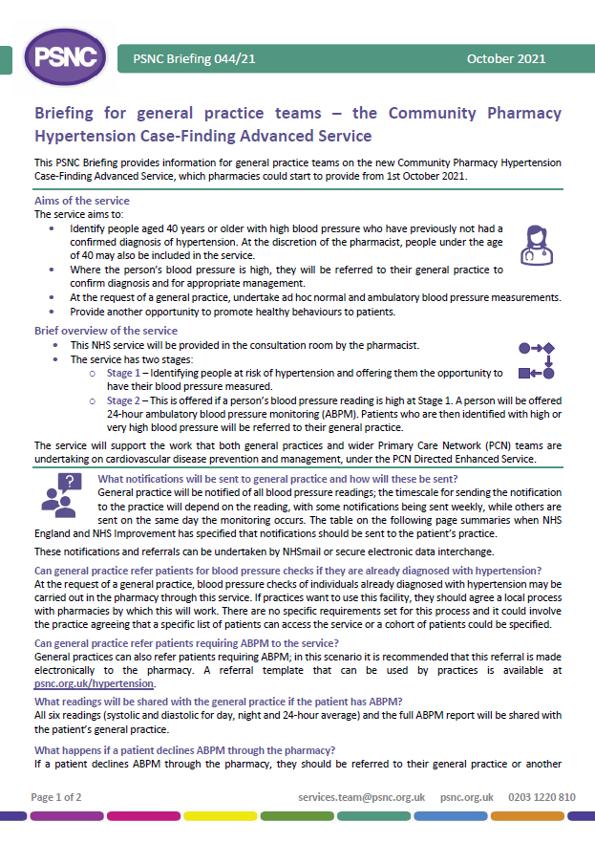
Pre-commencement activity
Engage with local GP Practice / PCN
GP practice briefing
Contractor implementation checklist
Step by step guide to prepare

Slide 19
Patient eligibility
Inclusion criteria
Adults ≥ 40 years with no diagnosis of hypertension
By exception, < 40 years with family history of hypertension (pharmacist’s discretion)
Approached or self requested 35-39 years old (pharmacist’s discretion)
Adults specified by a general practice (clinic and ambulatory blood pressure checks)
Exclusion criteria
Unable to give consent
Under 40 years old
People who have their blood pressure regularly monitored by a healthcare professional
Additional consideration
Unable to support due to cuff size

Slide 20
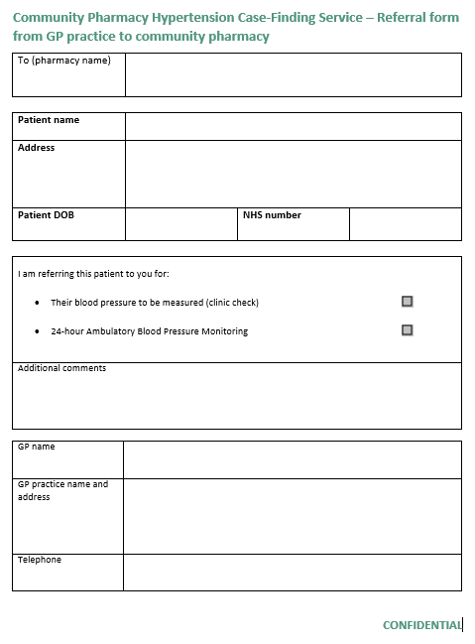
Patient eligibility
GP referrals
Can refer patients for both normal BP checks and ABPM
Need a locally agreed process
No specific requirements for the process
ABPM referrals best done electronically
Template referral form available

Slide 21
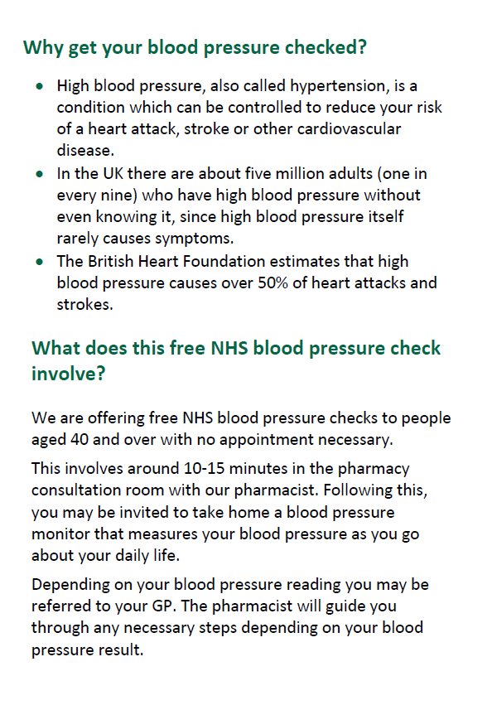
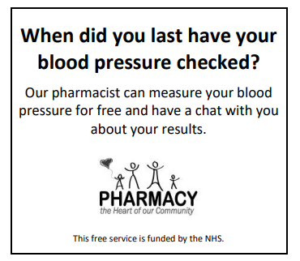
Providing the service
Promoting the service
Posters, leaflets, website
Patient advice
Consent is verbal
Off-site provision (with NHSE&I agreement)

Slide 22
Providing the service – Clinic check
Take a BP reading in both arms
Measure BP in line with NICE guidance
Both readings <140/90mmHg
Both readings ≥140/90mmHg
One reading <140/90mmHg and the other reading ≥140/90mmHg
Follow the service pathway
Take a third reading on the arm with the highest BP
If NOT substantially different from the first reading from that arm, use the lower of the two readings
If substantially different from the first reading from that arm
Clinic Blood Pressure
Low blood pressure:
90/60mmHg or lower
Normal blood pressure:
between 90/60mmHg & 139/89mmHg
Take another reading in that arm and use the lower of the last two readings
High blood pressure:
between 140/90mmHg & 179/119mmHg
Very high blood pressure:
180/120mmHg or higher

Slide 23
Providing the service – Clinic check
Low blood pressure:
90/60mmHg or lower
Normal blood pressure:
between 90/60mmHg & 139/89mmHg
Does patient experience symptoms?
If BP monitor indicates irregular pulse refer directly to registered GP
Give advice on healthy behaviours
Provide BP reading to patient
Recommend further blood pressure check within 5 years,
or 1 year if low BP or borderline
YES
NO
If patient is fainting or regularly feeling like they will faint, refer for same day GP appointment.
If experiencing dizziness, nausea, or fatigue, advise patient to see GP within 3 weeks.
Email results to GP in Weekly Summary email
END
END

Slide 24
Providing the service - ABPM
Provision
Loan arrangements - template loan agreement
Reset the ABPM
Fit the ABPM to the patient
Explain the functioning
Confirm understanding
Explain not to get the ABPM wet
Arrange a follow up appointment
Failure to attend
Two attempts to contact (on separate occasions)
Notify GP practice and provide clinic BP reading

Slide 25
Providing the service - ABPM
Return and follow up
Retrieve consultation data
Record the average daytime, night-time and 24-hour blood pressure readings
Based on the average 24-hour reading, follow service pathway
GP practice notification to include all six readings (systolic and diastolic for day, night and 24-hour average) and the full ABPM report
Failure to attend
Make attempts to contact
If no contact or return after 5 days:
Notify GP practice and provide clinic BP reading
Suspend service until the ABPM meter is retrieved or replaced

Slide 26
Providing the service - ABPM
Outcomes
Normal blood pressure:
between 90/60mmHg and 134/84mmHg
Stage 1 Hypertension:
Between 135/85mmHg and 149/94mmHg
Stage 2 Hypertension:
150/95mmHg or higher
Give advice on healthy behaviours
Provide BP reading to patient
Recommend further blood pressure check within 5 years
or 1 year if low BP or borderline
If Stage 2 indicated, refer for same day appointment or A&E
If Stage 1 indicated, refer for appointment within 3 weeks
Call to book appointment and
email results to GP.
Unregistered:
Blood pressure result given to patient
Email results / referral to GP
Email results to GP in Weekly Summary email
END
Provide information on how to register with a GP practice
END
END
END

Slide 27
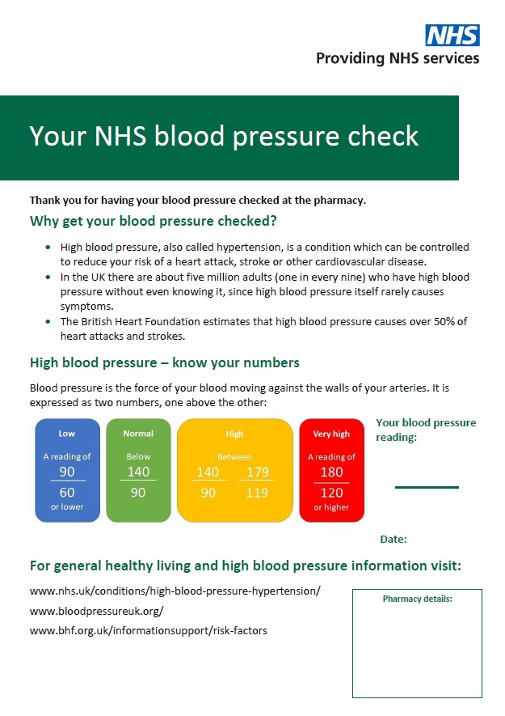
Providing the service
Blood pressure readings
Leaflet to note results
Healthy lifestyle advice
MECC mindset
Discuss lifestyle/behaviours
Consider local services that could support patients’ next steps

Slide 28
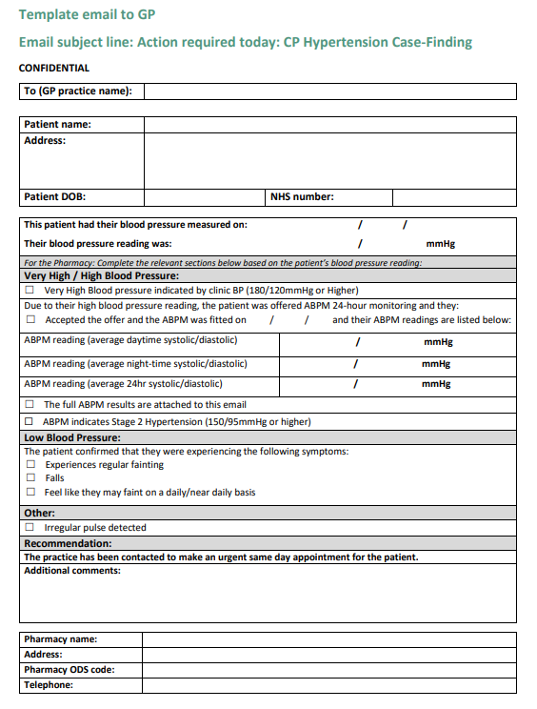
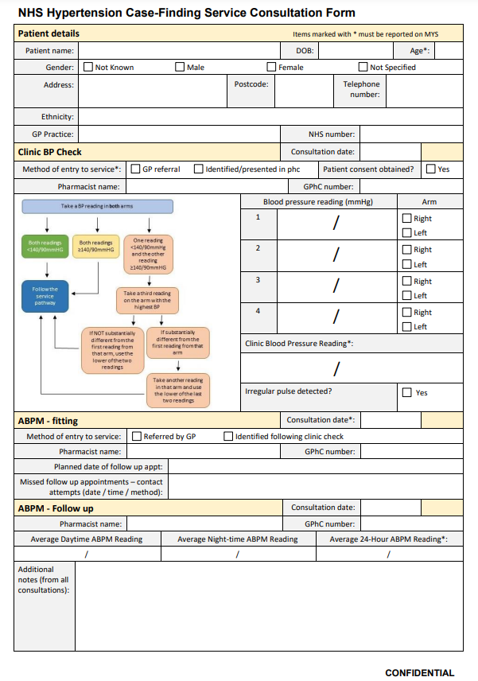
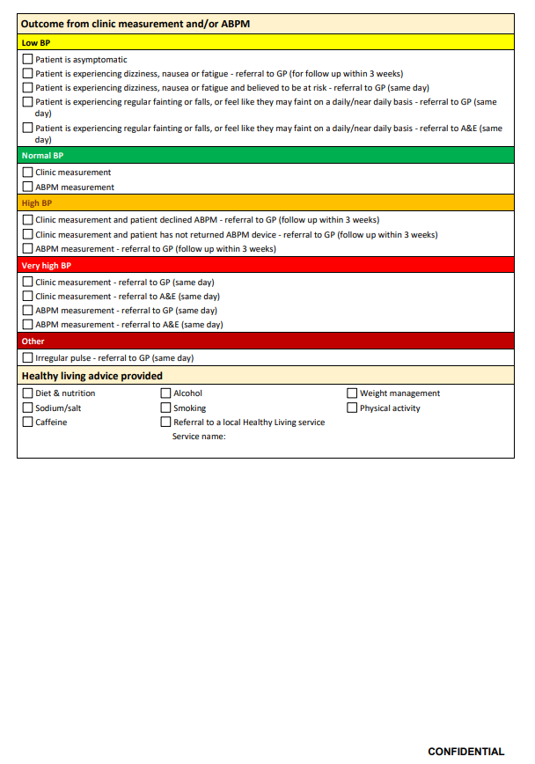
Providing the service
Communicating with GP practices
Service specification Appendix B
Weekly summary & referral templates
Record keeping and data management
Currently no IT systems to support
Template clinical record form
Application programming interface (API) will be developed to simplify data management and claim submission in IT systems
Period of retention of clinical records determined by contractor

Slide 29
Funding and claiming payment
Set-up fee of £440
Fee for each clinic check of £15
Fee for each ambulatory monitoring of £45
Incentive fees for Years 3, 4 and 5 of the CPCF 5-year for achieving ABPM targets:
£1,000 will be available if 5 ABPM intervention are provided in 2021/22;
£400 for 15 ABPM interventions in 2022/23 and
£400 for 20 ABPM interventions in 2023/24.
Incentive payments from outside the global sum
Incentive supports capital costs of equipment purchase
GP practice referrals paid at the same rates

Slide 30
Funding and claiming payment
Dataset to report to MYS for claims in Appendix C of service specification
Age of patient
Date of service provision
Clinic reading (systolic and diastolic)
If clinic reading, was this opportunistic or referred from a GP?
ABPM reading (average 24hr systolic and diastolic)
If ABPM, was this opportunistic or referred from a GP?
Report completed service provision only
Claim payment via the NHSBSA Manage Your Service (MYS) application
Claim month by the 5th of the month following completion. Later claims will not be processed

Slide 31
Working with Primary Care Networks
New PCN Directed Enhanced Service requirements commenced on 1st October 2021
Service supports CVD prevention and management work in GP practices & PCN
PCNs are seeking to improve diagnosis of hypertension
PCNs required to proactively work with community pharmacies on the case-finding service
Future requirement to support information exchange

Slide 32
Key next steps
Contractors need to engage their local practices
Let them know when you are going to start providing the service
Share the GP practice team briefing PSNC Briefing 044/21 to help explain that you will be sending all results and some referral
Identify that this will help them with the CVD aspects of the PCN DES
Ask if they would like you to complete any BP measurements to support them and agree how they will let you know which patients

Slide 33
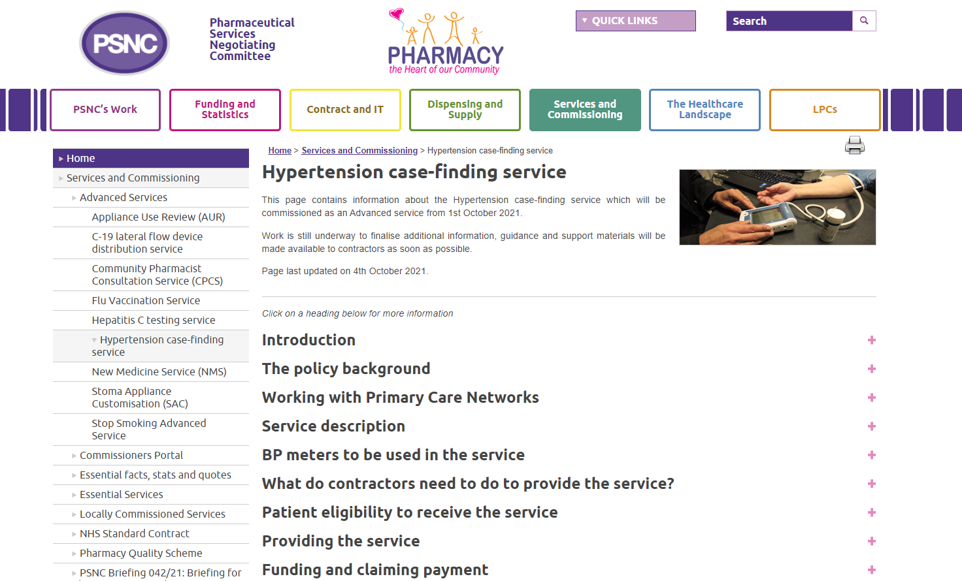
Questions
psnc.org.uk/hypertension
services.team@psnc.org.uk
Sign up to PSNC enews at
psnc.org.uk/enews
@PSNCNews
Good luck with the service!

