Slide 1
Community Pharmacies in 2021/22

Slide 2
Pharmacies in 2021/22
Summary and recap
Pharmacy services
Quality in pharmacies
Pharmacy funding and challenges
The future and ongoing discussions

Slide 3
Key changes for pharmacies in 2021/22
New Services: Hypertension case-finding and stop smoking services.
New Medicine Service (NMS): Expansion to new cohorts of patients.
Quality: New Pharmacy Quality Scheme (PQS) including work with respiratory patients and on weight management.
Funding: Core funding remains flat at £2.592bn.

Slide 4
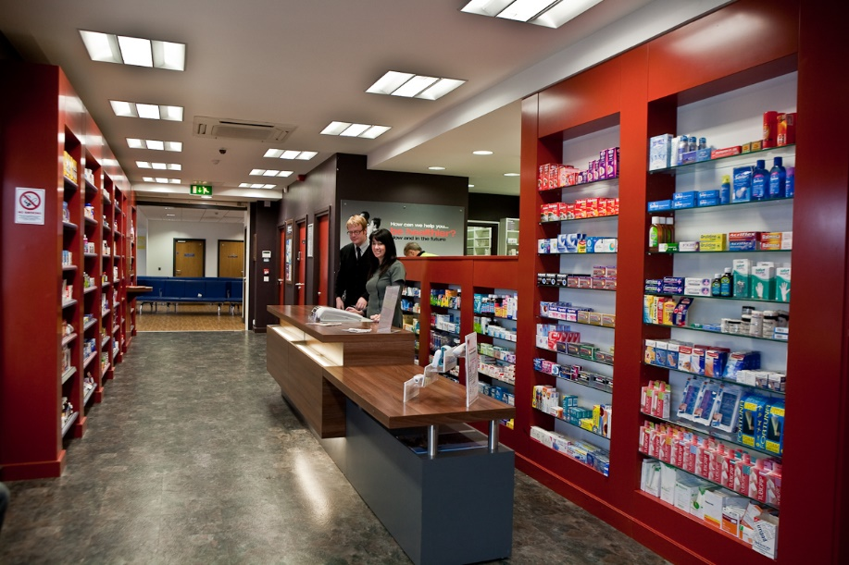
Recap: The five-year deal for pharmacies
Agreed in summer 2019: flat funding for pharmacies until 2023/24.
Set out a range of new services to be piloted and rolled out…
… adding to the clinical and public health role of pharmacies, and supporting key NHS objectives.
Freeing up capacity was a key ambition.

Slide 5
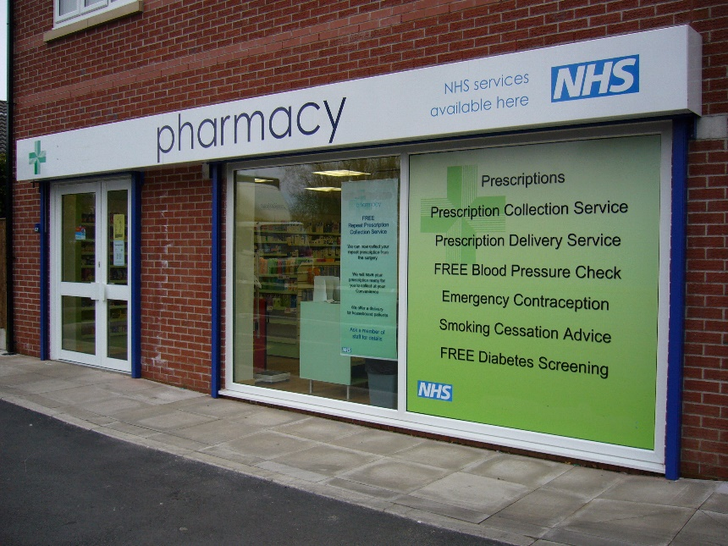
Recap: Pharmacies through COVID-19
Pharmacies have been under significant pressure throughout the pandemic.
Operational and logistical challenges, combined with cost pressures.
Pharmacies giving healthcare advice to 58 million people annually on a walk-in basis…
… with many of these people unable to access other parts of the NHS.

Slide 6
Recap: Pharmacy COVID-19 services
COVID-19 Lateral Flow Device Distribution Service: giving people easy access to tests.
Pandemic Delivery Service: ensuring vulnerable people could have their medicines delivered to them while they shielded.
COVID-19 vaccinations: around 700 pharmacy vaccination sites now live.

Slide 7
Recap: Recent pharmacy service changes
Medicines Use Reviews (MURs): decommissioned following by NHSE&I.
Hepatitis C Testing Service launched.
Community Pharmacist Consultation Service (CPCS): pharmacies make emergency medicines supplies or give advice to people with minor conditions, after NHS111 or GP referral.

Slide 8
Recap: Recent pharmacy service changes
Discharge Medicines Service (DMS): all pharmacies offer advice about newly prescribed medicines to patients referred by NHS Trusts after discharge from hospital.
The NHS flu vaccination service was expanded to new age groups last flu season…
… with pharmacies administering more than 2.76 million vaccinations.

Slide 9
New opt-in* pharmacy services for 2021/22
Hypertension Case-Finding: new national case-funding service launching in October 2021.
Smoking Cessation: from January 2022, NHS Trusts will be able to refer patients to a pharmacy Stop Smoking service.
Expansion of the New Medicine Service (NMS) to new patient cohorts from September 2021.
*This means some pharmacies may choose not to offer them

Slide 10
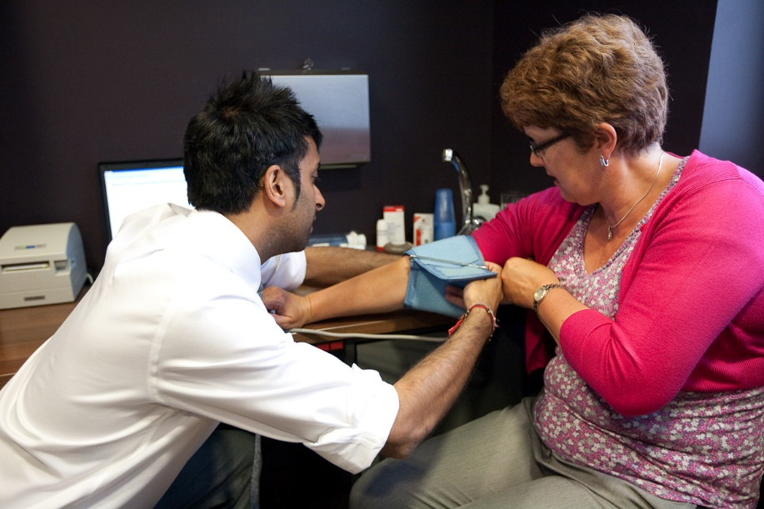
Hypertension Case-Finding Service
Aims to identify people aged 40 years or older with high blood pressure who have previously not had a confirmed diagnosis of hypertension.
At the discretion of the pharmacist people under the age of 40 may also be included.
Where blood pressure is high, the person will be referred to GPs to confirm diagnosis and for appropriate management.
Service starts from October but given capacity challenges it may be some months before pharmacies start to provide it at scale.

Slide 11
Hypertension Case-Finding Service
There are two stages to this new service:
Identifying people at risk of hypertension and offering them blood pressure measurement (a ‘clinic check’)
Where clinically indicated, offering 24-hour ambulatory blood pressure monitoring
The service will help to improve access to blood pressure checks and identify hypertension cases early.
It is line with Primary Care Network (PCN) plans, and PCNs are being asked to support the exchange of information between pharmacies and GPs.

Slide 12
Smoking Cessation service
Smoking remains a leading cause of illness in England, and a factor in COVID-19 outcomes.
NHS Trusts will be able to refer patients discharged from hospital to pharmacy to continue their smoking cessation care pathway.
Pharmacies will offer medication and behavioural support, in line with the NHS Long Term Plan care model for tobacco addiction.

Slide 13
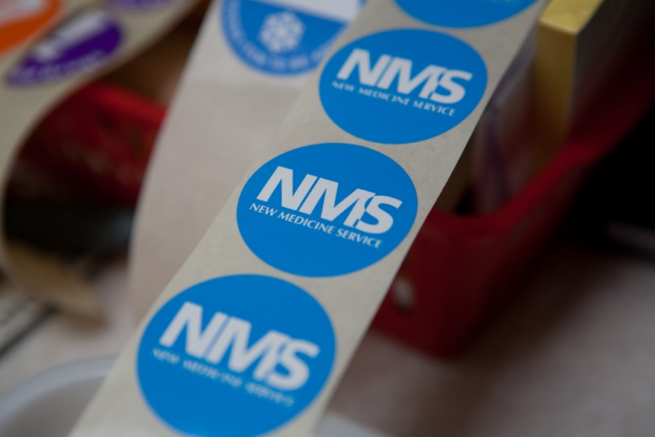
The New Medicine Service (NMS) (1)
The NMS provides support for patients prescribed a new medicine
Pharmacies can now offer the service to patients prescribed a new medicine for a wide range of conditions as below.
Acute coronary syndromes ▪ Asthma and COPD ▪ Atrial fibrillation ▪ Coronary heart disease ▪ Diabetes (Type 2) ▪ Epilepsy ▪ Glaucoma ▪ Gout ▪ Heart failure ▪ Hypercholesterolaemia ▪ Hypertension ▪ Long term risks of venous thromboembolism / embolism ▪ Osteoporosis ▪ Parkinson’s disease ▪ Stroke / transient ischemic attack ▪ Urinary incontinence / retention

Slide 14
The New Medicine Service (NMS) (2)
Pharmacists can also now provide ‘catch-up’ NMS to eligible patients who did not receive the NMS during the COVID-19 pandemic.
The NMS can be offered to support parents/guardians/carers of children and adults who could benefit from it, but where the patient is not able to provide informed consent.
The NMS continues to improve medicines adherence, and therefore health outcomes.

Slide 15
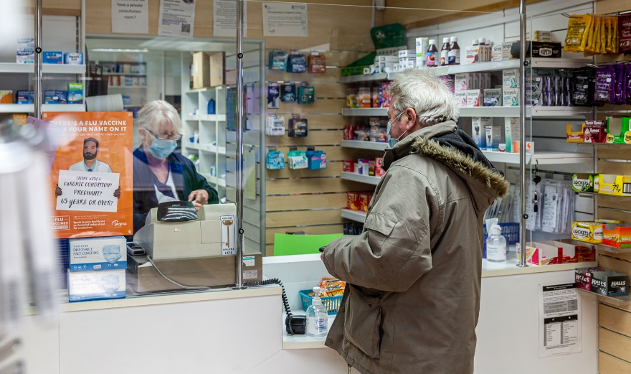
The Pharmacy Quality Scheme (PQS)
The PQS supports the delivery of the NHS Long Term Plan by rewarding community pharmacy contractors for achieving set quality criteria.
In 2021/22 pharmacy’s quality objectives focus on priorities supporting recovery from COVID-19.
This will include actively promoting COVID-19 vaccinations, specifically in Black, Asian, minority ethnic and low uptake communities…
… and offering inhaler checks to people prescribed a new inhaler who missed out on checks due to COVID.

Slide 16
Other inclusions in the PQS for 2021/22
Pharmacy teams will carry out an anticoagulant audit.
They will collaborate with PCNs on increasing uptake of flu vaccinations.
Patients prescribed antibiotics will be reviewed to help ensure safe and effective use.
Pharmacy teams will proactively discuss weight management with patients.
Children without spacers and all patients without personalised asthma action plans will be referred for support.
Pharmacy teams will talk to people about the environmental benefits of safe disposal of used or unwanted inhaler devices.

Slide 17
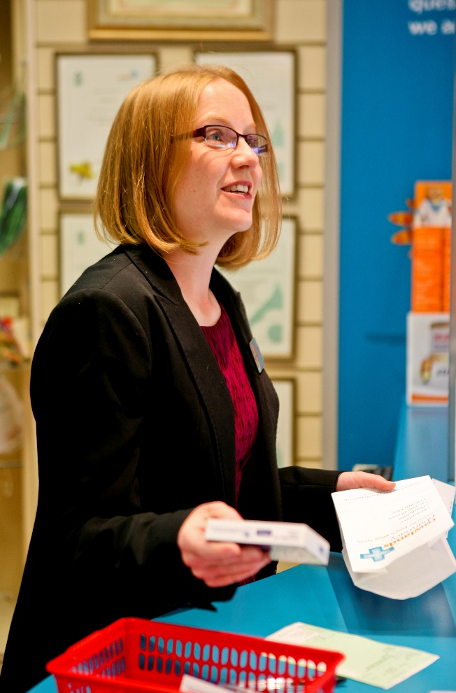
Other important changes for pharmacies
Revised Pharmacy Access Scheme (PhAS): continuing to help ensure that everyone has access to a pharmacy, even in remote areas.
Changes to NHS Regulations to include a pandemic provision.
NHSE&I to have right to refuse applications for new pharmacies if they will cause oversupply of services or only minor opening hours increases.

Slide 18
Ongoing discussions with Government
Progressing reforms to how pharmacies are reimbursed.
Exploring how pharmacy can improve access to palliative care medicines.
Changes to help ease capacity constraints in pharmacy.
Progressing legislation on hub and spoke.
Reviewing progress on the five-year deal.
Pharmacy cashflow and COVID costs.

Slide 19
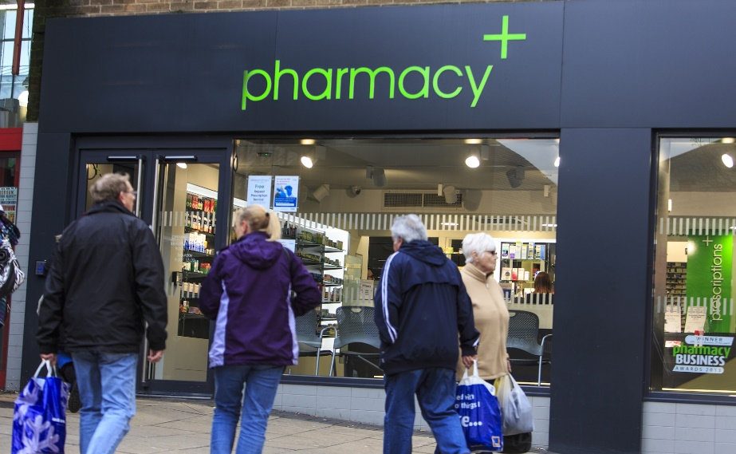
Community pharmacy funding
Pharmacies receive some 95% of their income from NHS funding.
Under the five-year deal, that funding remains flat for 2021/22 and beyond.
The sector’s bids for urgent funding increases have been rejected…
… but the continued underfunding means many pharmacies are struggling.
Capacity challenges also remain.

Slide 20
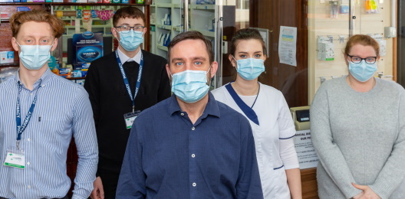
COVID related costs, and cashflow
Pharmacies received emergency loans (advance payments) in 2020 to ease cashflow.
After much negotiation, HM Government then agreed to cover COVID-19 related costs incurred by pharmacies.
Pharmacy owners had to submit a claim for these costs, which will be paid in October…
… but also in October, pharmacies will have to start repaying the loans from last year.
This will put pressure on cashflow for some.

Slide 21
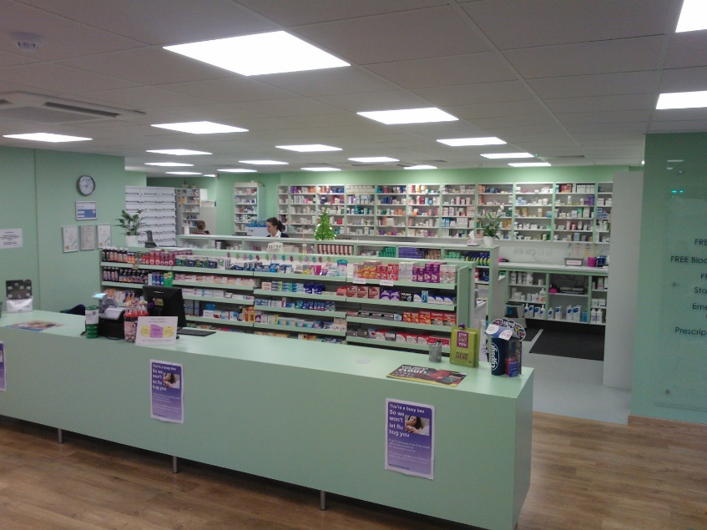
Reflections on pharmacy in 2021/22
Pharmacies are implementing a wide range of new clinical services…
… despite the ongoing COVID and cost pressures they face.
Patients are increasingly relying on pharmacies for walk-in advice.
Pharmacies look forward to continuing to support NHS goals, and to working with emerging local health structures.

