Slide 1
Pharmacy Quality Scheme (PQS) 2022/23
Rosie Taylor
Head of Service Development
Pharmaceutical Services Negotiating Committee
@Rosieanntaylor
services.team@psnc.org.uk

Slide 2
Overview
Introduction
Training requirements
Gateway criteria
Domains/quality criteria
Funding and Aspiration payment
Further information and guidance on PQS

Slide 3
Introduction
The PQS continues as part of the five-year CPCF for 2019/20 to 2023/24
This digital guide is an introduction to the requirements, but contractors should read the NHS England PQS guidance as well
Contractors have until the end of 31st March 2023 to meet the requirements of the PQS 2022/23 but must make their declaration on MYS between 9am on Monday 6th February 2023 and 11.59pm on 3rd March 2023

Slide 4
Introduction
TWO gateway criteria
FIVE domains
Need to complete all the elements in a domain to claim a payment – only exception is the Healthy living support domain

Slide 5
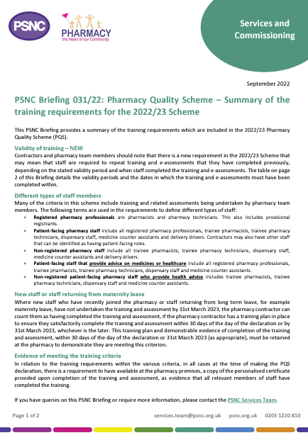
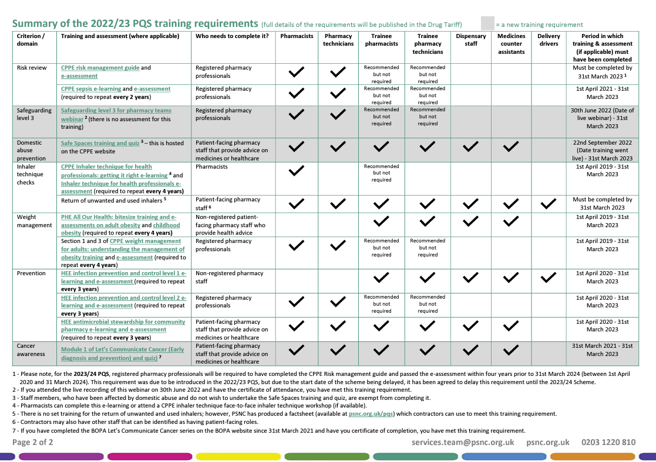
Training requirements
Validity of training – NEW
New staff/staff returning from long term leave
Retain copies of certificates
PSNC Briefing 031/22: PQS – Summary of the training requirements for the 2022/23 Scheme
Training record sheet

Slide 6
Gateway criteria

Slide 7
1. Advanced services – New Medicine Service
Must have delivered a minimum of 20 NMS between 1st April 2022 and end of 31st March 2023
Remember to claim payment by 5th April 2023 for March’s NMS – otherwise won’t count towards total
NHSBSA has published an NMS spreadsheet so contractors can see if they have met the gateway criterion
Information and resources at psnc.org.uk/nms

Slide 8
2. Patient safety report
New safety report
New since March 2022; or covering the last two years if not previously claimed; or since the contractor acquired or opened the pharmacy if this time period is less than two years
Must be specific to the individual pharmacy claiming the PQS payment
Does not need to be submitted but should be kept at the pharmacy

Slide 9
2. Patient safety report
The new safety report will need to cover:
Analysis of incidents and incident patterns (taken from an ongoing log);
Evidence of sharing learning (both locally and nationally);
Actions taken in response to national patient safety alerts; and
Learnings from a review of all patient safety incidents
If claimed for this before, cannot use the same report

Slide 10
Resources to assist you
Monthly template and patient safety report template
Community Pharmacy Patient Safety Group guidance – includes examples of a monthly and an annual patient safety report
Above resources available at psnc.org.uk/pqs
Info on how to report patient safety incidents through the NRLS/LFPSE available at psnc.org.uk/patientsafety
Notes:
​

Slide 11
Domain 1: Risk management and safeguarding

Slide 12
a) Risk review update
NEW: Need to have completed since 1st April 2021
No validity period for 2022/23 but four-year requirement introduced in 2023/24

Slide 13
a) Risk review update
Updated risk review (if competed for previous PQS)
managing the risk of missing sepsis identification;
missing red flag symptoms during over the counter (OTC) consultations; and
minimising the risk of transmission of COVID-19
If not claimed previously, need to complete new risk review
Resources available at psnc.org.uk/pqs:
Training record sheet; and
Risk review templates

Slide 14
b) Safeguarding level 3 webinar
No e-assessment
Do not need to watch again if attended the live event
Need certificate of completion if attended live event or watched on elfh website
If not received one from the live event, email ENGLAND.CommunityPharmacy@nhs.net

Slide 15
b) Safeguarding level 3 webinar
Complete an action plan on how you will manage people who require a safeguarding referral
Resources available at psnc.org.uk/pqs:
Training record sheet; and
Action plan template

Slide 16
c) Domestic abuse prevention
Domestic abuse (Safe spaces training) and quiz; and Ask for ANI and Safe Spaces scheme: training toolkit

Slide 17
c) Domestic abuse prevention
Staff members affected by domestic abuse are exempt from the Safe Spaces training if they do not wish to do this
One person responsible for the pharmacy – Safe Spaces set-up toolkit
Not a requirement to register as a Safe Space or to register to participate in Ask for ANI

Slide 18
Domain 2: Respiratory

Slide 19
a) Inhaler technique checks
Pharmacists must have completed this e-learning or attended a CPPE inhaler technique face-to-face workshop since 1st April 2019
Must also have passed the current version of the e-assessment, Inhaler technique for health professionals, updated in April 2020
Previous version of the CPPE e-assessment, Inhaler technique, does not meet the requirements

Slide 20
a) Inhaler technique checks
Offer NMS, with the appropriate inhaler technique check, to all patients presenting with a prescription for a new inhaler where patients would benefit from the service
Can offer NMS remotely
Training record sheet and data collection form at psnc.org.uk/pqs
More information and resources on NMS at psnc.org.uk/nms
Requirement ends on the day of the declaration

Slide 21
b) Inhaler waste management
There is no set training for this criterion; however, PSNC has produced a short briefing which pharmacy teams can use to meet this training requirement
Contractors may also have other staff that can be identified as having patient-facing roles

Slide 22
b) Inhaler waste management
Have conversations with all patients, their carers or representatives, for whom they have dispensed an inhaler about the environmental benefits of them returning all unwanted and used inhaler devices to a community pharmacy for disposal
Discussions can be supplemented with other communication methods such as leaflets, emails and texts
Requirement ends on the day of the declaration
Notes:
​

Slide 23
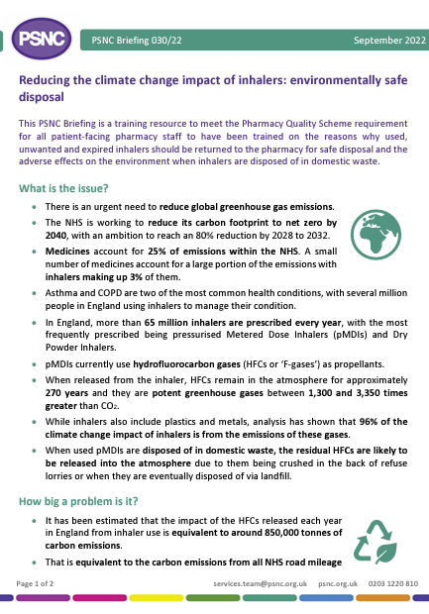
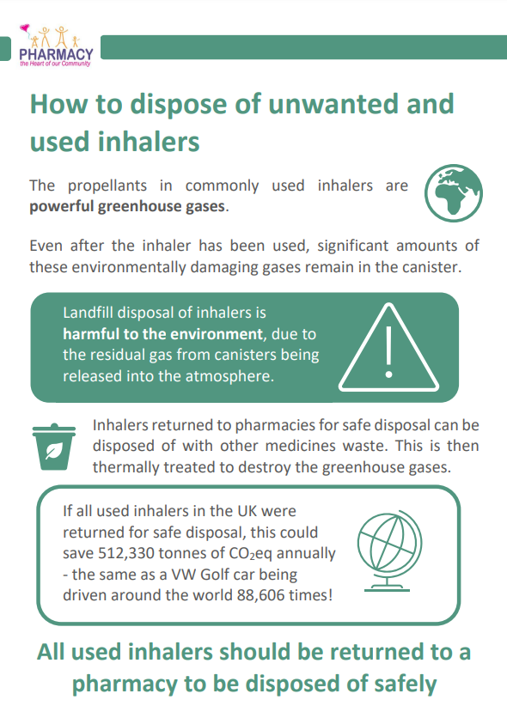
b) Inhaler waste management - resources
PSNC Briefing 030/22: Reducing the climate change impact of inhalers: environmentally safe disposal
Training record sheet
Patient briefing aid on inhaler disposal
Data collection form
All available at psnc.org.uk/pqs

Slide 24
c-e) Asthma referrals
Check all children aged 5 to 15 dispensed inhaled press and breathe pMDI for asthma have a spacer device, where appropriate, in line with NICE TA38;
Check all patients, 5 years and above with asthma have a personalised asthma action plan; and
Patients who are prescribed three or more short-acting bronchodilator inhalers without a corticosteroid inhaler in six months
Refer to an appropriate healthcare professional where this is not the case

Slide 25
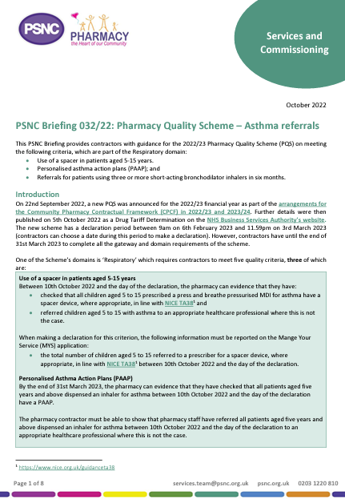
Resources
PSNC Briefing 032/22: PQS – Asthma referrals
Suggested processes for identifying patients
GP referral form
Data collection form
Available at psnc.org.uk/pqs
PharmOutcomes asthma referrals tool

Slide 26
Domain 3: Healthy living support

Slide 27
a) Weight management
Completed since 1st April 2019
Update weight management action plan (if completed for previous PQS)
If not claimed previously, create a weight management action plan

Slide 28
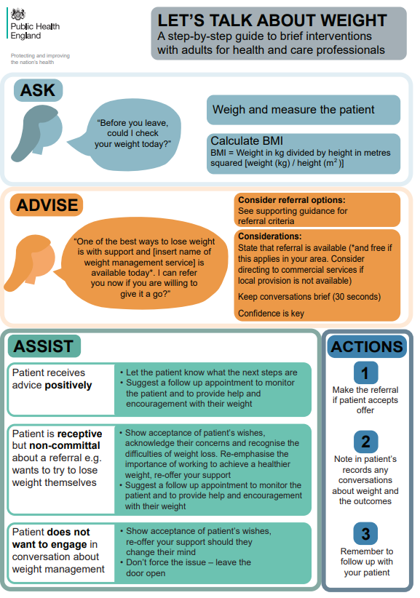
a) Weight management
Proactively discuss weight management with a minimum of 25 patients
Be able to measure a patient’s BMI and measure waist circumference – therefore expected to have equipment to accurately do this
Refer FOUR patients to a Local Authority funded tier 2 weight management service or the NHS Digital Weight Management Programme

Slide 29
a) Weight management
To gain the maximum points, must complete all the previous criteria having referred at least FOUR patients to either of the weight management programmes
If unable to identify four patients for referral, can still claim for the Intervention stage

Slide 30
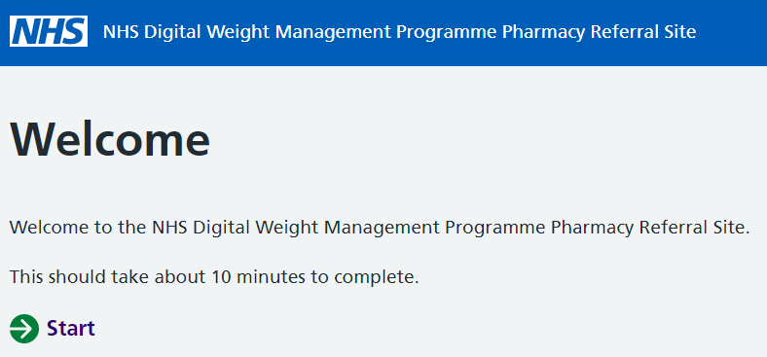
Resources to assist you
Training record sheet
Action plan template
Data collection form
NHS Digital Weight Management Programme resources:
Video on how to make a referral
Screen saver
All available at psnc.org.uk/pqs

Slide 31
Domain 4: Prevention

Slide 32
a) Antimicrobial stewardship
Complete the antibiotic review
UTI leaflet for women under 65 years
Upper RTI leaflet
Over four weeks with a minimum of 15 patients per leaflet
Extend to eight weeks if minimum number of patients not achieved
Data collection form in NHS England guidance
Required to report data to NHS England using the audit collection tool on MYS
Make a record of the start and end date of the review

Slide 33
a) Antimicrobial stewardship
Need to have been completed since 1st April 2020

Slide 34
a) Antimicrobial stewardship
Complete or update AMS action plan for the pharmacy​
Principles of AMS into self-care advice​
Reinforcing the messages around appropriate use of antibiotics, and uptake of vaccinations, including the flu vaccine​
Training record sheet and template action plan available ​at psnc.org.uk/pqs

Slide 35
b) Cancer awareness
New risk review on minimising the risk of missing suspected cancer symptoms
Record of how many referrals to GPs are made by the day of the declaration

Slide 36
b) Cancer awareness
Resources available at psnc.org.uk/pqs:
Training record sheet
Data collection form
Risk review template

Slide 37
Domain 5 – Addressing unwarranted variation in care

Slide 38
a) Palliative and end of life care action plan
After 16th January 2023, contractors must have updated NHS Profile Manager if they routinely hold the 16 palliative and end of life critical care medicines (listed in the PQS Drug Tariff Determination) and can support local access to parenteral haloperidol
Action plan to use when you do not have the required stock of the 16 critical medicines or parenteral haloperidol available for a patient
Template action plan available at psnc.org.uk/pqs

Slide 39
Funding
Total funding is £75 million
Points allocated to Respiratory domain vary with contractor’s script volume in 2021/22
This is to better reflect the varying workload of different sized pharmacies
Value of points between £67.50 and £135
Declaration period: 9am on 6th February 2023 and 11.59pm on 3rd March 2023 (but have until end of 31st March 2023 to complete the work)
Payment will be made by NHSBSA on 3rd April 2023

Slide 40
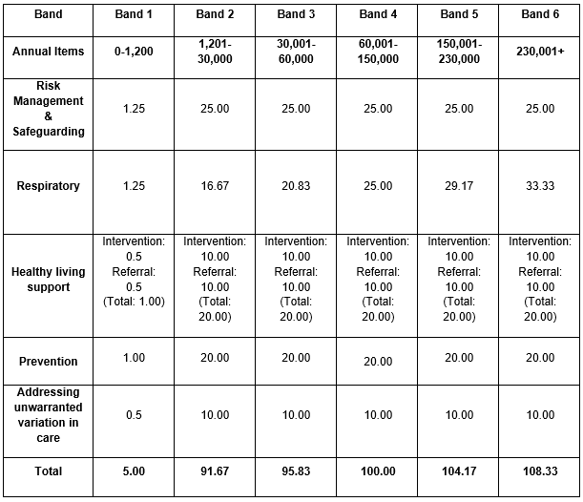
Funding

Slide 41
Aspiration payment
As with previous schemes, an Aspiration payment can be claimed
It is optional to claim – not claiming will not impact on the PQS payment received
Can claim 70% of the value of the points you expect to achieve
Claim period: 9am on 10th October to 11.59pm on 4th November 2022
Payment on 1st December 2022

Slide 42
Other resources
PSNC 2022/23 Action and Evidence Portfolio Workbook
PSNC Briefing on important PQS dates for the diary
PSNC Briefing for general practice teams – changes to the NHS community pharmacy
Coming soon…
PharmOutcomes PQS assessment framework

Slide 43
Further information
Further information and support at psnc.org.uk/pqs
Please read the NHS England PQS guidance
PQS FAQs at psnc.org.uk/pqsfaqs
Sign up to PSNC email newsletter at psnc.org.uk/enews
Email: services.team@psnc.org.uk

Slide 44
Thank you for watching

