Slide 1
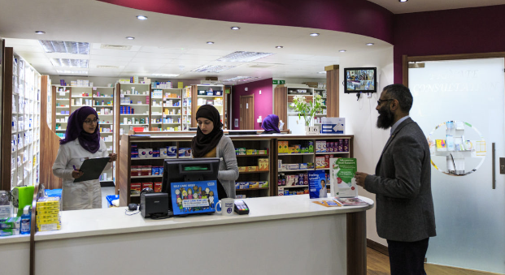
Community Pharmacy NHS Advanced Services

Slide 2
Overview
New Medicine Service (NMS)
Flu Vaccination Service
Community Pharmacist Consultation Service (CPCS)
Hypertension Case-Finding Service (Blood pressure check service)
Smoking Cessation Service (SCS)
Appliance Use Review (AUR)
Stoma Appliance Customisation (SAC)
Hepatitis C Testing Service
Pharmacy Contraception Service (PCS) – commissioned from early 2023
Questions, comments and next steps

Slide 3
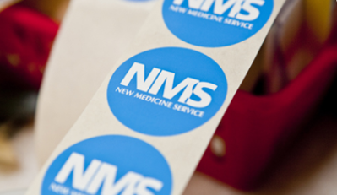
New Medicine Service (NMS)

Slide 4
NMS
Provides early support to patients to maximise the benefits of newly prescribed medicines
Proof of concept research shows that an intervention by a pharmacist can help to improve patients’ adherence
In the research, patients who used the service experienced fewer medicines problems and made less use of other NHS services, saving money and GP time
Ref: The cost effectiveness of a telephone-based pharmacy advisory service to improve adherence to newly prescribed medicines​
Ref: The New Medicine Service Evaluation

Slide 5
NMS – outline of the service
Three stage process:
Patient engagement (day 0)
Intervention (typically between 7-14 days after patient engagement)
Follow up (typically between 14 and 21 days after the initial intervention)
Opportunity to provide healthy living advice at each stage

Slide 6
NMS – conditions covered by the service
Follows the prescribing of a new medicine for:
Acute coronary syndromes | Heart failure
Asthma and COPD | Hypercholesterolaemia
Atrial fibrillation | Hypertension
Coronary heart disease | Long term risks of venous thromboembolism/embolism
Diabetes (Type 2) | Osteoporosis
Epilepsy | Parkinson’s disease
Glaucoma | Stroke / transient ischemic attack
Gout | Urinary incontinence/retention
In 2023, subject to a positive evaluation of an ongoing pilot, the above list of conditions will be expanded to include patients who are newly prescribed an antidepressant

Slide 7
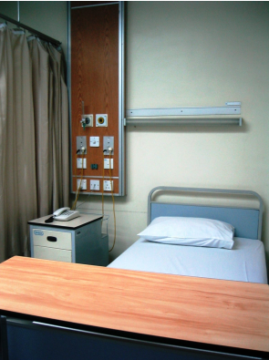
NMS – patient engagement
Recruitment by the pharmacy team
Referral by a general practice prescriber
Referral following a Structured Medication Review
Referral post discharge from hospital

Slide 8
NMS – Intervention
Intervention (typically between 7-14 days after patient engagement)
Face to face in a consultation area, over the phone or via video
Semi-structured interview technique to:
assess adherence
identify problems
identify the patient’s need for further information and support
Pharmacist provides advice and support
agrees follow up
agrees solution(s)
refers to GP practice (only where absolutely necessary)

Slide 9
NMS – Follow up
Follow up (typically between 14 and 21 days after the initial intervention)
Face to face in a consultation area, over the phone or via video
Semi-structured interview technique to:
assess adherence
identify problems
identify the patient’s need for further information and support
Pharmacist provides advice and support
Patient adherent / non-adherent
Provide more advice and support or
Refer to GP practice (using nationally agreed NMS Feedback form)

Slide 10
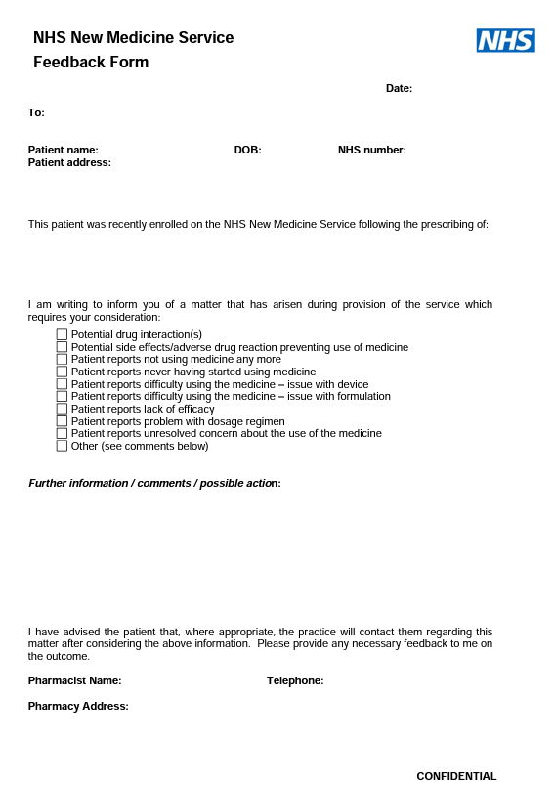
Communicating with GP practices
Pharmacy contractors are required to contact the patient’s GP practice only if an issue is identified during the NMS where the pharmacist believes the patient’s prescriber should be informed
National NMS Feedback Form designed by GPC England/PSNC/NHS Employers
Referrals will only be made when absolutely necessary

Slide 11
Communicating with GP practices
GPC England advised that pharmacists should refer to the practice, rather than suggesting patients make an appointment with their GP
This approach allows the GP practice to determine how they want to deal with the issue raised in the Feedback Form

Slide 12
Referrals from GP practices
NHS guidance for Primary Care Networks (PCNs) on the provision of Structured Medication Reviews (SMR) includes referrals being made to the NMS
Proactive call in guidance published by NHS England to support PCN clinical pharmacy teams with implementation of the SMR and optimisation service requirements in the Network Contract Directed Enhanced Service Specification for 2022/23 to work with community pharmacies to connect patients appropriately to the NMS
Active role for both GPs and PCN clinical pharmacists to promote, refer and set expectation with patients
Ref: NHS England website, Structured medication reviews and medicines optimisation
Ref: Network Contract Directed Enhanced Service – contract specification 2022/23 – primary care network requirements and entitlements

Slide 13
Referrals from hospitals
The Discharge Medicines Service (DMS) became a new Essential service within the Community Pharmacy Contractual Framework in February 2021
NHS Trusts can refer patients who would benefit from extra guidance around newly prescribed medicines for provision of DMS
There is a 2022/23 Commissioning for Quality and Innovation (CQUIN) target for hospitals to encourage referrals for DMS
Ref: 2022/23 Commissioning for Quality and Innovation

Slide 14
Flu Vaccination Service

Slide 15
Flu Vaccination Service
Anyone aged 18 and over in any of the NHS identified at-risk groups is eligible to access the service
If patients are not eligible for a free NHS flu vaccination, then many pharmacies also offer a private flu service where the patient can pay for a vaccination

Slide 16
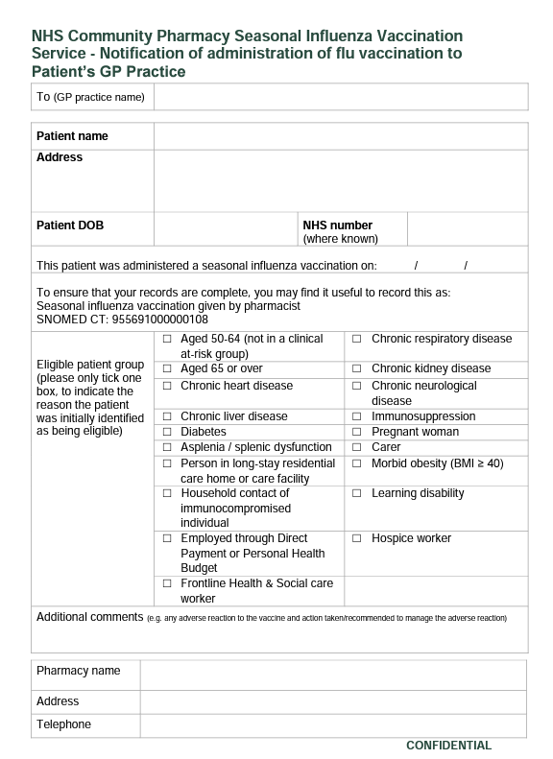
Communicating with GP practices
Pharmacies must send a notification to GP practices of patients who have been vaccinated in the pharmacy, so medical records can be updated
Sent on the same day as vaccination or on the following working day
A national GP Practice Notification Form is available, however, generally electronic notifications are now sent to the patient’s GP practice

Slide 17
Community Pharmacist Consultation Service (CPCS)

Slide 18
CPCS
The service commenced in October 2019
It aims to relieve pressure on the wider NHS by connecting patients with community pharmacy
It is part of a series of steps to get the public to view pharmacy as their first port of call for healthcare needs
It can deliver a swift, convenient and effective service to meet patient needs

Slide 19
CPCS
It connects patients who have a minor illness or need an urgent supply of a medicine with a community pharmacy
Referrals come from NHS 111 (telephony and online for requests for urgent supply), Integrated Urgent Care Clinical Assessment Services and in some cases, patients are referred via the 999 service
In March 2023, referrals will also be accepted from Urgent and Emergency Care settings
Since November 2020, general practices can refer patients for a minor illness consultation via CPCS, once a local referral pathway has been agreed

Slide 20
CPCS
In June 2022, more than 118k people received CPCS; these are patients who might otherwise have gone to see a GP
The CPCS provides the opportunity for community pharmacy to play a bigger role than ever within the urgent care system
Community pharmacy teams are not permitted to actively promote CPCS to patients as NHS England’s intention is that the service is only used by patients for urgent cases
It is therefore unlikely that GP practice teams will see this service being advertised by community pharmacies
Ref: NHS England website, High street pharmacists treat thousands more people for minor illnesses. 6th October 2022

Slide 21
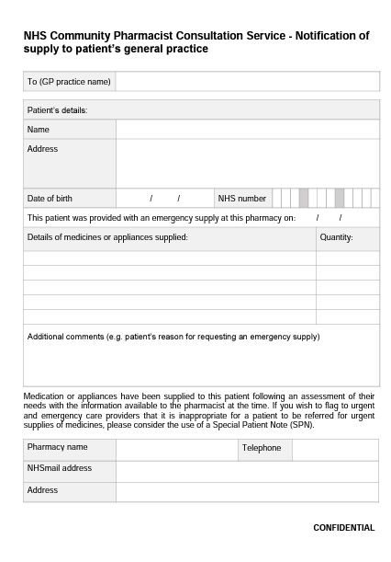
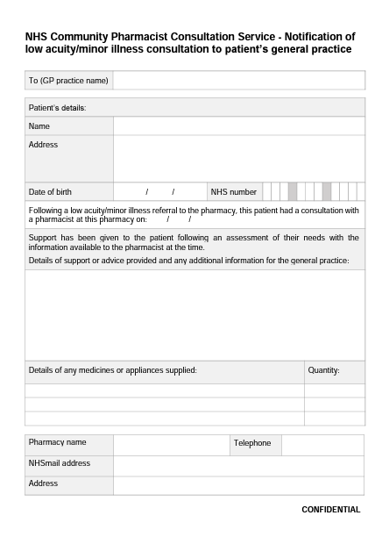
Communicating with GP practices
If a community pharmacist does make an urgent supply of a medicine or appliance under the CPCS, they are required to notify the patient’s GP practice on the day the supply is made or on the following working day

Slide 22
GP referral pathway to CPCS
GPs can refer patients to community pharmacies to receive a CPCS consultation for minor illness
Unlike NHS 111, GPs cannot refer patients for an urgent supply of a medicine or appliance
There must first be local discussions to agree how the referral pathway will work
Discussions will involve pharmacy owners, the PCN and the member general practices, the NHS and the Local Pharmaceutical Committee

Slide 23
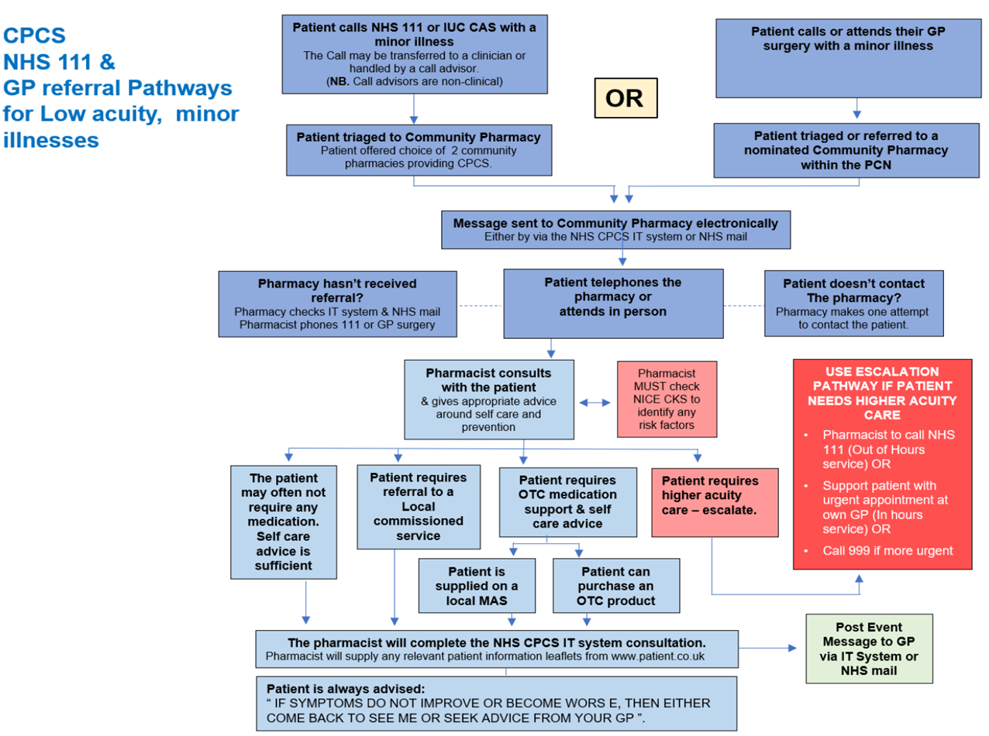

Slide 24
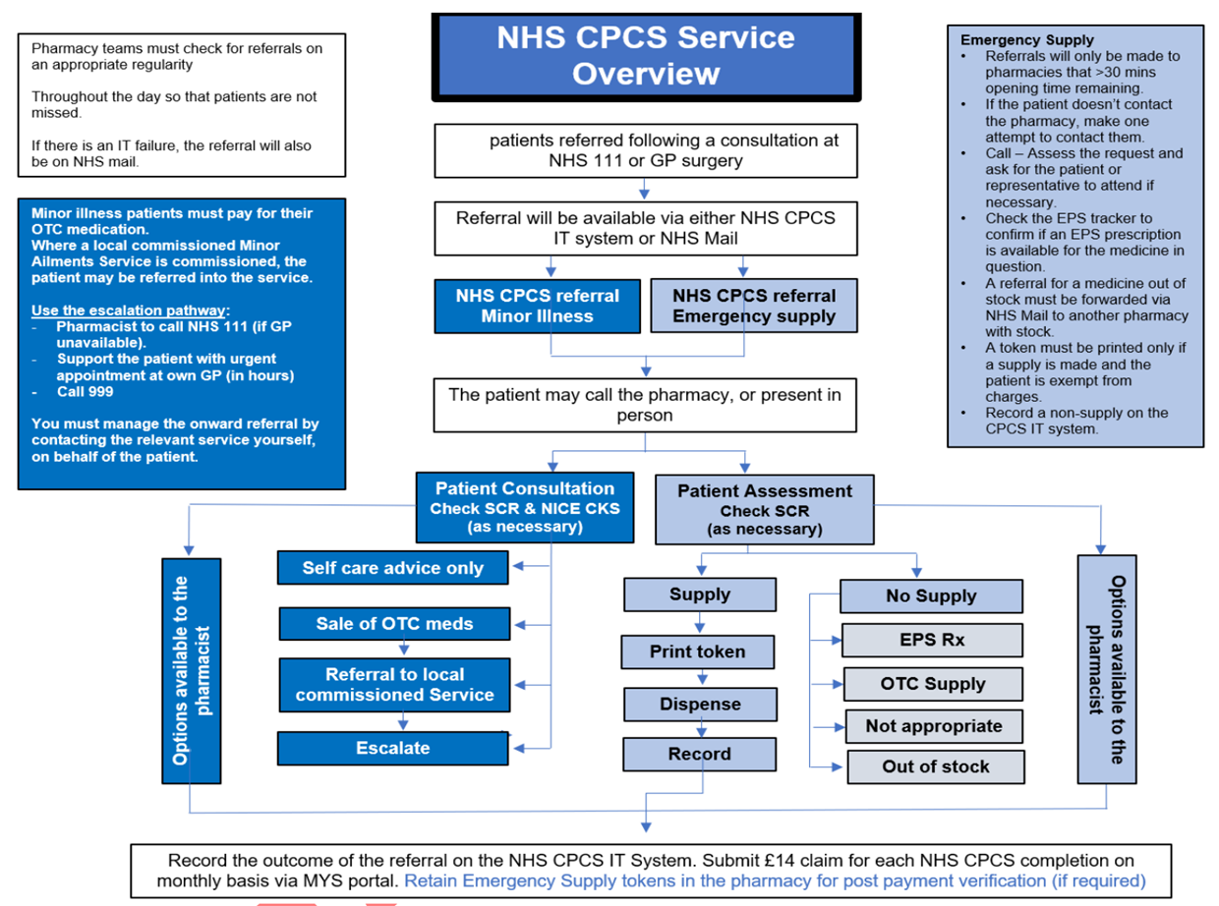

Slide 25
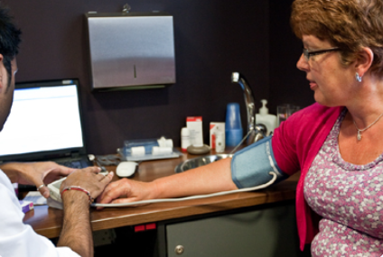
Hypertension Case-Finding Service (Blood Pressure Checks Service)

Slide 26
Hypertension Case-Finding Service
Early detection of hypertension is vital
Evidence that community pharmacy can provide a key role in detection and subsequent treatment of hypertension
Estimated 5.5 million people have undiagnosed hypertension across the country
Community pharmacy engagement has the potential to improve outcomes and reduce the burden on general practices
Levels of detection have fallen over the past few years due to the impact of COVID-19 on routine blood pressure monitoring

Slide 27
Hypertension Case-Finding Service
The service commenced in October 2021
The service aims to:
Identify people with high blood pressure aged 40 years or older (who have previously not had a confirmed diagnosis of hypertension), and to refer them to general practice to confirm diagnosis and for appropriate management
At the request of a general practice, undertake ad hoc clinic and ambulatory blood pressure measurements
Provide another opportunity to promote healthy behaviours to patients
Currently, only pharmacists can provide the service, but the service specification is being amended to allow pharmacy technicians to deliver the service to make best use of their skill-mix

Slide 28
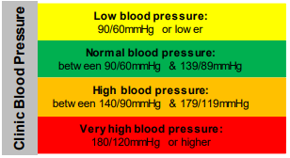
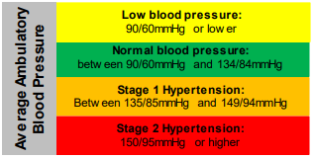
Hypertension Case-Finding Service
Two stages:
Stage 1 - identify people at risk of hypertension – ‘Clinic check’
Stage 2 - 24-hour ambulatory blood pressure monitoring (ABPM)

Slide 29
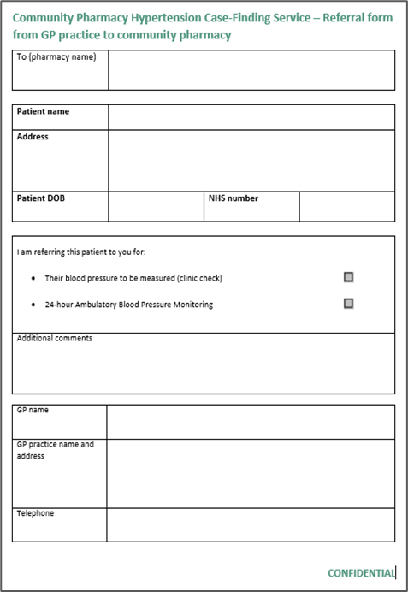
GP practice referrals
Can refer patients for both normal BP checks and ABPM
Need a locally agreed process
No specific requirements for the process
ABPM referrals best done electronically
Template referral form available

Slide 30
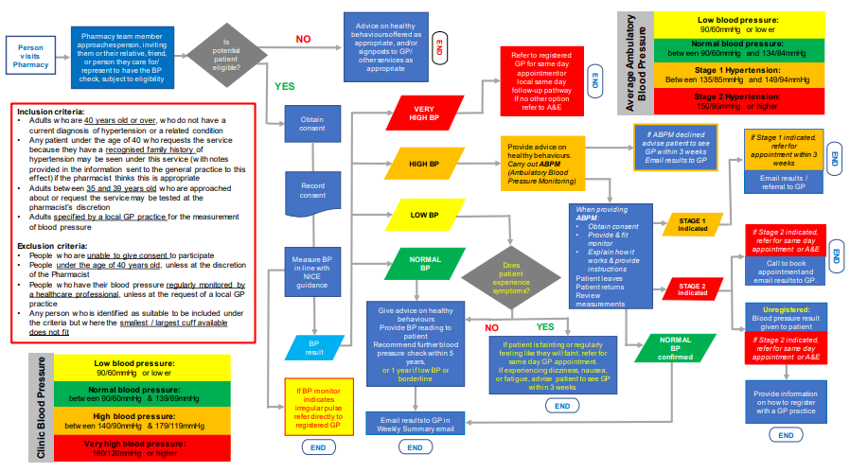
Service pathway

Slide 31
Advice on healthy behaviours offered as appropriate, and/or signposts to GP/ other services as appropriate
Average Ambulatory Blood Pressure
Low blood pressure:
90/60mmHg or lower
Pharmacy team member approaches person, inviting them or their relative, friend, or person they care for/ represent to have the BP check, subject to eligibility
Is potential patient eligible?
NO
Person visits Pharmacy
END
Normal blood pressure:
between 90/60mmHg and 134/84mmHg
Refer to registered GP for same day appointment or
local same day follow-up pathway
If no other option refer to A&E
Stage 1 Hypertension:
Between 135/85mmHg and 149/94mmHg
YES
END
VERY HIGH BP
Stage 2 Hypertension:
150/95mmHg or higher
Inclusion criteria:
Adults who are 40 years old or over, who do not have a current diagnosis of hypertension or a related condition
Any patient under the age of 40 who requests the service because they have a recognised family history of hypertension may be seen under this service (with notes provided in the information sent to the general practice to this effect) if the pharmacist thinks this is appropriate
Adults between 35 and 39 years old who are approached about or request the service may be tested at the pharmacist’s discretion
Adults specified by a local GP practice for the measurement of blood pressure
Exclusion criteria:
People who are unable to give consent to participate
People under the age of 40 years old, unless at the discretion of the Pharmacist
People who have their blood pressure regularly monitored by a healthcare professional, unless at the request of a local GP practice
Any person who is identified as suitable to be included under the criteria but where the smallest / largest cuff available does not fit
Obtain consent
If ABPM declined advise patient to see GP within 3 weeks
Email results to GP
If Stage 1 indicated, refer for appointment within 3 weeks
Provide advice on healthy behaviours.
Carry out ABPM (Ambulatory Blood Pressure Monitoring)
HIGH BP
END
Record consent
Email results / referral to GP
LOW BP
When providing ABPM:
Obtain consent
Provide & fit monitor
Explain how it works & provide instructions
Patient leaves
Patient returns
Review measurements
STAGE 1 indicated
If Stage 2 indicated, refer for same day appointment or A&E
Measure BP in line with NICE guidance
NORMAL BP
Does patient experience symptoms?
END
Call to book appointment and
email results to GP.
STAGE 2 indicated
Give advice on healthy behaviours
Provide BP reading to patient
Recommend further blood pressure check within 5 years,
or 1 year if low BP or borderline
Unregistered:
Blood pressure result given to patient
NO
YES
BP result
If patient is fainting or regularly feeling like they will faint, refer for same day GP appointment.
If experiencing dizziness, nausea, or fatigue, advise patient to see GP within 3 weeks.
NORMAL BP confirmed
If Stage 2 indicated, refer for same day appointment or A&E
Clinic Blood Pressure
Low blood pressure:
90/60mmHg or lower
Normal blood pressure:
between 90/60mmHg & 139/89mmHg
If BP monitor indicates irregular pulse refer directly to registered GP
Provide information on how to register with a GP practice
END
High blood pressure:
between 140/90mmHg & 179/119mmHg
Email results to GP in Weekly Summary email
Very high blood pressure:
180/120mmHg or higher
END
END
END

Slide 32
Smoking Cessation Service (SCS)

Slide 33
SCS
Commissioned from March 2022
Allows NHS trusts to undertake a transfer of care on patient discharge, referring patients (where they consent) to a community pharmacy of their choice to continue their smoking cessation treatment, including providing medication and support as required
Based on the Ottawa Model of Smoking Cessation
Currently, only pharmacists can provide the service, but the service specification is being amended to allow pharmacy technicians to deliver the service to make best use of their skill-mix

Slide 34
SCS
Pharmacists should follow the consultation structure within the NCSCT Standard Treatment Protocol for SCS, which includes:
Undertaking a CO test
Provision of behavioural support
Supply of nicotine replacement therapy (NRT)
This will be initially determined by the details of NRT supplied at discharge from hospital
The pharmacy will supply a maximum of two weeks NRT at a time
The course length should not exceed 12 weeks treatment from the defined quit date – this includes any treatment supplied to the patient while in hospital and at the point of discharge
Ref: NCSCT Standard Treatment Protocol for SCS

Slide 35
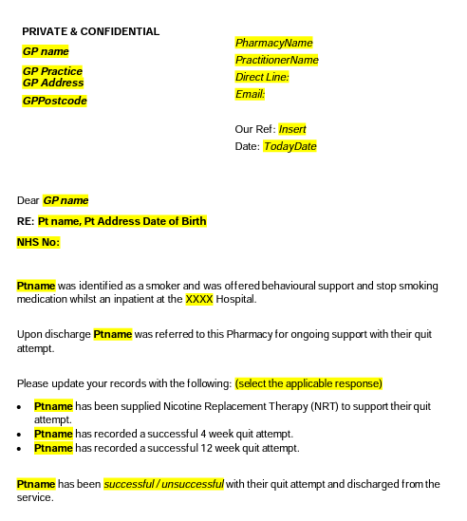
SCS – communicating with GP practices
The patient’s GP practice must be notified of the outcome of the service provision
The template outlines the data to be shared with a patient’s GP practice when they are discharged from the service

Slide 36
Appliance Use Reviews (AURs)

Slide 37
AURs
AURs aim to improve the patient’s knowledge and use of any specified appliance* by:
establishing the way the patient uses the appliance and the patient’s experience of such use
identifying, discussing and assisting in the resolution of poor or ineffective use of the appliance by the patient
advising the patient on the safe and appropriate storage of the appliance
advising the patient on the safe and proper disposal of the appliances that are used or unwanted
* Specified appliances are listed in Part IXC of the Drug Tariff

Slide 38
AURs
Any information which the pharmacist or specialist nurse considers necessary for the prescriber to be aware of, must be forwarded to the patient’s GP practice (if they are registered with one)
Any information sent to a patient’s GP practice must also be copied to any nurse who is practising with the GP and providing relevant primary medical services to the patient, if it is known that there is such a nurse

Slide 39
Stoma Appliance Customisation (SAC)

Slide 40
SAC
Involves the customisation of a quantity of more than one stoma appliance*, based on the patient’s measurements or a template
The aim of the service is to ensure proper use and comfortable fitting of the stoma appliance and to improve the duration of usage, thereby reducing waste
* Stoma appliances suitable for this service are listed in Part IXC of the Drug Tariff

Slide 41
Hepatitis C Testing Service

Slide 42
Hepatitis C Testing Service
The Community Pharmacy Hepatitis C Antibody Testing commenced in September 2020
It is focused on provision of point of care testing for Hepatitis C antibodies to people who inject drugs, i.e. individuals who inject illicit drugs, e.g. steroids or heroin, but who haven’t yet moved to the point of accepting treatment for their substance use
Where people test positive for Hepatitis C antibodies, they will be referred for a confirmatory test and treatment, where appropriate

Slide 43
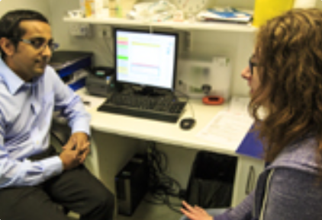
Pharmacy Contraception Service (PCS)

Slide 44
PCS Tier 1
From early 2023, a Pharmacy Contraception Service Tier 1 will be commissioned
Initially the service will involve pharmacists providing review and ongoing supply of routine oral contraception that was initiated in general practice or a sexual health clinic
The supplies will be authorised via a Patient Group Direction (PGD), with appropriate checks, such as the measurement of the patient’s blood pressure and body mass index, being undertaken, where necessary

Slide 45
PCS Tier 2
Subject to a positive evaluation of the ongoing pilot, from 4th October 2023, Tier 2 of the service will be introduced
This will enable pharmacists to also initiate oral contraception, via a PGD, and provide ongoing clinical checks and annual reviews

Slide 46
Questions, comments and
next steps

Slide 47
Further information
Questions or comments on this presentation can be addressed to the Services Team at PSNC:
services.team@psnc.org.uk
psnc.org.uk/nms | psnc.org.uk/aur
psnc.org.uk/flu | psnc.org.uk/sac
psnc.org.uk/cpcs | psnc.org.uk/hep-c
psnc.org.uk/hypertension | psnc.org.uk/pcs
psnc.org.uk/scs | psnc.org.uk/workingwithgps

