Slide 1
Read and delete this slide
This Community Pharmacy England presentation on the Pharmacy First service is for use by LPCs when running local events on the service
Further information on the service is available at cpe.org.uk/pharmacyfirst
Presenters should first read the service specification and the FAQs on the Community Pharmacy England website, and familiarise themselves with the clinical pathways, Patient Group Directions and protocol. The content of these documents/resources provide the key information and additional background knowledge for anybody giving this presentation at an event
Presenters may also want to watch the Community Pharmacy England Pharmacy First: Getting to know the service webinar available at cpe.org.uk/webinars, as this presentation is based on the PowerPoint used during the webinar
Questions or comments on this presentation can be addressed to the Services Team: services.team@cpe.org.uk ​
You can pick and choose the elements of the presentation that suit that needs of your event/discussion. There is also some text highlighted in yellow in the presentation that will need to be amended/deleted depending on the audience
Last updated: 20th December 2023

Slide 2
The Pharmacy First service

Slide 3
Presentation overview
Strategic context for the service​
Summary of the service requirements​
The clinical pathways and PGDs​
Learning and development requirements​
Preparing to provide the service​
Q&A

Slide 4
The Pharmacy First service
Community Pharmacy England submitted proposals for a Pharmacy First service to DHSC and NHSE in March 2022​
This was followed up with a comms and lobbying campaign​
On 9th May 2023, DHSC and NHSE published the Delivery plan for recovering access to primary care​
This included a commitment to commission a Pharmacy First service, allowing the treatment of seven conditions​
The start date is 31st January 2024 (subject to IT support being available)

Slide 5
The Pharmacy First service
New Advanced service (therefore optional) that will include seven new clinical pathways
Builds on the Community Pharmacist Consultation Service (CPCS), which most pharmacies provide – expectation is that most pharmacies will choose to provide the extended Pharmacy First service
The service will consist of three elements:
Referrals for minor illness consultations with a pharmacist
Previously part of CPCS
Urgent supply of repeat meds and appliances
Previously part of CPCS
Clinical pathway consultations
New element

Slide 6
Patient calls or attends their GP practice with a minor illness
Patient triaged and referred to a nominated community pharmacy
Message sent to community pharmacy electronically
Either by integrated IT system / standalone IT form / via NHSmail
Pharmacy hasn’t received a referral
Pharmacy checks IT system and NHSmail then contacts GP practice (or other authorised healthcare provider)
Patient telephones the pharmacy or attends in person
Patient doesn’t contact the pharmacy
Pharmacy attempts to contact patient using details provided in the referral
Referrals for minor illness consultations – how the referral process works
Pharmacist consults with patient
Checks NICE CKS and gives appropriate advice around self care and prevention
ESCALATION PATHWAY
Pharmacist calls NHS 111 (or out of hours provider)
Support patient to make appointment with GP practice
Call 999 if urgent
Patient does not require medicine, self care advice is sufficient
Patient requires referral to locally commissioned service
Patient requires OTC/PGD medicines and self care advice
Patient requires higher acute care - escalate
Product is supplied from local PGD service
Patient can purchase an OTC product
Post event message to GP practice via IT system or NHSmail
Pharmacist completes the NHS IT system consultation
Supplies relevant information leaflets and advises “If symptoms do not improve or become worse, then either come back to see me or seek advice from your GP”.

Slide 7
Urgent supply of repeat medicines and appliances
Allows pharmacists to make supplies of medicines and appliances that patients have been prescribed (repeat medicines)
The pharmacist will interview the patient requesting the item and satisfy themselves that there is an immediate need for it to be supplied and impracticable in the circumstances for the patient to obtain a prescription without undue delay
Will assess suitability and legality of making a supply and confirm they have the product in stock

Slide 8
Urgent supply of repeat medicines and appliances
If the medicine/appliance is not in stock, with the agreement from the patient, they will identify another pharmacy that provides the service (and has the item in stock) and refer the patient to this pharmacy
If it is not appropriate to make a supply, the pharmacist will ensure the patient is able to speak to another healthcare professional by either:
Referring the patient to their own general practice; or
By contacting a local out of hours provider

Slide 9
What does this mean for CPCS?
CPCS will end on 30th January 2024 and the Urgent supply of repeat meds and Referrals for minor illness consultations with a pharmacist elements of CPCS will become part of the Pharmacy First service from 31st January 2024
Authorised referring organisations (NHS 111, 999 service, GP practices, primary care out of hours service or an UEC setting) can still formally refer patients for these two elements (although GP practices cannot make referrals for the Urgent supply of repeat meds element (as is the case with CPCS) – must be sent via a secure digital route; verbal/telephone referrals are not allowed
Patients will not be able to walk-in to a pharmacy and access these parts of the service (self-refer); needs to be a referral from an authorised referring organisation

Slide 10
Clinical pathway consultations (new element)

Slide 11
Clinical pathway consultations
Involves pharmacists providing advice and NHS-funded treatment, where clinically appropriate for seven common conditions:
Sinusitis
12 years and over
Sore throat
5 years and over
Acute otitis media
1 to 17 years
Infected insect bite
1 year and over
Impetigo
1 year and over
Shingles
18 years and over
Uncomplicated UTI
Women 16 to 64 years

Slide 12
Clinical pathway consultations
Authorised referring organisations can formally refer patients for this part of the service
Clinical pathways consultations can be provided remotely, except for the acute otitis media pathway (otoscope required)
Remote consultations must be via high-quality video link
Pharmacies opting-in must provide all three elements of the new service
There are no changes to the former CPCS elements of the service, e.g. referrals are still required and telephone consultations are still possible, where clinically appropriate

Slide 13
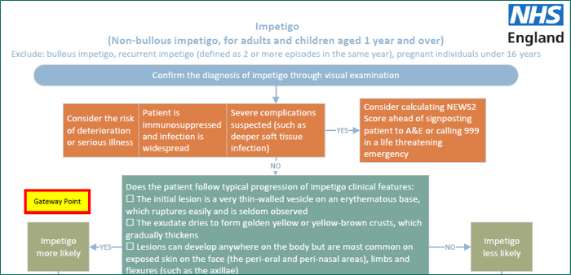
Clinical pathways consultations
Service spec and seven clinical pathways developed
23 associated PGDs and one clinical protocol (P med)
The clinical pathways contain one or more Gateway points
For a patient to be eligible to receive a clinical pathways consultation, a Gateway point must be passed

Slide 14
High-level service overview
Referral
Referral
Referral
Patient presents to the pharmacy
Gateway
met
Urgent repeat meds referral
Minor illness referral
Clinical pathway referral
Gateway
met
Gateway
not met
Gateway
not met
Urgent repeat meds consultation
Minor illness consultation
Clinical pathway consultation
Self-care Essential service
A more detailed service pathway diagram can be found in Annex A of the service spec

Slide 15
The service requirements
Pharmacy must have a consultation room, with access to IT equipment for record keeping​
Must have an otoscope (for acute otitis media clinical pathway) – except distance selling pharmacies who cannot provide this pathway
With consent, the patient’s GP record (e.g. via GP Connect Access Record), national care record or an alternative clinical record for the patient, must be checked by the pharmacist unless there is good reason not to do so
Must have an NHS-assured clinical IT system​
Where supplies of an NHS medicine are made, the normal prescription charge rules apply
From April 2024, an initial cap of 3,000 consultations per month per pharmacy will be put in place

Slide 16
Funding
Funding for the clinical pathways consultations comes from the additional £645m provided to support the recovery plan
Initial fixed payment of £2,000
Must sign-up to provide the service on MYS by 11.59pm on 30th January 2024
The payment will be reclaimed if 5 clinical pathways consultations are not provided by the end of March 2024
£15 fee per completed consultation (also applies to CPCS consultations from 1st Jan 2024)

Slide 17
Funding
A monthly fixed payment of £1,000 where the pharmacy meets a minimum number of clinical pathways consultations:
From April 2024, an initial cap of 3,000 consultations per month per pharmacy will be put in place
From October 2024, new caps will be introduced based on actual provision of clinical pathway consultations, designed to deliver 3 million consultations per quarter
Month | Minimum number of clinical pathways consultations
February 2024 | 1
March 2024 | 5
April 2024 | 5
May 2024 | 10
June 2024 | 10
July 2024 | 10
August 2024 | 20
September 2024 | 20
October 2024 onwards | 30

Slide 18
The clinical pathways and PGDs

Slide 19
Clinical pathway consultations
The clinical pathways element will enable the management of common infections by community pharmacies through offering self-care, safety netting advice, and only if appropriate, supplying a restricted set of medicines to complete episodes of care for seven common conditions
NHSE commissioned SPS to develop patient group directions (PGDs) and a protocol for the Pharmacy First service
The final PGDs and protocol, published on the NHS England website, have received national approval from the National Medical Director, Chief Pharmaceutical Officer and National Clinical Director for IPC & AMR
Pharmacists cannot deviate from the clinical pathways and PGDs

Slide 20
Development of clinical pathways
Multi-professional expert working group to develop robust clinical pathways for each of the 7 conditions
Adherence to NICE guidelines
National template for PGDs developed by SPS
Pharmacy Quality Scheme antimicrobial stewardship foundation
AMR Programme Board Oversight National Medical Director and Chief Medical Officer for England

Slide 21
Monitoring and surveillance
NHSE will closely monitor the Pharmacy First service post-launch to allow for robust oversight and monitor for any potential impact on antimicrobial resistance so that any needed mitigations can be quickly actioned
NHSE is working with NHSBSA to enable pharmacy reimbursement and functionality for PGD supply to be recorded via ePACT2 data, or in a parallel dashboard
NIHR will commission an evaluation of Pharmacy First services considering implications for antimicrobial resistance

Slide 22
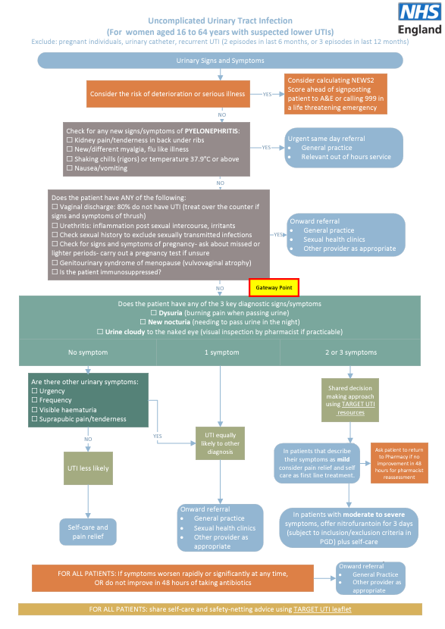

Slide 25
Notifications and referrals to general practice

Slide 26
Notifications and referrals
A patient’s general practice will be notified on the day of provision of the service or on the following working day
If a patient needs an in-hours appointment with their GP practice, after agreeing this course of action, the pharmacist should contact the patient’s GP practice to secure them an appointment
If known that a patient has used the service more than twice within a month, with the same symptoms and no indication for urgent referral, pharmacists will consider referring the patient to their general practice

Slide 27
Learning and development for pharmacists

Slide 28
Learning and development
Pharmacy First self-assessment framework – developed by the Centre for Pharmacy Postgraduate Education and NHSE
Additional training options highlighted on CPPE website including ENT clinical assessment skills workshop
Personal development action plan
Clinical examination training also available funded by NHSE
Lots of support to upskill and give pharmacists the confidence to offer this service

Slide 29
Expansion of other services

Slide 30
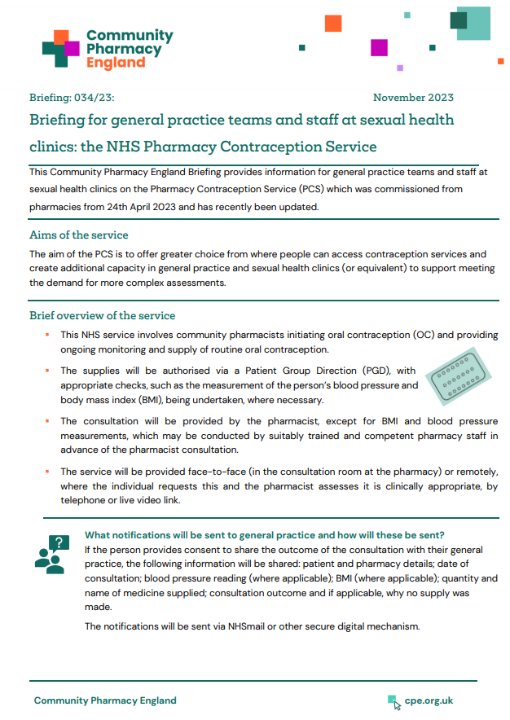
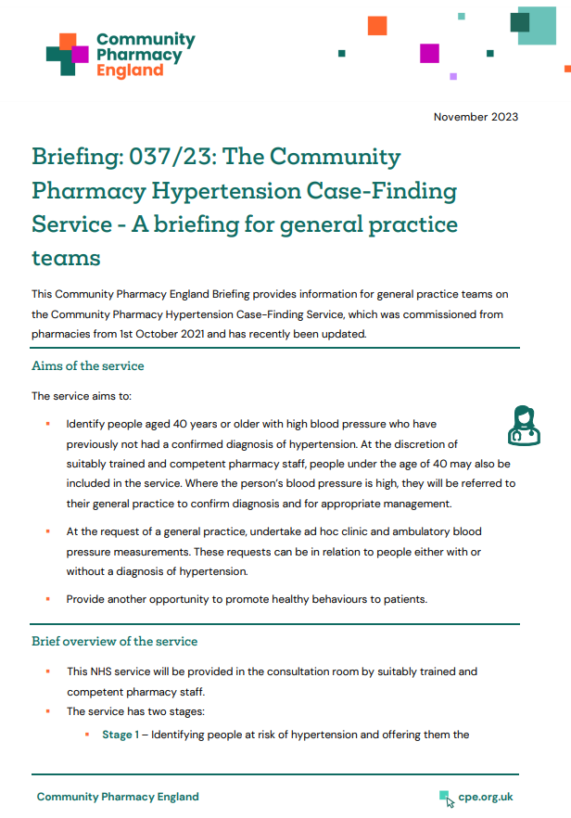
Expansion of other services
From 1st December 2023:
The Pharmacy Contraception Service was expanded to allow pharmacists to also initiate oral contraception (OC)
Previously they were only able to provide ongoing monitoring and repeat supplies of OC when this had been initiated at a GP practice or sexual health clinic
The Hypertension Case-Finding Service was expanded to allow suitably trained and competent pharmacy staff to provide the service
Previously only pharmacists and pharmacy technicians could provide the service
General practice briefings available at cpe.org.uk/briefings

Slide 31
Community Pharmacy England webinars
[May be relevant to highlight, will depend on the audience of the event]
CPE Pharmacy First webinars:
Getting to know the service recorded version available
Getting ready for launch – 15th Jan [What to say about this webinar, will be dependent on when the LPC event is held, will be either: bookings are full, but a recorded version will be available after the event OR recorded version available/available soon]
cpe.org.uk/webinars

Slide 32
Questions cpe.org.uk/pharmacyfirst

