Slide 1
Read and delete this slide
This Community Pharmacy England presentation on the Pharmacy First service is for use by LPCs when running local events on the service
Further information on the service is available at cpe.org.uk/pharmacyfirst
Presenters should first read the service specification and the FAQs on the Community Pharmacy England website, and familiarise themselves with the clinical pathways, Patient Group Directions and protocol. The content of these documents/resources provide the key information and additional background knowledge for anybody giving this presentation at an event
Presenters may also want to watch the Community Pharmacy England Pharmacy First: Getting to know the service webinar available at cpe.org.uk/webinars, as this presentation is based on the PowerPoint used during the webinar
Questions or comments on this presentation can be addressed to the Services Team: services.team@cpe.org.uk ​
You can pick and choose the elements of the presentation that suit that needs of your event/discussion. There is also some text highlighted in yellow in the presentation that will need to be amended/deleted depending on when the local event is held, availability of other local training events, etc
Last updated: 20th December 2023

Slide 2
Pharmacy First: Getting to know the service

Slide 3
Presentation overview
Strategic context for the service​
Summary of the service requirements​
The clinical pathways and PGDs​
Learning and development requirements​
Preparing to provide the service​
Q&A

Slide 4
The Pharmacy First service
Community Pharmacy England submitted proposals for a Pharmacy First service to DHSC and NHSE in March 2022​
This was followed up with a comms and lobbying campaign​
On 9th May 2023, DHSC and NHSE published the Delivery plan for recovering access to primary care​
This included a commitment to commission a Pharmacy First service, allowing the treatment of seven conditions​
The start date is 31st January 2024 (subject to IT support being available)

Slide 5
The Pharmacy First service
Pharmacy First will be a new Advanced service that will include seven new clinical pathways and will replace the Community Pharmacist Consultation Service (CPCS)
The service will consist of three elements:
Clinical pathway consultations
new element
Urgent supply of repeat meds and appliances
previously part of CPCS
Referrals for minor illness consultations
previously part of CPCS

Slide 6
What are the seven conditions?
Sinusitis
12 years and over
Sore throat
5 years and over
Acute otitis media
1 to 17 years
Infected insect bite
1 year and over
Impetigo
1 year and over
Shingles
18 years and over
Uncomplicated UTI
Women 16 to 64 years

Slide 7
The Pharmacy First service
Pharmacies opting-in must provide all three elements of the new service
Patients can present to the pharmacy for clinical pathways consultations (only)
Clinical pathways consultations can be provided remotely, except for the acute otitis media pathway (otoscope required)
Remote consultations must be via high-quality video link
DSPs can only provide clinical pathways consultations remotely (due to the link to Essential services)
They cannot provide the acute otitis media pathway (otoscope required)
There are no changes to the former CPCS elements of the service, e.g. referrals are still required and telephone consultations are still possible, where clinically appropriate

Slide 8
Summary of the service requirements

Slide 9
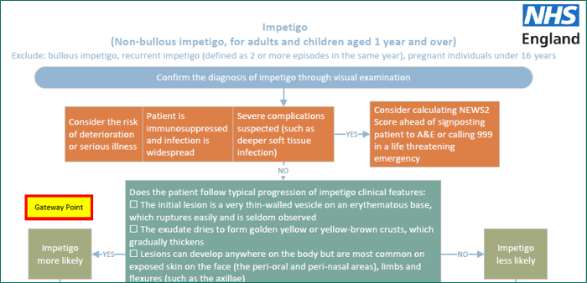
Clinical pathways consultations
Service spec and seven clinical pathways developed
23 associated PGDs and one clinical protocol (P med)
The clinical pathways contain one or more Gateway points
For a patient to be eligible to receive a clinical pathways consultation, a Gateway point must be passed

Slide 10
High-level service overview
Referral
Patient presents to the pharmacy
Gateway
met
Urgent repeat meds referral
Minor illness referral
Clinical pathway referral
Gateway
met
Gateway
not met
Gateway
not met
Urgent repeat meds consultation
Minor illness consultation
Clinical pathway consultation
Self-care Essential service
A more detailed service pathway diagram can be found in Annex A of the service spec

Slide 11
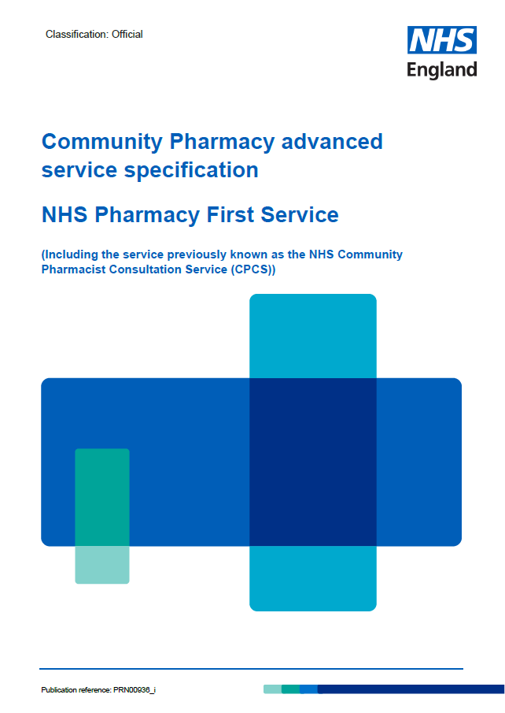
The service requirements
Complying with Terms of Service requirements for Essential services and clinical governance​
Have a consultation room meeting the ToS requirements, with access to IT equipment for record keeping​
Equipment – otoscope – see buying advice in Annex C​
Standard operating procedure, including the process for escalation​
Competency and training requirements​
Have an NHS-assured clinical IT system​
Sign-up to provide the service on MYS​
Where supplies of an NHS medicine are made, the normal prescription charge rules apply

Slide 12
Funding
Funding for the clinical pathways consultations comes from the additional £645m provided to support the recovery plan
Initial fixed payment of £2,000
Must sign-up to provide the service on MYS by 11.59pm on 30th January 2024
Claims submitted by 11.59pm on 31st Dec 2023 will be paid on 1st February 2024
Claims submitted by 11.59pm on 30th Jan 2024 will be paid on 1st March 2024
The payment will be reclaimed if 5 clinical pathways consultations are not provided by the end of March 2024
£15 fee per completed consultation (also applies to CPCS consultations from 1st Jan 2024)

Slide 13
Funding
A monthly fixed payment of £1,000 where the pharmacy meets a minimum number of clinical pathways consultations:
From April 2024, an initial cap of 3,000 consultations per month per pharmacy will be put in place
From October 2024, new caps will be introduced based on actual provision of clinical pathway consultations, designed to deliver 3 million consultations per quarter
Month | Minimum number of clinical pathways consultations
February 2024 | 1
March 2024 | 5
April 2024 | 5
May 2024 | 10
June 2024 | 10
July 2024 | 10
August 2024 | 20
September 2024 | 20
October 2024 onwards | 30

Slide 14
The clinical pathways and PGDs

Slide 15
Clinical pathway consultations
The clinical pathways element will enable the management of common infections by community pharmacies through offering self-care, safety netting advice, and only if appropriate, supplying a restricted set of medicines to complete episodes of care for seven common conditions
NHSE commissioned SPS to develop patient group directions (PGDs) and a protocol for the Pharmacy First service
The final PGDs and protocol, published on the NHS England website, have received national approval from the National Medical Director, Chief Pharmaceutical Officer and National Clinical Director for IPC & AMR

Slide 16
Development of clinical pathways
Multi-professional expert working group to develop robust clinical pathways for each of the 7 conditions
Adherence to NICE guidelines
National template for PGDs developed by SPS
Pharmacy Quality Scheme antimicrobial stewardship foundation
AMR Programme Board Oversight National Medical Director and Chief Medical Officer for England

Slide 17
Monitoring and surveillance
NHSE will closely monitor the Pharmacy First service post-launch to allow for robust oversight and monitor for any potential impact on antimicrobial resistance so that any needed mitigations can be quickly actioned
NHSE is working with NHSBSA to enable pharmacy reimbursement and functionality for PGD supply to be recorded via ePACT2 data, or in a parallel dashboard
NIHR will commission an evaluation of Pharmacy First services considering implications for antimicrobial resistance

Slide 18
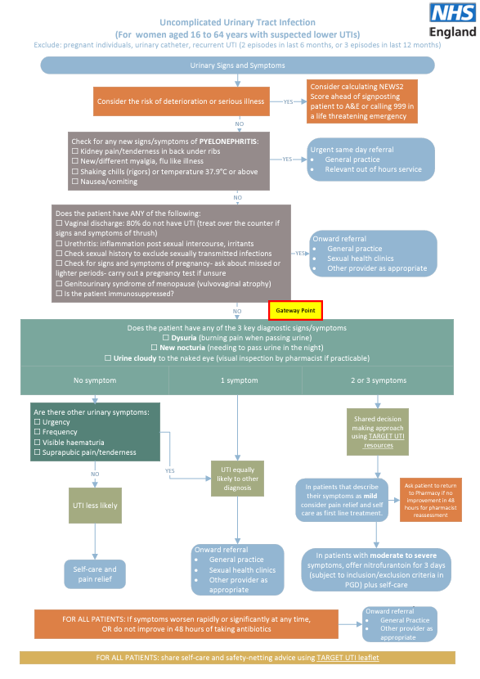

Slide 21
PGDs
Pharmacists need to read all 23 PGDs and protocol
Draft PGDs and protocol published on 1st December 2023 to help pharmacists and pharmacy owners start to prepare
Pharmacists must read and sign the final versions of the PGDs and protocol, rather than the draft versions
Draft versions are not signed by NHSE – do not provide authorisation to supply medicines at NHS expense for the Pharmacy First service

Slide 22
Learning and development requirements

Slide 23
Learning and development
CPPE webpage detailing training resources
www.cppe.ac.uk/services/pharmacy-first/
Pharmacy First self-assessment framework – developed by CPPE and NHSE
Personal development action plan

Slide 24
Learning and development
NHSE funded training by Cliniskills
Clinical examination skills includes e-learning and face-to-face training [LPCs can add relevant local training dates from the website]
Otoscope training webinar 18th January 2024, 6-7.30pm [remove if date passed/webinar full when LPC event is held]
www.cliniskills.com/community-pharmacists/
CPE Pharmacy First webinars:
Getting to know the service recorded version available
Getting ready for launch – 15th Jan [What to say about this webinar, will be dependent on when the LPC event is held, will be either: bookings are full, but a recorded version will be available after the event OR recorded version available/available soon]

Slide 25
Preparing to provide the service

Slide 26
Preparing to provide the service
Download and read the service specification and clinical pathways​
If you then want to provide the service from the start date, sign up on MYS – preferably by 31st December 2023​
Place an order for an otoscope​
Download and start​
reading the PGDs and​
clinical protocol

Slide 27
Preparing to provide the service
Start considering which IT system you want to use and look into costs and contracting​
Provide an initial briefing on the service for your staff​
Create a training plan with pharmacists who will provide the service (using the CPPE self-assessment), including ensuring they know how to use an otoscope​
Check our LPC website for details of any local training sessions​
Start to develop an SOP or update your CPCS SOP

Slide 28
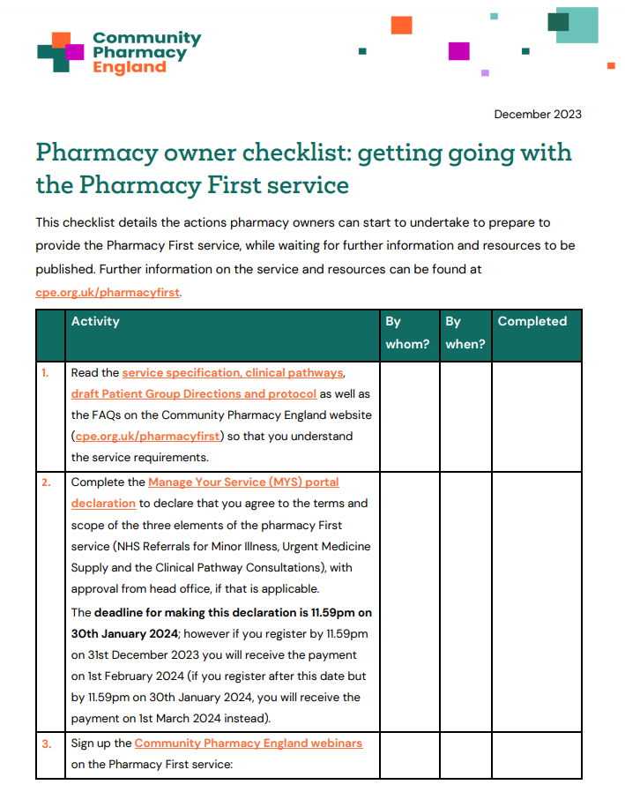
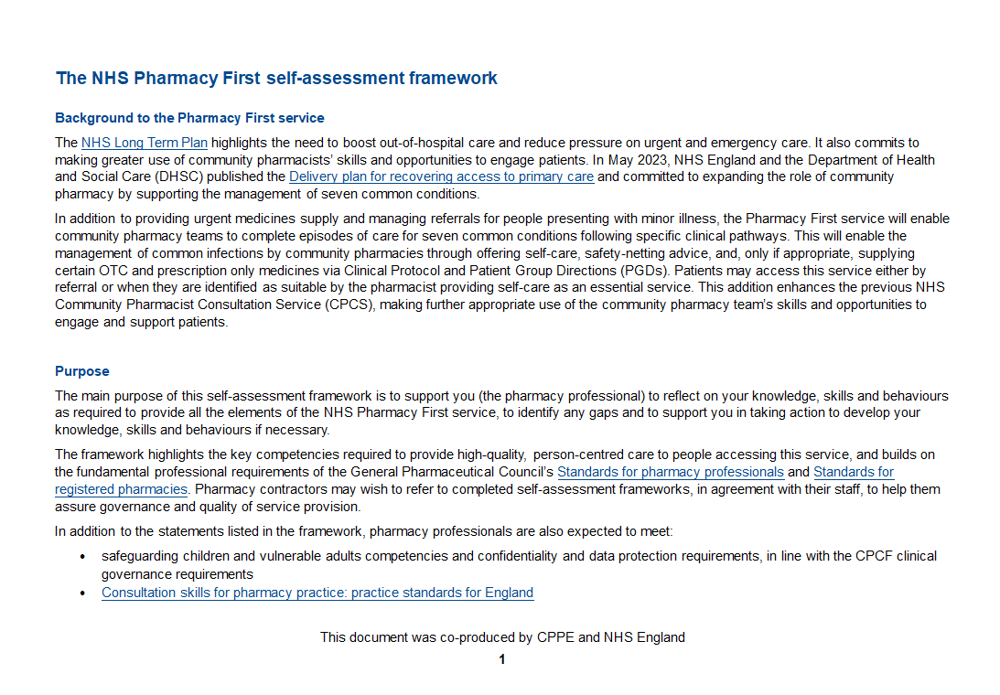
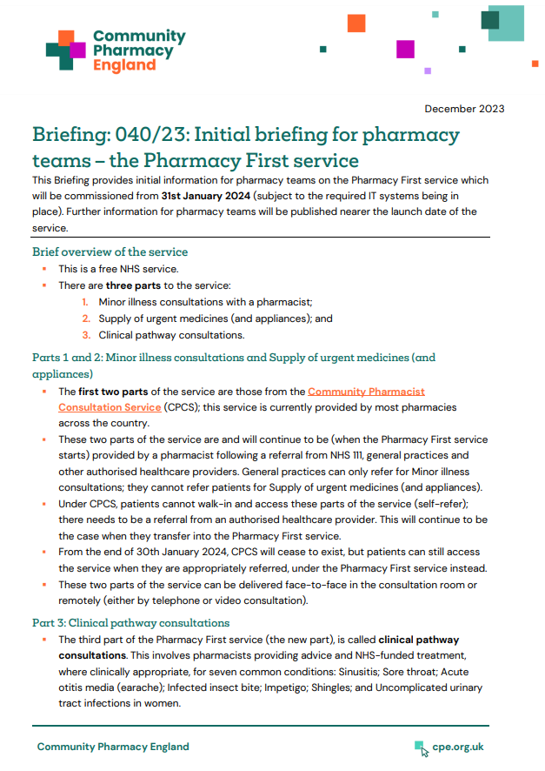
Resources to help you get ready
Checklists of things to do to prepare for the service for pharmacy owners and pharmacists​
The CPCS toolkit is being updated to cover the new service​
CPPE Pharmacy First webpage and self-assessment framework​
Cliniskills training modules and locally organised training options​
Summary briefing for pharmacy team members

Slide 29
Promoting the service
NHS England is developing a marketing campaign for the service
LPCs are starting to brief Local Medical Committees and general practices about the service
A briefing for LMCs and general practice teams is available at cpe.org.uk/pharmacyfirst
Further resources are being developed by Community Pharmacy England to help you and LPCs to promote the service to patients, the public and local stakeholder organisations

Slide 30
Questions cpe.org.uk/pharmacyfirst

