Slide 1
Read and delete this slide
This Community Pharmacy England presentation on the Pharmacy Contraception Service is for use by pharmacy owners/teams when presenting on the Pharmacy Contraception Service to GP practice and sexual health clinic teams
Further information on the service is available at cpe.org.uk/PCS
Presenters should first read the service specification and the FAQs on the Community Pharmacy England website and familiarise themselves with the Patient Group Directions. The content of these documents/resources provide the key information and additional background knowledge for anybody giving this presentation at an event
Presenters may also want to watch the Community Pharmacy England Pharmacy Contraception Service: Getting going with the service webinar available at cpe.org.uk/webinars, as this presentation is based on the PowerPoint used during the webinar
Questions or comments on this presentation can be sent to the Services Team: services.team@cpe.org.uk ​
You can pick and choose the elements of the presentation that suit the needs of your event/discussion. There is also some text highlighted in yellow in the presentation that will need to be amended/deleted depending on the audience
Last updated: 13th March 2025

Slide 2
The Pharmacy Contraception Service
[Name of presenter]

Slide 3
Presentation overview
Strategic context for the service​​
What does this mean for general practices and sexual health clinics
Overview of the service
Summary of the service requirements​​
The PGDs​​, the consultation & outcomes
Notifications to general practice
Learning and development for pharmacists​​
Q&A

Slide 4
Strategic context for the service……
Aim of the service is to:
Offer greater choice from where people can access contraception services
Create additional capacity in primary care and sexual health clinics to support meeting the demand for more complex assessments
Support addressing health inequalities by providing wider healthcare access
Signposting service users to local sexual health services
Delivery Plan for recovering access in primary care (May 2023) highlighted expansion of the service to increase access to and convenience of contraception services in line with the Government’s Women’s Health Strategy for England (August 2022)
Notes:
NHS England commenced a pilot in 2021.
This involved pharmacies offering repeat supplies of oral contraception to people who had previously had the product prescribed.
Pilot of Tier 2 commenced in October 2022
In April 2023 following negotiations the Tier 1 service was launched
Due to concerns from the CPE committee, which were shared with Ministers, that there is not enough money to pay for the current services and dispensing delivered by the sector, no additional support material was produced to support the launch of the service.
In May 2023. the Delivery Plan for recovering access to primary care was published.
This included a commitment to increase provision of the PCS and the Hypertension Case-Finding Service and proposed additional funding to support this.
After negotiations between Community Pharmacy England, NHSE and DHSC, we have agreed to launch expansion of PCS on 1st December 2023.
The development does not stop there. NHSE has a commitment to look at Independent Prescribing as an alternative to PGDs as part of the IP pathfinder programme.
Work is also underway to scope out a service for what was proposed to be Tier 3 –ongoing management and supply of LARCs.
Proposal to test a contraception service
NHS England proposed a tiered approach to development of the service and increasing level of specialism

Slide 5
The Pharmacy Contraception Service
Advanced service (therefore optional) ​
Over 81% (consider stat for local coverage) of pharmacies nationally have signed up to provide the service​​ (January 2025)
The service consists of:
Supply via patient group direction (PGD)
Blood pressure and Body Mass Index measured (where clinically applicable)
Provided by pharmacists
2
On-going supply
3
Review
1
Initiation

Slide 6
What does this mean for practice / clinic appointments?
Aim is to work together to reduce workload at the practice / clinic
General practices and sexual health clinics can:
Still provide consultations for contraception and review on-going contraception needs – may want to focus on more complex cases
Opt to signpost or electronically refer individuals (recommended) to the pharmacy service for a consultation with a pharmacist
Referrals where made, must be sent via a secure digital route
Individuals will be able to walk-in to a pharmacy and access the service

Slide 7
Why formal referrals are recommended
Reassures patients that their concern / request has been taken seriously and the pharmacist will be expecting the patient​
If signposted, the patient may feel they are being ‘fobbed off’ and be unsatisfied with the service provided by the GP practice ​and the pharmacy as they won’t be expecting the patient
Patient will be sent to a pharmacy providing the service​
If signposted, patients may have to figure out themselves who is providing the service (the referral route should provide a more joined-up patient journey)​
There is an auditable trail of referral
If signposted there is no way to confirm that the individual’s need was met
If the patient does not contact the pharmacy, the pharmacy team will follow up with the patient
If signposted, this will not happen as the pharmacy won’t be aware that the patient was meant to visit the pharmacy

Slide 8
Why formal referrals are recommended
The pharmacy team can proactively contact the patient upon receipt of referral to arrange a time for the patient to speak to the pharmacist – beneficial to patient and pharmacy workload
If signposted, the patient may present at a time that means they may have to wait to be seen by the pharmacist
The pharmacy will receive patient information on the referral therefore ensuring they are informed of the reason for the referral
If signposted, the individual will have to talk through their request or need, provide other information again, which may be frustrating for the individual and does not present a joined-up patient journey
Referral data can show that patients are being actively supported to access appropriate care, evidencing that GP practices are meeting other PCARP requirements
If signposted, this data is not captured

Slide 9
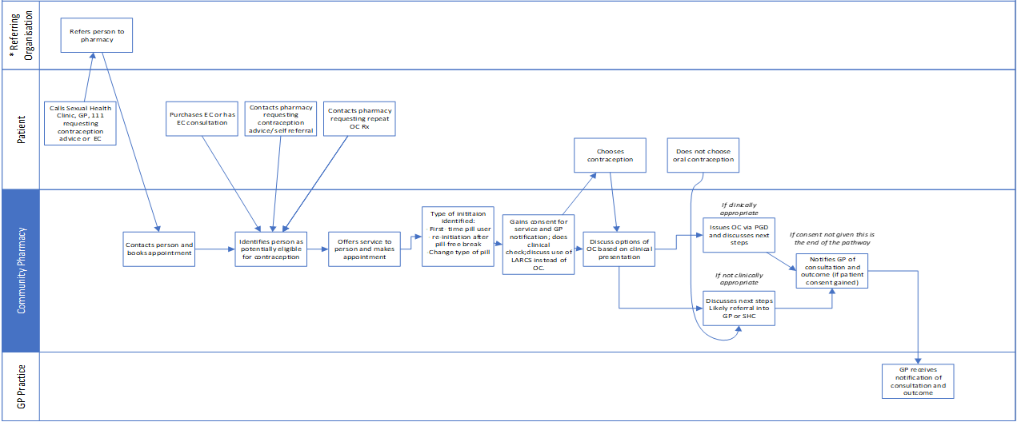
High-level service overview - initiation
*referring organisation includes primary care (e.g. GP practices and pharmacies) and Sexual Health Clinics
Initiation is:
Starting oral contraception for the first time
Needs to restart following a pill free break
A person is being switched to an alternative pill
A copy of the service pathway diagram can be found in Annex A of the service specification

Slide 10
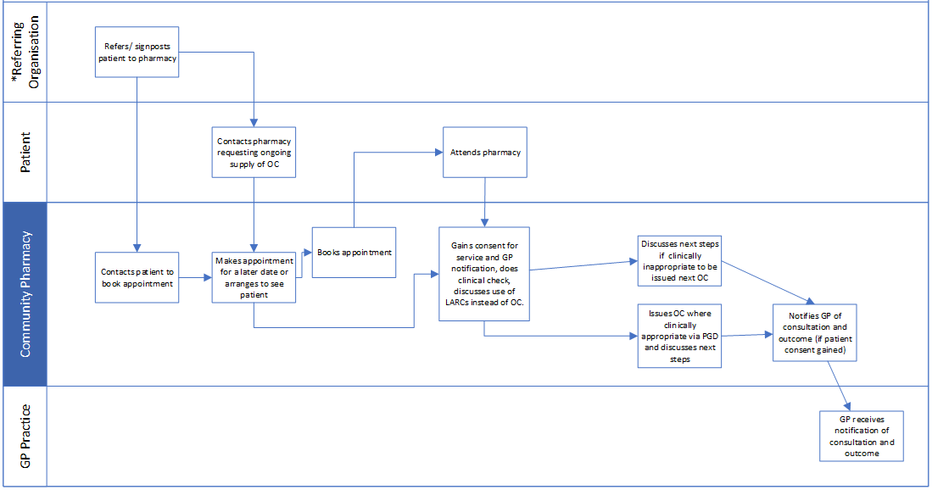
High-level service overview – Ongoing supply
*referring organisation includes primary care (e.g. GP practices and pharmacies) and Sexual Health Clinics
Ongoing supply is:
where a person has been supplied with oral contraception by a primary care provider (including general practice and pharmacies) or a sexual health clinic (or equivalent) and a subsequent equivalent supply is needed.
Their current supply of oral contraception should still be in use.
A copy of the service pathway diagram can be found in Annex A of the service specification

Slide 11
The service requirements
The pharmacy must have a consultation room, with access to IT equipment for record keeping​
Must have an NHS-assured clinical IT system​
The pharmacy must have appropriate equipment to measure a person’s blood pressure, weight and height.
Must offer consultations for both initiation of and for ongoing supply of oral contraception
Supply under a PGD must be undertaken by a pharmacist

Slide 12
The PGDs
NHS England utilised patient group directions (PGD) templates developed by the Specialist Pharmacy Service for the service
The final PGDs, published on the NHS England website, have received national approval from the National Medical Director and the Chief Pharmaceutical Officer
Pharmacists cannot deviate from the PGDs

Slide 13
The consultation
Verbal consent to receive the service is sought from the person and recorded in the pharmacy’s clinical record for the service
If the person provides consent to share the outcome of the consultation with their general practice, information will be shared
If the person does not consent to sharing information with their general practice or they are not registered with a general practice, the consultation can still proceed, and a notification to the practice will not need to be sent
Clinical appropriateness of a supply of oral contraception will be determined by the pharmacist

Slide 14
The consultation
If the pharmacist is concerned about a potential safeguarding issue, then appropriate action would be taken, where necessary, in line with local safeguarding processes
Includes a conversation with the person regarding alternative and more effective forms of contraception, e.g. Long-acting reversible contraception
If a person requires urgent escalation to another healthcare setting the pharmacist will arrange this
For combined oral contraception, a supply will require BMI and a blood pressure measurement to be taken in line with NICE guideline
A person accessing the service may also offer their own weight, height and blood pressure measurements

Slide 15
Outcomes
If the assessment criteria are met, supply of an oral contraceptive can be made
On initiation, the quantity supplied will not exceed 3 months
Following initiation, ongoing supplies can be made of up to 12 months duration
Where a person is initiated, pharmacists use their professional discretion as to the appropriate choice of product, from those included in the PGD
Wherever practicable, supply will be the best value product to meet the clinical need of the patient

Slide 16
Outcomes
Local ICB formularies/restrictions will be referred to and followed accordingly.
Ongoing supplies will be made in line with the person’s previous supply, e.g. in the instance that a branded product has been supplied for clinical reasons such as an allergy to product constituents, the ongoing supply should be made from an equivalent brand/generic equivalent
If a supply is not deemed clinically appropriate, the pharmacist will explain why this is the case to the person and refer them to their general practice or sexual health clinic (or equivalent)

Slide 17
Notifications
Where the individual consents, their general practice will be notified on the day of provision of the service or on the following working day
Where possible, sent as a structured message in real time via the NHS-assured IT system
NHSmail as a back-up

Slide 18
Learning and development
Pharmacist will have developed competence in the clinical skills and knowledge required to deliver all aspects of the service
Training undertaken from a variety of sources including from the Centre for Pharmacy Postgraduate Education and/or the NHS England e-learning for healthcare
Must complete appropriate Safeguarding level 3 training or have access to advice from someone who is Safeguarding level 3 trained
Lots of support to upskill and give pharmacists the confidence to offer this service

Slide 19
Engaging the team
Briefing available to provide information for general practice teams and local sexual health clinics (or equivalent) teams on the service
One-page infographic
Digital poster available to highlight the availability of the service from participating community pharmacies

Slide 20
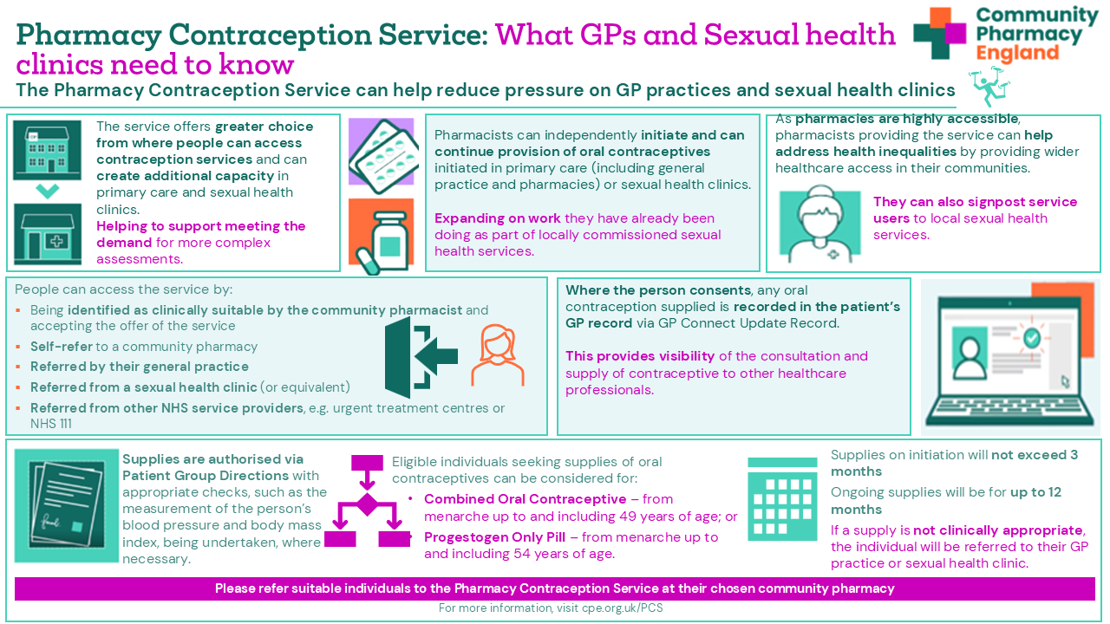
Summary

Slide 21
Questions

