Slide 1
Read and delete this slide
This Community Pharmacy England presentation on the Pharmacy Contraception Service is for use by pharmacy owners/teams when presenting on the Pharmacy Contraception Service (PCS) to patients such as at Patient Participation Groups meetings.
Further information on the service is available at cpe.org.uk/PCS
Presenters should first read the service specification and the FAQs on the Community Pharmacy England website and familiarise themselves with the Patient Group Directions. The content of these documents/resources provide the key information and additional background knowledge for anybody giving this presentation at an event
Presenters may also want to watch the Community Pharmacy England PCS: Getting going with the service and Emergency contraception and the PCS on-demand webinars available at cpe.org.uk/webinars, as this presentation is based on the PowerPoints used during theses webinars
Questions or comments on this presentation can be sent to the Services Team: services.team@cpe.org.uk ​
You can pick and choose the elements of the presentation that suit the needs of your event/discussion. There is also some text highlighted in yellow in the presentation that will need to be amended/deleted depending on the audience
You may want to consider alternative designs for your slide backgrounds
Last updated: 13th November 2025

Slide 2

The Pharmacy Contraception Service
[Name of presenter]

Slide 3
Presentation overview
Introduction
What does this mean for general practice?
How the service works
How are supplies made without a prescription?
Pharmacists and their teams
How do a find a pharmacy providing the service?
Other services provided in community pharmacy
Q&A

Slide 4

The Pharmacy Contraception Service
The service started on 24th April 2023
Aim of the service is to:
Offer greater choice from where people can access contraception services
Create additional capacity in primary care and sexual health clinics to support meeting the demand for more complex assessments
It is an optional service for pharmacies to provide but over 95% of pharmacies have signed up to provide it
Part of the Delivery Plan for recovering access in primary care (May 2023) to increase access to and convenience of contraception services in line with the Government’s Women’s Health Strategy for England (August 2022)

Slide 5
The Pharmacy Contraception Service
The service consists of:
No need for a prescription from your GP practice
Blood pressure and Body Mass Index measured (where clinically applicable)
Provided by pharmacists and pharmacy technicians
2
On-going supply
of oral contraception
3
Review of
oral contraception
1
Initiation of
oral contraception
4
Provision of
oral emergency contraception

Slide 6


What does this mean for practice / clinic appointments?
Aim is to work together to reduce workload at the practice / clinic
General practices and sexual health clinics can:
  Still provide consultations for emergency contraception, contraception and review on-going contraception needs – may want to focus on more complex cases
  Option to signpost to the pharmacy service for a consultation with a pharmacist or pharmacy technician
  Referrals where made, must be sent via a secure digital route
Individuals will be able to walk-in to a pharmacy and access the service

Slide 7


How does the service work?
If a you need emergency contraception or an oral contraceptive (new / on-going supply), you can access the service by:
  Being identified as clinically suitable by the pharmacist or pharmacy technician and accepting the offer of the service
  Walking into or contacting a community pharmacy
  Being signposted by your general practice
  Being signposted from a sexual health clinic or
  Being signposted from other NHS service providers, e.g. urgent treatment centres or NHS 111.
The pharmacist or pharmacy technician will have a consultation with you
  In a private consultation room in the pharmacy; or
  Remotely via a telephone/video consultation is clinically appropriate

Slide 8


How does the service work?
For emergency contraceptive pill (morning after pill):
  Open to individuals of childbearing potential following confirmation of unprotected sexual intercourse or where regular contraception has been compromised or used incorrectly
  No age restrictions
  Within 4 to 5 days of having unprotected sex
For oral contraception, open to individuals age from their first period to up to an including:
  49 years for combined oral contraceptives
  54 years for the progestogen only pill (except for Drospirenone –up to and including 49 years)

Slide 9


How does the service work?
Subject to exclusion criteria
With your consent, they will check your GP record or other clinical record
Review and discuss suitability
Includes a conversation with the person regarding alternative and more effective forms of emergency contraception and contraception, e.g. Long-acting reversible contraception

Slide 10


How does the service work?
If the pharmacist or pharmacy technician is concerned about a potential safeguarding issue, then appropriate action would be taken, in line with local safeguarding processes
If a person requires urgent escalation to another healthcare setting the pharmacist or pharmacy technician will arrange this
For combined oral contraception, a supply will require BMI and a blood pressure measurement to be taken in line with NICE guideline
In some cases, for emergency contraception, a supply will require BMI or weight measurements to be taken to confirm the dosage
A person accessing the service may also offer their own weight, height and blood pressure measurements

Slide 11
How does the service work?
For emergency contraception – a discussion to confirm the circumstances and what would be the best options
If initiating oral contraception – a discussion on contraceptive options
If providing an on-going supply of oral contraception – checks for any changes in medical history or any problems experienced with the current contraception
If a supply is clinically appropriate
Pharmacist or pharmacy technician will issue a supply
Discuss next steps
If a supply is not clinically appropriate
Pharmacist or pharmacy technician will explain why a supply cannot be made
If person consents, GP is notified of consultation, the outcome and the person’s record is updated
If person consents, GP is notified of consultation, the outcome and the person’s record is updated
Refer to GP or sexual health clinic where appropriate

Slide 12

Outcomes – Emergency contraception
Pharmacist or pharmacy technician can supply one dose of the emergency contraception pill
Two types of pill:
  pills with levonorgestrel (brands include Levonelle): you need to take this pill within 4 days (96 hours) of unprotected sex
  pills with ulipristal acetate (brands include ellaOne): you need to take this pill within 5 days (120 hours) of unprotected sex
Pharmacist or pharmacy technician will use their professional discretion to advise on the most appropriate choice of product

Slide 13

Outcomes – oral contraception
On initiation, the pharmacist can supply up to 3 months of contraception
Following initiation, ongoing supplies will be for a minimum of 6 months and can be made of up to 12 months duration
Where a new supply of contraception is initiated, the pharmacist or pharmacy technician will use their professional discretion as to the appropriate choice of product
Wherever practicable, supply will be the best value product to meet the clinical need of the patient
Ongoing supplies will be made in line with the person’s previous supply subject to availability

Slide 14


How are supplies made without a prescription?
The service uses a legal mechanism called a patient group direction (PGD) to enable the supply
The PGDs were developed by the Specialist Pharmacy Service for the service
PGDs are authorised by NHS England, have received national approval from the National Medical Director and the Chief Pharmaceutical Officer
They enable pharmacists and pharmacy technicians providing the service to offer two types of oral emergency contraceptives and most available oral contraceptives without a prescription
Pharmacists and pharmacy technicians cannot deviate from the PGDs

Slide 15


Pharmacists and their teams
Pharmacists are experts in medicines
As part of their training, they undergo a four-year degree
and a foundation training year (where they work as a trainee pharmacist in a pharmacy, hospital or other appropriate location)
Pharmacy technicians work under the supervision of the pharmacist. They undergo two years consecutive work-based experience under the direction of a pharmacist or another pharmacy technician and complete a GPhC-approved integrated competency and knowledge-based qualification or course
The pharmacist and pharmacy technicians providing the consultation will have developed competence in the clinical skills and knowledge required to deliver all aspects of the service
Pharmacists and pharmacy technicians have been provided with lots of support to upskill and give them the confidence to offer this service
Other members of the pharmacy team also have relevant qualifications for their roles to ensure they are appropriately trained to offer health advice

Slide 16
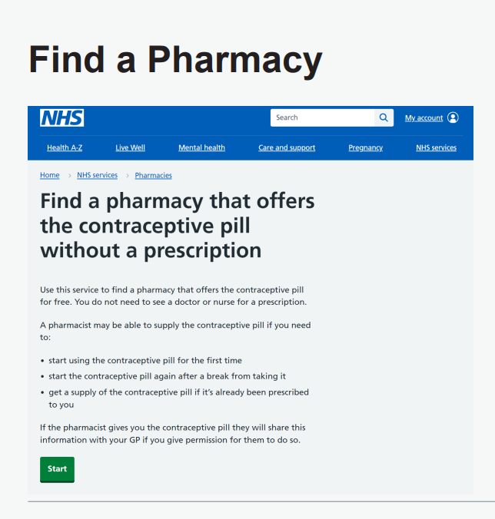
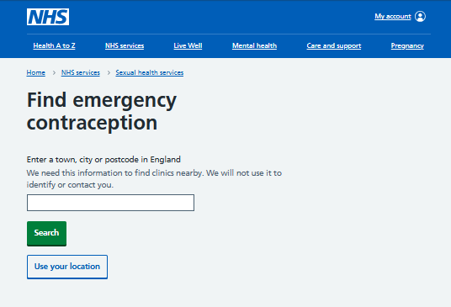


How do you a find a pharmacy providing the service?
Use the NHS website Find a Pharmacy tool
Enter a postcode to search or use your location
The webpage provides an overview of the service

Slide 17

Other services provided in pharmacies
While you are at your pharmacy, why not ask about other services that they provide
Many pharmacies now provide the following NHS services:
Pharmacy First service
A pharmacist led service to support patients with 7 common conditions and where electronically referred, support with minor illness consultations and the supply of urgent medicines (and appliances)
Blood pressure checks service
Aimed at patients aged 40 years and above
Flu vaccination service
New Medicine Service
Provides support to patients with long-term conditions newly prescribed certain medicines
Lateral Flow Device Service
Provides patients eligible for COVID-19 treatments with free access to lateral flow device tests

Slide 18

Questions

