Slide 1
Read and delete this slide
This Community Pharmacy England presentation on the Pharmacy Contraception Service is for use by LPCs when running local events on the Pharmacy Contraception Service
Further information on the service is available at cpe.org.uk/PCS
Presenters should first read the service specification and the FAQs on the Community Pharmacy England website and familiarise themselves with the Patient Group Directions. The content of these documents/resources provide the key information and additional background knowledge for anybody giving this presentation at an event
Presenters may also want to watch the Community Pharmacy England Pharmacy Contraception Service: Getting going with the service and the Emergency contraception and the PCS on-demand webinars available at cpe.org.uk/webinars, as this presentation is based on the PowerPoints used during these webinars
Questions or comments on this presentation can be sent to the Services Team: services.team@cpe.org.uk ​
You can pick and choose the elements of the presentation that suit the needs of your event/discussion. There is also some text highlighted in yellow in the presentation that will need to be amended/deleted depending on the audience
Last updated: 13th November 2025

Slide 2
The Pharmacy Contraception Service – for general practice colleagues
[Name of presenter
& LPC]

Slide 3
Presentation overview
Strategic context for the service​​
What does this mean for general practices and sexual health clinics
Overview of the service
Summary of the service requirements​​
The PGDs​​, the consultation & outcomes
Learning and development for pharmacists​​ and pharmacy technicians
Q&A

Slide 4
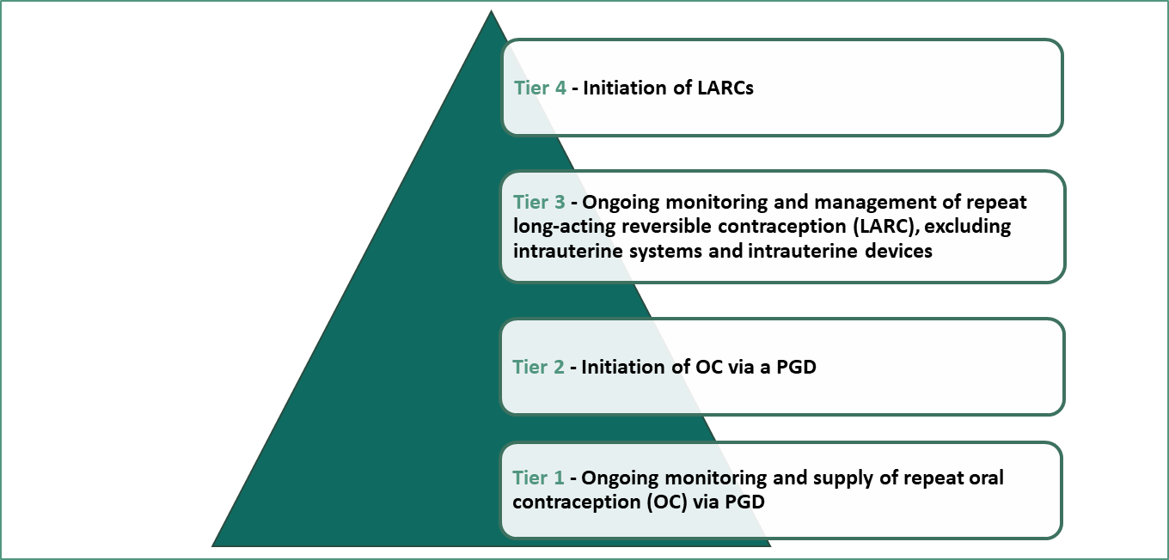

Strategic context for the service
NHS Long Term Plan
“importance of NHS services complementing the action taken by local government to support the commissioning of sexual health services”
Pharmacy offer for sexual health, reproductive health and HIV: a resource for commissioners and providers
“the role community pharmacy can play in supporting ongoing contraception”
Commitment in CPCF to
“test a range of prevention services”
Notes:
Pharmacies have experience of providing emergency contraception and contraception services as part of locally commissioned sexual health services.
The NHS Long Term Plan highlighted the importance……
A Public Health England resource for commissioners (2019) highlighted the role community pharmacy can play in supporting ongoing contraception.
The 2015 Community Pharmacy Contractual Framework included a commitment to test……….

Slide 5
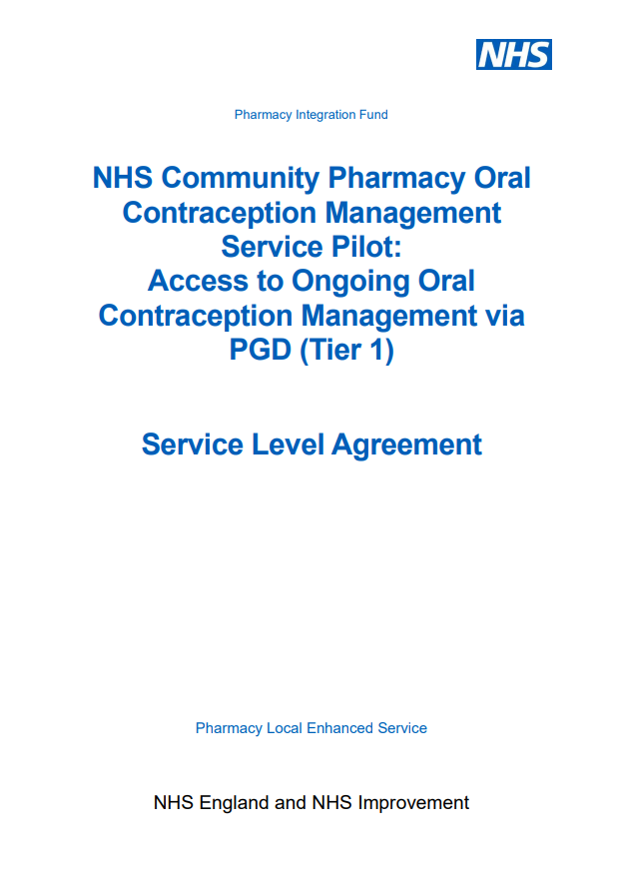





Strategic context for the service
2021 - commence Tier 1 pilot
April 2023 - Launch of Tier 1 PCS – ongoing supply
December 2023 - Expansion of PCS – include initiation
October 2022 – commence Tier 2 pilot
May 2023 - Delivery Plan for recovering access to primary care
29th October 2025 – Inclusion of oral emergency contraception
Notes:
NHS England commenced a pilot in 2021.
This involved pharmacies offering repeat supplies of oral contraception to people who had previously had the product prescribed.
Pilot of Tier 2 (initiation) commenced in October 2022
In April 2023 following negotiations the Tier 1 service was launched
In May 2023. the Delivery Plan for recovering access to primary care was published. This included a commitment to increase provision of the PCS and the Hypertension Case-Finding Service and proposed additional funding to support this.
Following negotiations in December 2023, we had an expansion of PCS to include initiation.
Following a further round of negotiations in March 2025, the service was further expanded in October 2025 to include provision of oral emergency contraception.
The development does not stop there. NHSE has looked at Independent Prescribing as an alternative to PGDs as part of the IP pathfinder programme.
Work is also underway trailing a few pharmacies with what was proposed to be Tier 3 – ongoing management and supply of LARCs.

Slide 6
Strategic context for the service
Aim of the service is to:
  Offer greater choice from where people can access contraception services
  Create additional capacity in primary care and sexual health clinics to support meeting the demand for more complex assessments
Support addressing health inequalities by providing wider healthcare access
Signposting service users to local sexual health services
Delivery Plan for recovering access in primary care (May 2023) highlighted expansion of the service to increase access to and convenience of contraception services in line with the previous Government’s Women’s Health Strategy for England (August 2022)
Now provides consistent access from community pharmacies across England to free oral contraception (OC) and oral emergency contraception (EC)

Slide 7
The Pharmacy Contraception Service
Advanced service (therefore optional) ​
Over 95% (consider stat for local coverage) of pharmacies nationally have signed up to provide the service​​ (October 2025)
The service consists of:
Supply via patient group directions (PGD)
Blood pressure and Body Mass Index measured (where clinically applicable)
Provided by pharmacists and pharmacy technicians
2
On-going supply
of oral contraception
3
Review of
oral contraception
1
Initiation of
oral contraception
4
Provision of
oral emergency contraception

Slide 8


What does this mean for practice / clinic appointments?
Aim is to work together to reduce workload at the practice / clinic
General practices and sexual health clinics can:
  Still provide consultations for emergency contraception, contraception and review on-going contraception needs – may want to focus on more complex cases
  Opt to signpost to the pharmacy service for a consultation with a pharmacist or pharmacy technician
  Referrals where made, must be sent via a secure digital route
Individuals will be able to walk-in to a pharmacy and access the service

Slide 9
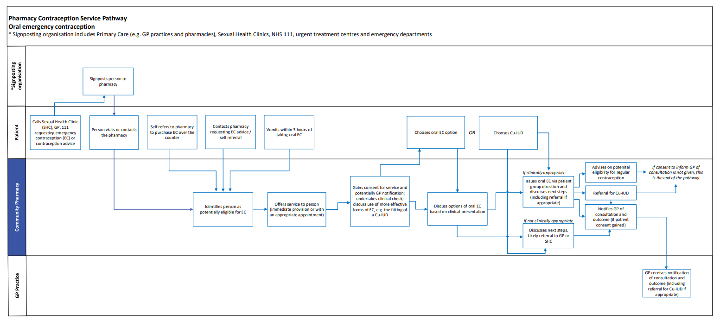
High-level service overview - EC
*signposting organisation includes primary care (e.g. GP practices and pharmacies) and Sexual Health Clinics
A copy of the service pathway diagram can be found in Annex A of the service specification

Slide 10
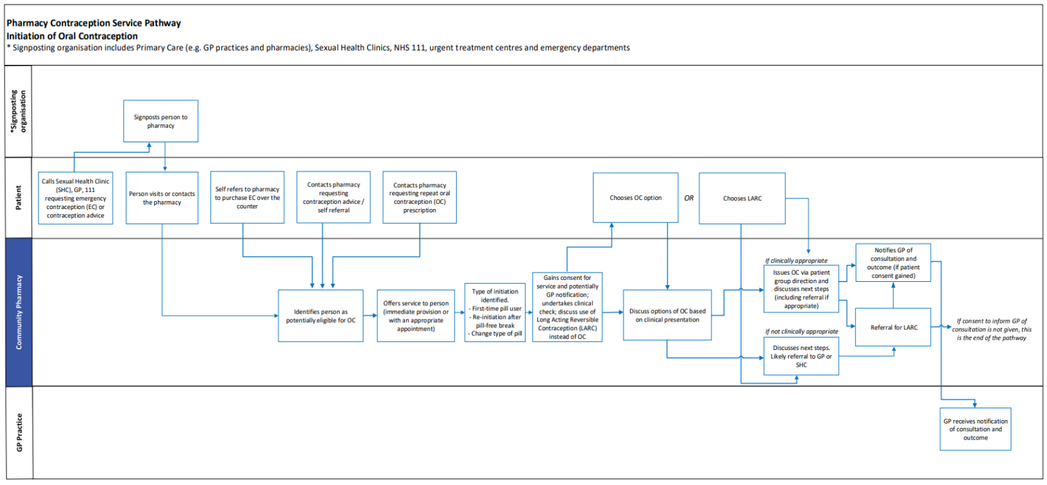
High-level service overview - initiation
*signposting organisation includes primary care (e.g. GP practices and pharmacies) and Sexual Health Clinics
Initiation is:
Starting oral contraception for the first time
Needs to restart following a pill free break
A person is being switched to an alternative pill
A copy of the service pathway diagram can be found in Annex A of the service specification

Slide 11
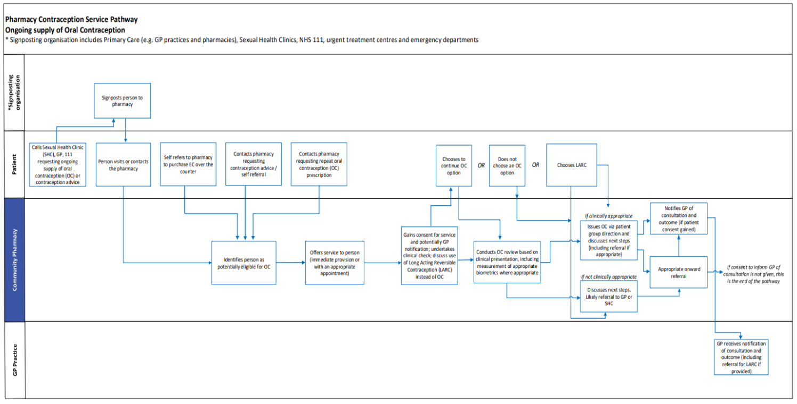
High-level service overview – Ongoing supply
*signposting organisation includes primary care (e.g. GP practices and pharmacies) and Sexual Health Clinics
Ongoing supply is:
where a person has been supplied with oral contraception by a primary care provider (including general practice and pharmacies) or a sexual health clinic (or equivalent) and a subsequent equivalent supply is needed.
Their current supply of oral contraception should still be in use.
A copy of the service pathway diagram can be found in Annex A of the service specification

Slide 12
The service requirements
Pharmacies must have a consultation room, with access to IT equipment for record keeping​
Distance selling premises pharmacies (DSPs) are not permitted to provide face-to-face consultations with patients present at the pharmacy premises – they can only provide the service remotely
All must have an NHS-assured clinical IT system​
Pharmacies (except for DSPs) must have appropriate equipment to measure a person’s blood pressure, weight and height. DSPs can only accept patient submitted biometrics
All pharmacies providing the service must offer consultations for EC and both initiation of and for ongoing supply of OC

Slide 13
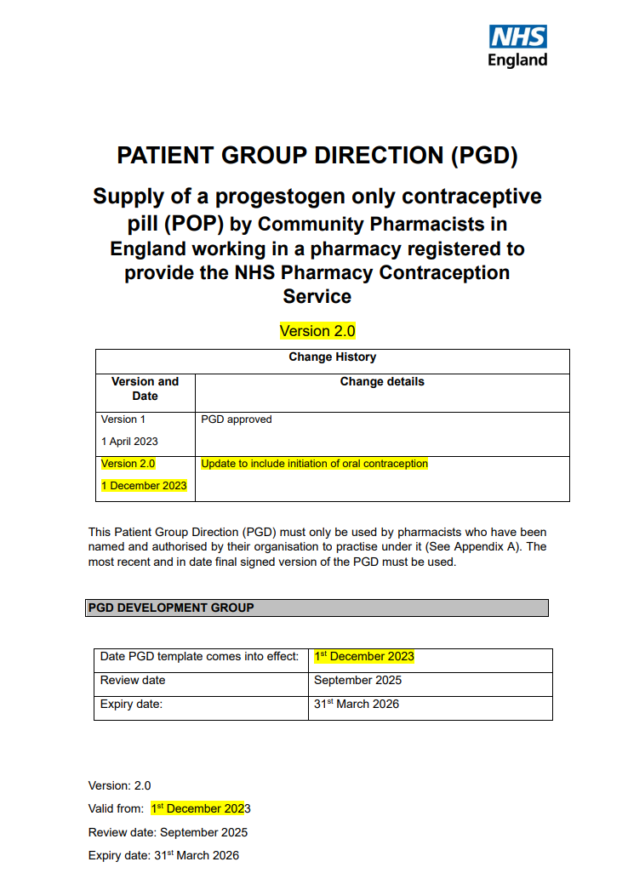
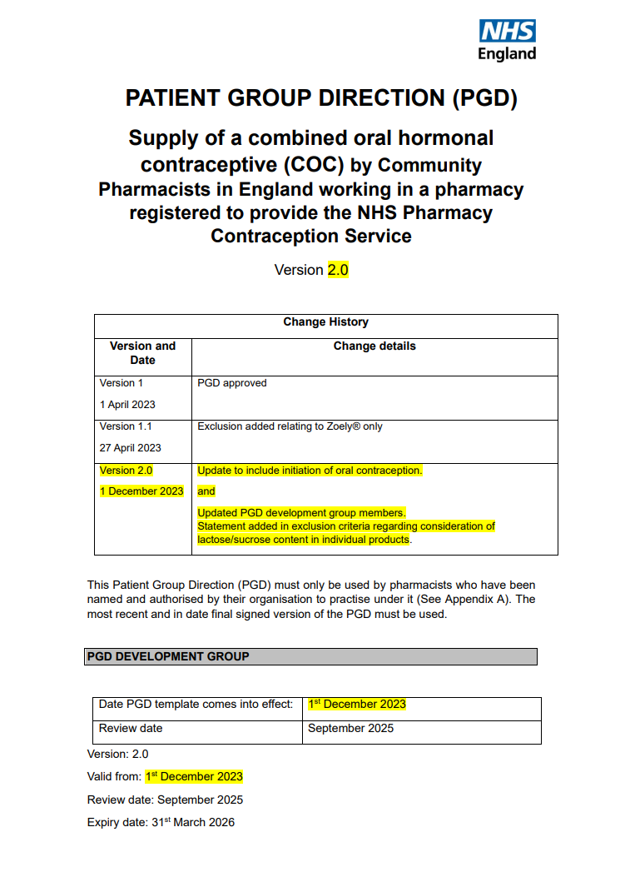
The PGDs
NHS England utilised PGD templates developed by the Specialist Pharmacy Service
The PGDs have received national approval from the National Medical Director and the Chief Pharmaceutical Officer
4 PGDs
Pharmacists and pharmacy technicians cannot deviate from the PGDs

Slide 14
The consultation
Verbal consent to receive the service is sought from the person and recorded in the pharmacy’s clinical record for the service
If the person provides consent to share the outcome of the consultation with their general practice, information will be shared
If the person does not consent to sharing information with their general practice or they are not registered with a general practice, the consultation can still proceed, and a notification to the practice will not need to be sent
Clinical appropriateness of a supply of oral EC or OC will be determined by the pharmacist or pharmacy technician

Slide 15
The consultation
If the pharmacist or pharmacy technician is concerned about a potential safeguarding issue, then appropriate action would be taken, in line with local safeguarding processes
Includes a conversation with the person regarding alternative and more effective forms of contraception, e.g. Long-acting reversible contraception (LARC)
If a person requires urgent escalation to another healthcare setting, the pharmacist or pharmacy technician will arrange this
For combined oral contraception, a supply will require BMI and a blood pressure measurement to be taken in line with NICE guidelines
In some cases, for emergency contraception, a supply will require BMI or weight measurements to be taken to confirm the dosage
A person accessing the service may also offer their own weight, height and blood pressure measurements

Slide 16
The consultation – EC
Review of:
  Circumstances as to why EC may be needed
  Recent sexual activity
  Previous use and current contraceptive use
  Medical history and eligibility
  Menstrual cycle
Discuss Cu-IUD as an option and oral EC options
Discuss and provide advice on additional concerns, e.g. sexually transmitted infections
Confirm any additional contraception need

Slide 17
The consultation – initiating OC
Assessment of suitability including review of:
  Personal history
  Family history
  Sexual history
  Medical history and eligibility
Discussion of options, including LARC, and selection of desired method of contraception
Where OC selected, selection of appropriate formulation and provision of associated essential information

Slide 18
The consultation – ongoing OC
Review of:
  Personal history
  Family history
  Sexual history
  Medical history and eligibility
Discuss and address any issues, side effect or concerns
Discuss LARC as an option
Confirm ongoing contraception and where this is OC, confirm pill and agree supply quantity

Slide 19
Outcomes
If a supply is clinically appropriate
Pharmacist or pharmacy technician will issue a supply
Counsel and discuss next steps
If a supply is not clinically appropriate
Pharmacist or pharmacy technician will explain why a supply cannot be made
If person consents, GP is notified of consultation, the outcome and the person’s record is updated
If person consents, GP is notified of consultation, the outcome and the person’s record is updated
Refer to GP or sexual health clinic where appropriate
Notifications where consented:
Sent as a structured message in real time via the NHS-assured IT systems
Sent via NHSmail as a back-up if IT system is down

Slide 20

Outcomes – oral EC
Pharmacist or pharmacy technician can supply one dose of the emergency contraception pill
Choice of:
Pharmacist or pharmacy technician will use their professional discretion to advise on the most appropriate choice of product
A repeat dose can be provided if the person vomits with 3 hours
Signpost or referral made where LARC required
Levonorgestrel
Within 4 days (96 hours) of UPSI
Ulipristal acetate
Within 5 days (120 hours) of UPSI

Slide 21
Outcomes - OC
If the assessment criteria are met, supply of OC can be made
On initiation, the quantity supplied will not exceed 3 months
Following initiation, ongoing supplies will be for a minimum of 6 months and can be made of up to 12 months duration
Where a person is initiated, pharmacists or pharmacy technicians use their professional discretion as to the appropriate choice of product, from those included in the PGD
Wherever practicable, supply will be the best value product to meet the clinical need of the patient
Local ICB formularies/restrictions will be referred to and followed accordingly.
Ongoing supplies will be made in line with the person’s previous supply, e.g. in the instance that a branded product has been supplied for clinical reasons such as an allergy to product constituents, the ongoing supply should be made from an equivalent brand/generic equivalent

Slide 22
Learning and development
Pharmacists and pharmacy technicians will have developed competence in the clinical skills and knowledge required to deliver all aspects of the service
Training is undertaken from a variety of sources including from the Centre for Pharmacy Postgraduate Education and/or the NHS England e-learning for healthcare
Must complete appropriate Safeguarding level 3 training or have access to advice from someone who is Safeguarding level 3 trained
Lots of support to upskill and give pharmacists and pharmacy technicians the confidence to offer this service

Slide 23
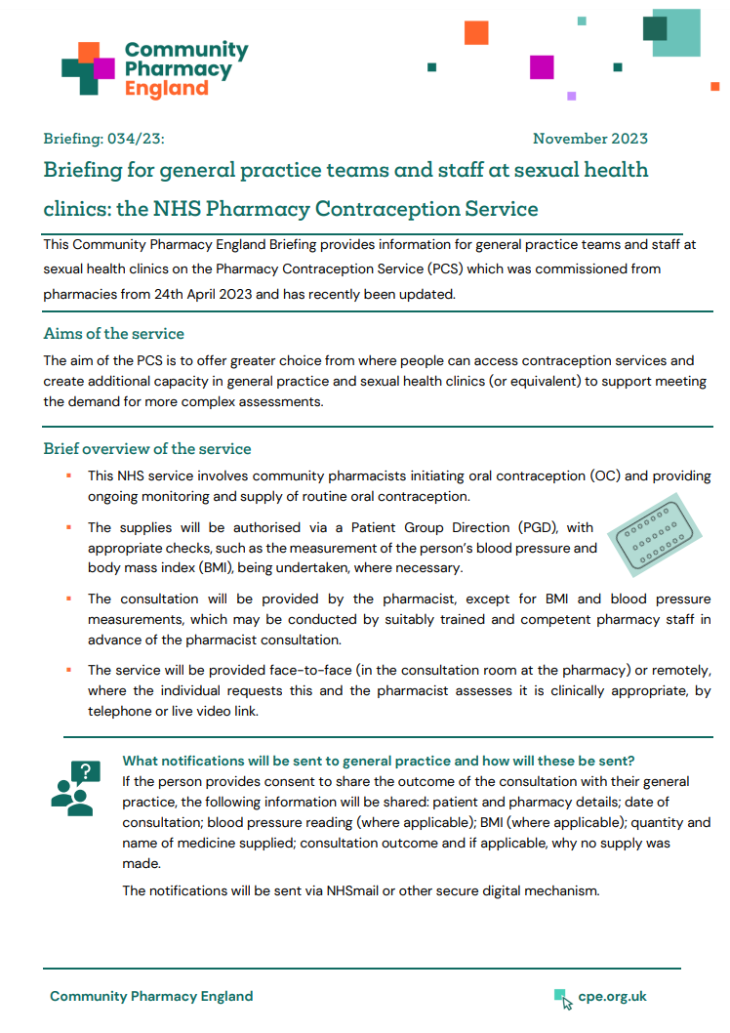
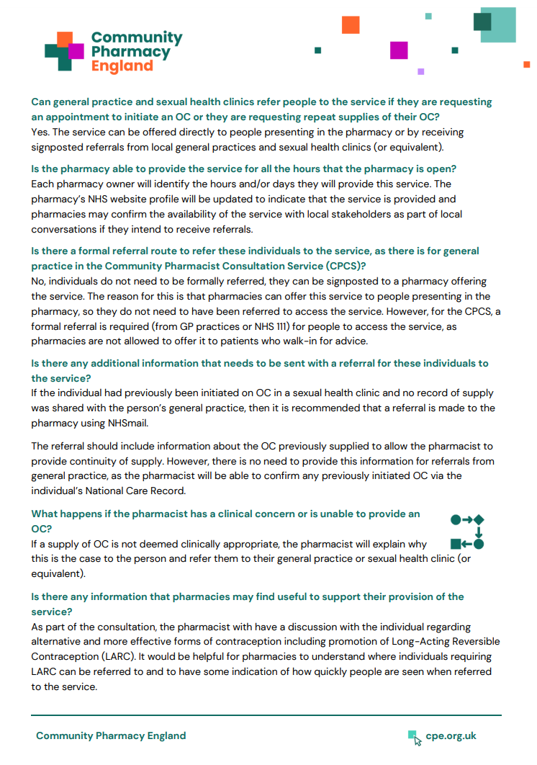

Engaging the team
Briefing available to provide information for general practice teams and local sexual health clinics (or equivalent) teams on the service
One-page infographic available
Digital posters available to highlight the availability of the service to patients from participating community pharmacies

Slide 24
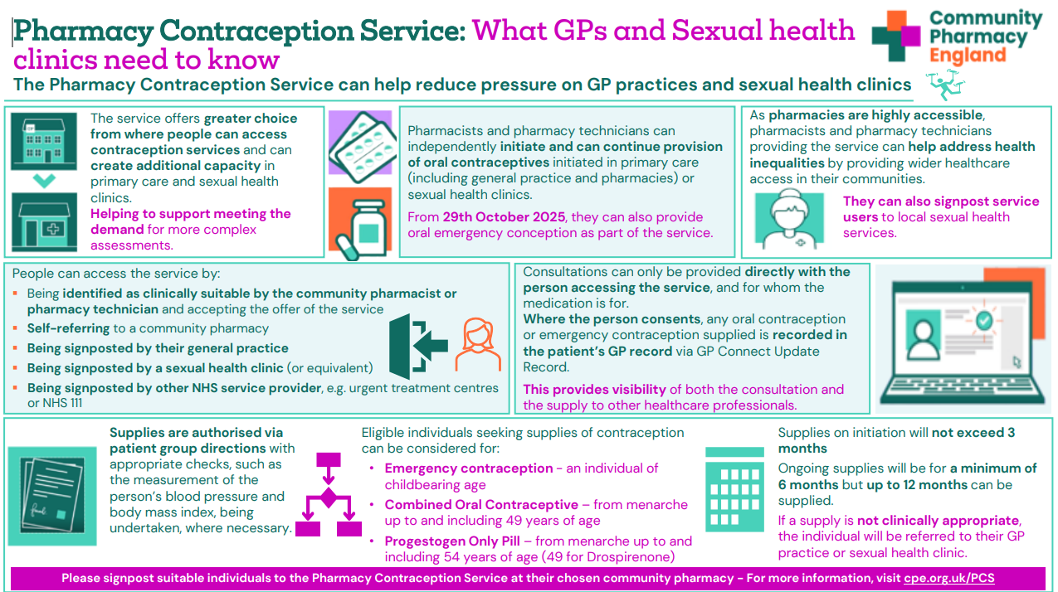
Summary

Slide 25

Questions cpe.org.uk/PCS

