Slide 1
Instructions for LPCs
Read and then delete this slide
These slides are for use by LPCs to help facilitate conversations with local stakeholders such as leaders of Integrated Care Boards (ICBs) following the publication of ‘A Prescription for Success’
Actions:
Update slide 2 with your logo and relevant names
Delete slides depending on the length of time available. For questions, clarifications or support please contact Becky Butterworth by email to becky.butterworth@cpe.org.uk
Note:
Background and further information is available here: https://cpe.org.uk/our-news/new-report-sets-out-opportunity-to-make-community-pharmacies-cornerstone-of-neighbourhood-health/
The slide deck can be shared in PDF format

Slide 2
Community Pharmacies: A Prescription for Success

Slide 3
Introduction

Slide 4

10-Year Health Plan
The Government has set out its ambitions to make the NHS ‘Fit for the Future’.
The 10-Year Health Plan, rests on three fundamental shifts:
hospital to community care
analogue to digital systems
treatment to prevention
Its proposed Neighbourhood Health Service aims to:
Bringing care into local communities
Creating patient-centred teams
Ending fragmentation
Transforming access to general practice
Preventing unnecessary hospital admissions

Slide 5
How pharmacy fits in
Community pharmacy has demonstrated its capacity for transformation:
During the COVID-19 pandemic, pharmacies remained open, and were a key part of the testing and vaccination programmes
The sector has continued evolving through initiatives like Pharmacy First
Over 9,000 pharmacists are now qualified as independent prescribers, and soon all newly registered pharmacists will have prescribing qualifications
Community pharmacy can be transformed into a cornerstone of the Neighbourhood Health Service

Slide 6
Financial challenges
Over half of pharmacy owners are operating at a loss
42% having to reduce their opening hours
15% needing to cut back on some national services
Increased investment is essential – the whole of primary care requires adequate resources to meet current demand

Slide 7
A Prescription for Success – The Role of Community Pharmacy in Delivering the 10-Year Plan for Health

Slide 8

The Review
The 10-Year Health Plan aligns strongly with a Vision for Community Pharmacy, developed by the Nuffield Trust and The King’s Fund two years ago
A Prescription for Success highlights the relationship between the Government’s 10-Year Health Plan and the earlier Vision for Community Pharmacy
This new report was commissioned by Community Pharmacy England and developed by Helen Buckingham, one of the co-authors of the Vision for Community Pharmacy and Chair of National Voices

Slide 9
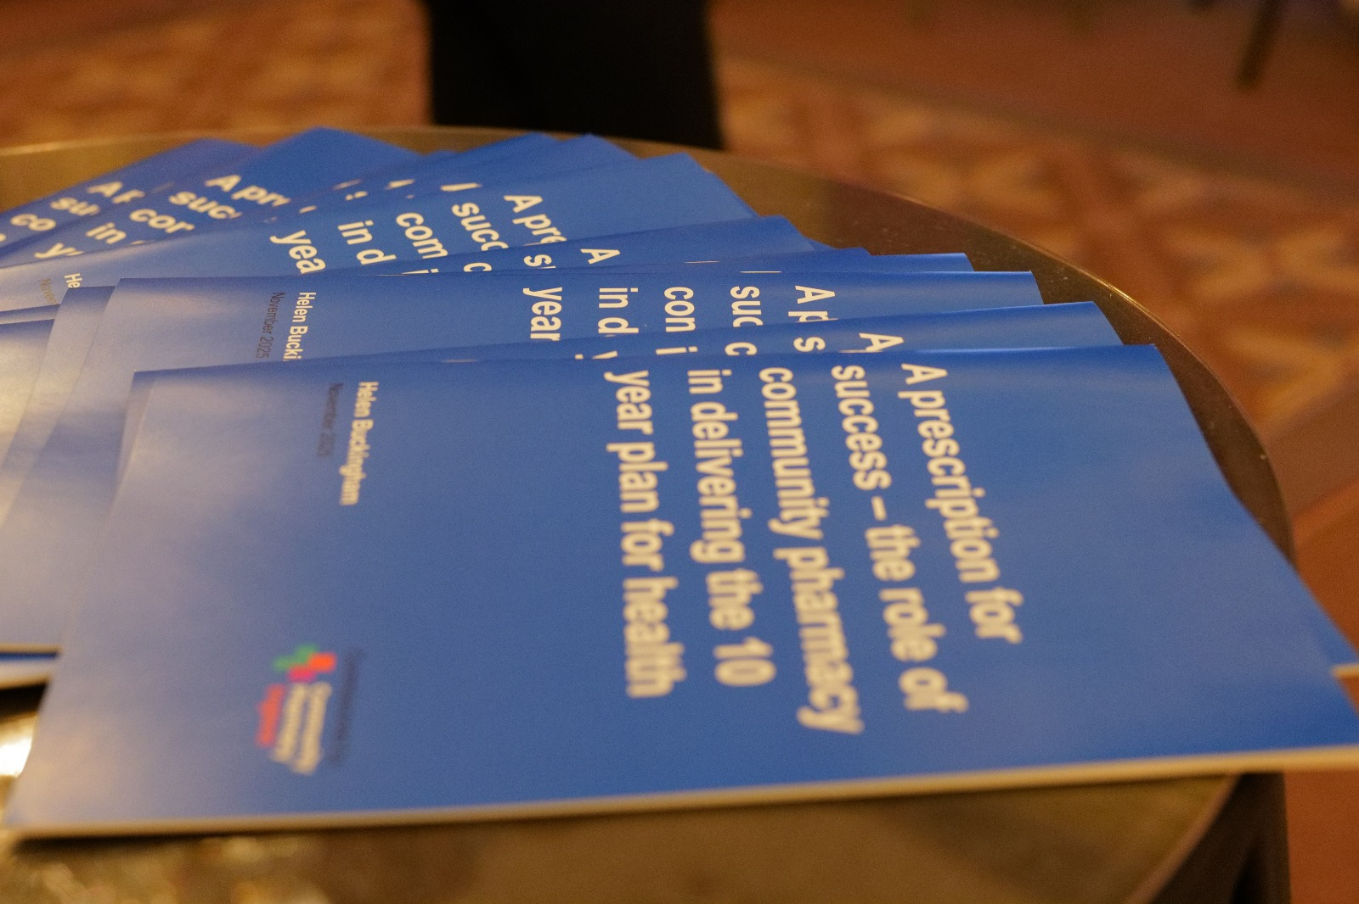
The Review
A Prescription for Success sets out the unprecedented opportunity to transform the community pharmacy sector into a cornerstone of the Neighbourhood Health Service, delivering integrated, accessible, and preventative care to communities across England
But warns that realising the potential of community pharmacy requires coordinated action

Slide 10




Slide 11
Maximising contribution and delivery

Slide 12



The local system opportunity
A modernised community pharmacy sector can:
Provide accessible preventative services and support population health
Offer rapid access for common conditions, reducing demand on general practice
Support the management of long-term conditions, complementing GP-led care
Deliver integrated clinical services through independent prescribing
Improve patient outcomes and experience while offering strong value for commissioners

Slide 13

Going forwards
To realise these benefits, community pharmacy must be strategically embedded in system planning, investment strategies, and workforce programmes
Pharmacy and NHS leaders, including ICBs, will need to work closely to resolve these issues, unlock new capacity, and ensure that pharmacies can deliver high-quality, accessible, preventative care at neighbourhood level

Slide 14







Co-ordinated action
A Prescription for Success sets out the following five questions. By addressing these together, we can maximise the contribution community pharmacies can make towards delivering the 10-Year Health Plan:
How will community pharmacists be engaged in service transformation?
How will investment be made in pharmacy IT and estates?
How will commissioning capacity be strengthened?
How will pharmacy be integrated into system-wide workforce planning?
How can the pharmacy contract be reformed to ensure long-term sustainability?

Slide 15
For more information, visit https://cpe.org.uk/wp-content/uploads/2025/11/A-Prescription-for-Success-report.pdf -

