Slide 1
Community pharmacy: A unified partner in frailty care Insert your name and LPC

Slide 2
Instructions for LPC use – delete after reading
These PowerPoint slides are fully editable and designed to give you a framework to showcase your local community pharmacy frailty offer to the neighbourhood / place team.
The slides can be tailored for more specific patient cohorts / local circumstances if appropriate.
Sub-header slides have been included to accentuate the various ‘offers’. These can be removed if required.
Where possible, include summaries of real-life patient stories / personas to bring content to life.

Slide 3
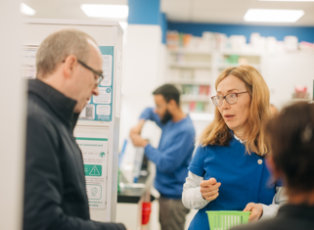
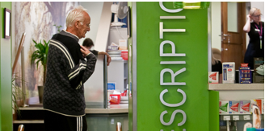
Background
The role of community pharmacy in proactive, joined up frailty care
Frailty is common, often hidden and changes over time
Community pharmacy has frequent, trusted contact with people at risk
We support earlier identification, prevention of deterioration, and coordinated care
Working alongside the Integrated Neighbourhood Team to keep people well at home

Slide 4
Offer 1 Community pharmacy as the lighthouse for frailty

Slide 5
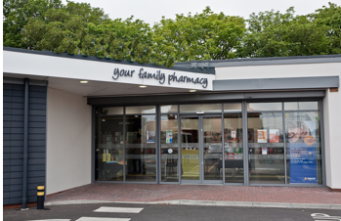
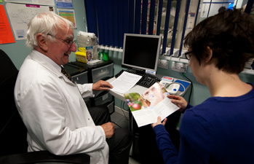
Community pharmacy as the lighthouse for frailty
Accessible front door and early identification and escalation of concern
Regular contact with older people and those with long-term conditions
Able to spot early warning signs of frailty, such as:
Changes in mobility or confidence
Increased confusion or forgetfulness
Weight loss, poor appetite or fatigue
Increasing reliance on carers or family
Acting early to raise concerns and connect people to the right support
Helping prevent crisis presentations and unplanned admissions

Slide 6
Offer 2 Local intelligence from everyday conversations

Slide 7
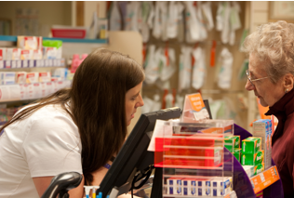
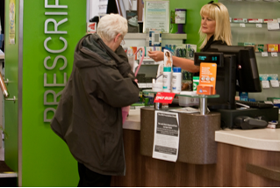
Local intelligence from everyday conversations
Understanding the person, not just the prescription
Pharmacy teams build long-term relationships with patients and carers
Non-clinical conversations reveal important frailty indicators:
Difficulty managing medicines
Falls or near misses
Social isolation or loneliness
Carer strain
Insights can support holistic assessments and shared care planning
Amplifying patient and carer voices within the neighbourhood system

Slide 8
Offer 3 Advice, education and navigation

Slide 9
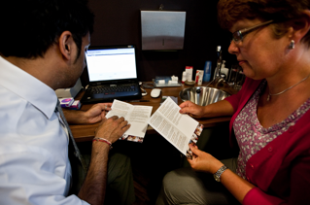
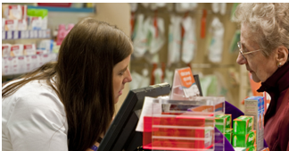
Advice, education and navigation
Helping people with frailty access the right help
Practical advice on:
Medicines use and side effects
Staying safe and independent at home
When and how to seek further support
Supporting carers with education and reassurance
Connecting people to:
GP and wider primary care
Social prescribing and voluntary sector services
Falls prevention, strength and balance, and wellbeing services
Reducing confusion and fragmentation for people with frailty

Slide 10
Offer 4 Prevention and slower frailty progression

Slide 11
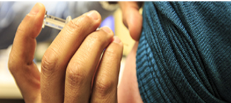
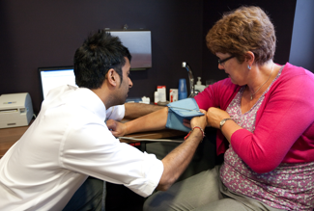
Prevention and slower frailty progression
Keeping people resilient and independent
Delivering prevention services that support people living with or at risk of frailty:
Vaccinations to reduce avoidable illness
Hypertension case-finding and cardiovascular risk management
Health promotion and lifestyle advice
Supporting early intervention to maintain function
Targeting people who may not engage with other services
Contributing to neighbourhood prevention and ageing-well strategies

Slide 12
Offer 5 Clinical expertise for safer medicines use

Slide 13
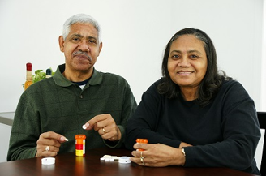

Clinical expertise for safer medicines use
Reducing harm and improving quality of life
Medicines optimisation for people with frailty and polypharmacy
Services including:
New Medicine Service (NMS)
Discharge Medicines Service (DMS)
Blood pressure testing
Pharmacy First
Identifying medicines-related risks:
Falls risk
Sedation or confusion
Poor adherence or administration challenges
Improving outcomes and supporting shared clinical decision-making

Slide 14
Offer 6 A committed partner in frailty pathways

Slide 15
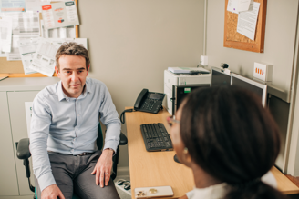

A committed partner in frailty pathways
Working as part of the Integrated Neighbourhood Team
Community pharmacy is willing and ready to do more:
Contribute to frailty identification and escalation pathways
Share intelligence and learning with partners
Co-design services with patients, carers, and professionals
Supporting consistent, person-centred approaches across providers
One neighbourhood system, working together to support people living with frailty

Slide 16
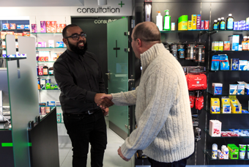
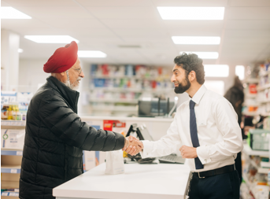
The value for the INT
Why community pharmacy matters for frailty
Earlier identification of deterioration
Trusted, long-standing relationship with patients
Reduced pressure on urgent and acute services
Better medicines safety and adherence
Improved patient and carer experience
Stronger prevention and neighbourhood resilience

