Slide 1
Community pharmacy: A unified partner in neighbourhood care
Insert your name and LPC

Slide 2
Instructions for LPC use – delete after reading
These PowerPoint slides are fully editable and designed to give you a framework to showcase your local community pharmacy frailty offer to the neighbourhood / place team.
The slides can be tailored for more specific patient cohorts / local circumstances if appropriate.
Sub-header slides have been included to accentuate the various ‘offers’. These can be removed if required.
Where possible, include summaries of real-life patient stories / personas to bring content to life.

Slide 3


Background
Working together for earlier support, better outcomes and joined up care for our communities.
Community pharmacy:
Is a valuable partner within the Integrated Neighbourhood Team
Should be recognised as community asset - trusted, accessible, and embedded in local communities
Has shared priorities with INTs: prevention, early intervention, and reducing inequalities
Has a key role in listening to and amplifying patient and provider voices

Slide 4
Offer 1
Community pharmacy as the local lighthouse

Slide 5
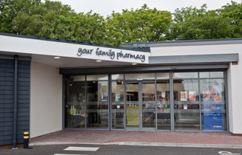
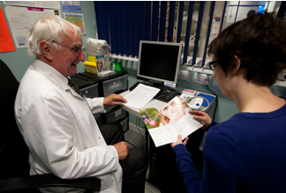
Community pharmacy as the local lighthouse
An early warning system and accessible front door
Highly accessible: long opening hours, no appointment needed, frequent contact, trusted relationships
Often the first place people turn when something feels wrong
Able to spot early warning signs of deterioration or unmet need
Escalate concerns and signpost appropriately across the neighbourhood system
Supporting proactive, not reactive, care

Slide 6
Offer 2
Local intelligence through trusted relationships

Slide 7
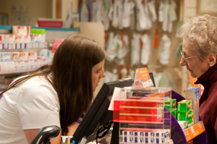

Local intelligence through trusted relationships
Understanding people beyond their medical record
Pharmacy teams know their patients and families over time
Everyday, non-medical conversations reveal important insights
Early awareness of issues such as:
  Medication adherence challenges
  Social isolation, stress, or declining function
  Changes in health behaviours
Intelligence can be shared (appropriately) to support joined-up care planning and targeting of resources

Slide 8
Offer 3
Advice, education and connection

Slide 9

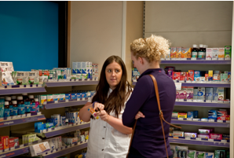
Advice, education and connection
Helping people navigate the system
Providing clear, accessible health advice and education
Supporting self-care and confidence to manage conditions
Connecting people to:
  GP and wider primary care
  Social prescribing and voluntary sector services
  Local wellbeing, prevention, and support offers
Acting as a connector between patients and the wider system, strengthening community resilience

Slide 10
Offer 4
Prevention at scale, close to home

Slide 11

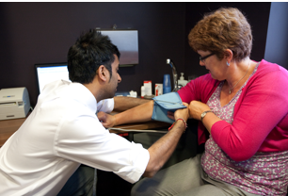
Prevention at scale, close to home
Keeping people well, not just treating illness
Strong, established prevention offer including:
  Vaccination services
  Hypertension case-finding
  Health promotion and self care / lifestyle advice
Opportunistically reaches people who may not routinely access other services
Reducing health inequalities through local, trusted access
Supporting neighbourhood prevention priorities

Slide 12
Offer 5
Clinical expertise in the community

Slide 13
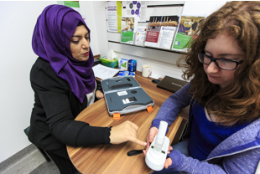
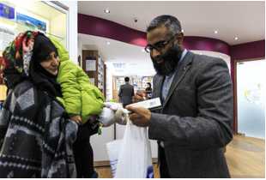
Clinical expertise in the community
Delivering safe, effective, patient-centred care
Highly trained clinicians embedded in local communities
Delivery of services such as:
  New Medicine Service (NMS)
  Hypertension case-finding
  Pharmacy First
  Pharmacy Contraception Service
  Screening and medicines optimisation
Improving medicines safety, outcomes, and patient understanding
Reducing pressure on other parts of the system

Slide 14
Offer 6
A willing and engaged partner

Slide 15


A willing and engaged partner
Committed to shared goals and shared learning
Community pharmacy wants to do more as part of the INT
Ready to:
  Share insight and data where appropriate
  Co-design pathways with partners and patients
  Align activity to neighbourhood priorities
Valuing every voice—patients, carers, and professionals with a focus on flexible solutions
One system, one team, one shared purpose

Slide 16
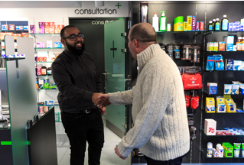
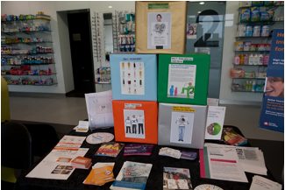
What this means for the INT
A simple ask
Include community pharmacy as a core neighbourhood partner
Create clear routes for communication and escalation
Use pharmacy intelligence and trusted, long-standing relationships with patients to support proactive care
Work together to deliver prevention, early intervention, and better outcomes

