Slide 1
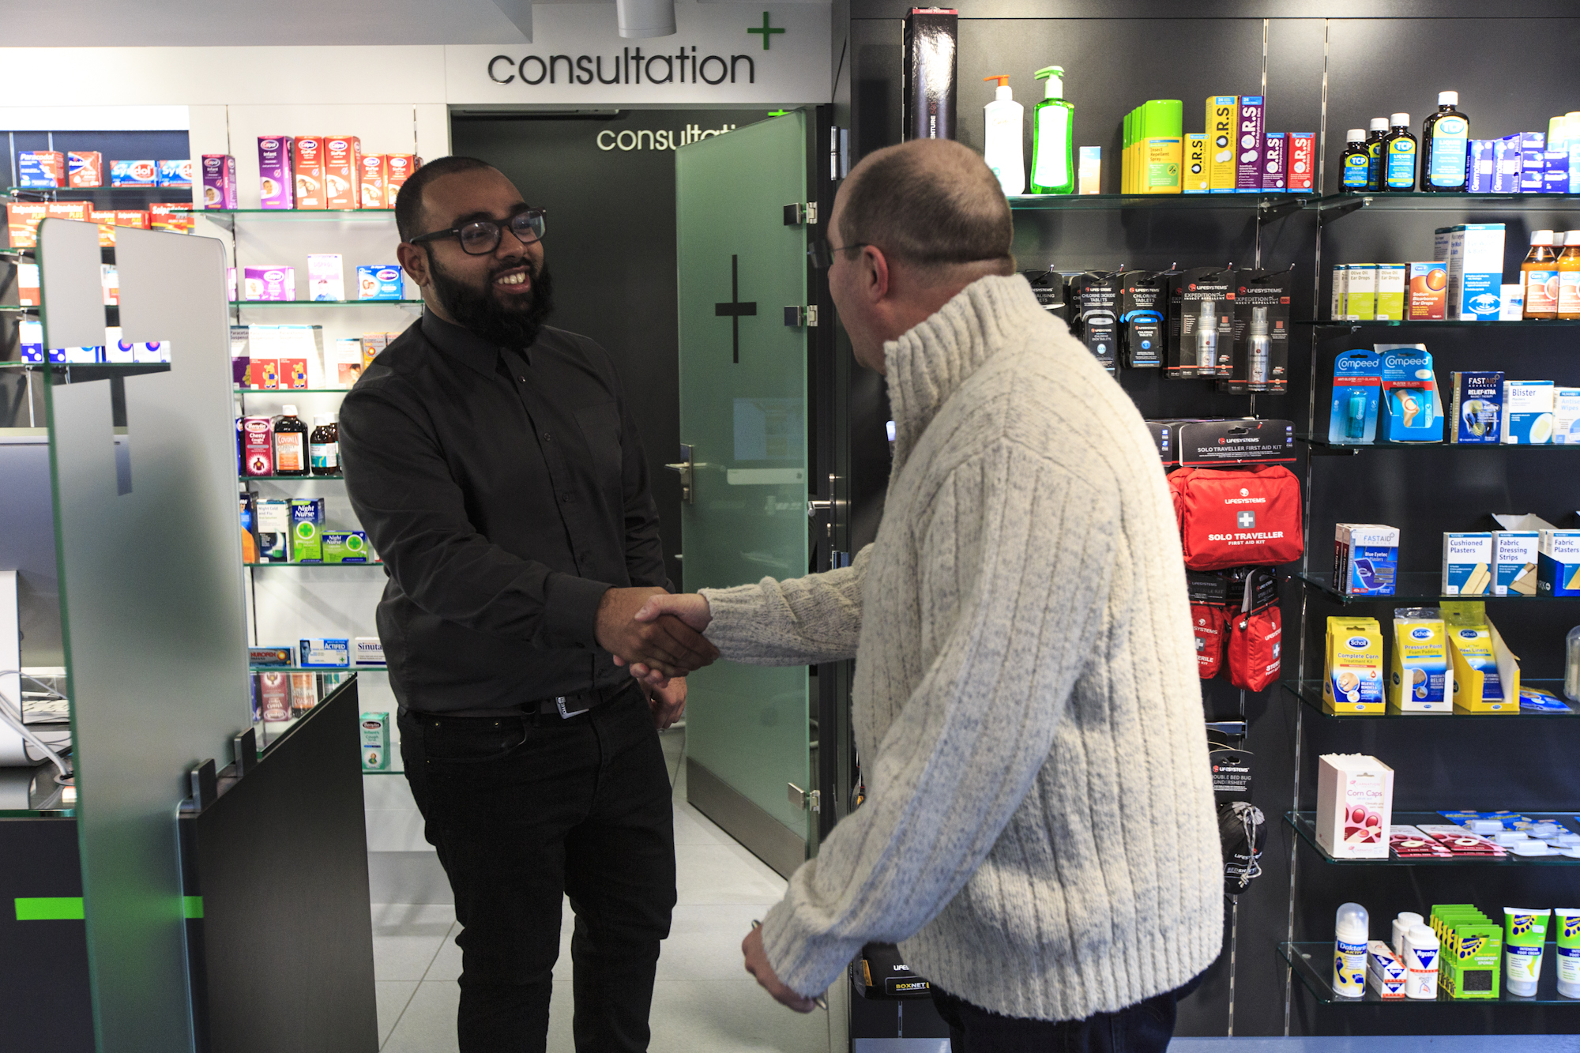
Community Pharmacy: Services provided by your pharmacy team
Trusted, accessible and embedded in local communities. Working together as part of your neighbourhood team.
Provided by all community pharmacies
Repeat dispending (eRD) – improve convenience and access to repeat prescriptions.
Discharge Medicines Service – reduces readmissions to hospital and improves patient safety at transitions of care.
Disposal of unwanted medicines – pharmacies take back patients’ unwanted medicines.
Healthy living pharmacies – health promotion interventions to improve health and wellbeing.
Support for self care – advice provision and, if appropriate, sale of medicines.
Other Essential services – dispensing appliances, signposting and public health (promotion of healthy lifestyles).
Essential services
Community pharmacy introduction
There are XXX community pharmacies in XXX area
Often open longer hours than other local healthcare services, including at weekends
Highly skilled team led by a pharmacist; supporting easy access to a team of healthcare professionals
Insert relevant information on workforce, e.g. from Community Pharmacy Workforce Survey
Over 99% of people living in areas of highest deprivation are within 20 minutes walk of a pharmacy
A trusted and accessible destination for healthcare needs
Nationally specified service, locally commissioned to meet local population needs
Respiratory Syncytial Virus (RSV) and Pertussis Vaccination Service – some pharmacies are taking part in this programme. Click here for further information.
National Enhanced services
Community pharmacies can choose to provide any of these services, as long as they meet service specific criteria
Pharmacy First – provides access to consultations for seven common conditions. GPs and NHS 111 can refer for minor conditions. NHS 111 can also refer for urgent supply of repeat medicines.
Pharmacy Contraception Service – aims to provide patients with greater choice and access for their contraception needs. This service also includes access to emergency contraception.
Hypertension Case-Finding Service – aims to identify people aged 40 years or older, or at the discretion of pharmacy staff, people under the age of 40, with high blood pressure and to refer them to general practice to confirm diagnosis and for appropriate management.
Seasonal Vaccination Service – supports the administration of COVID-19 and adult flu vaccinations to patients at risk of developing more serious complications from these viruses.
New Medicine Service - provides support for people with long-term conditions newly prescribed a medicine to help improve medicines adherence; it is focused on specific patient groups and conditions.
Other Advanced services include Smoking Cessation Service and COVID-19 Lateral Flow Device Service
Advanced services
Community Pharmacy: the first stop in everyday neighbourhood health

Slide 2
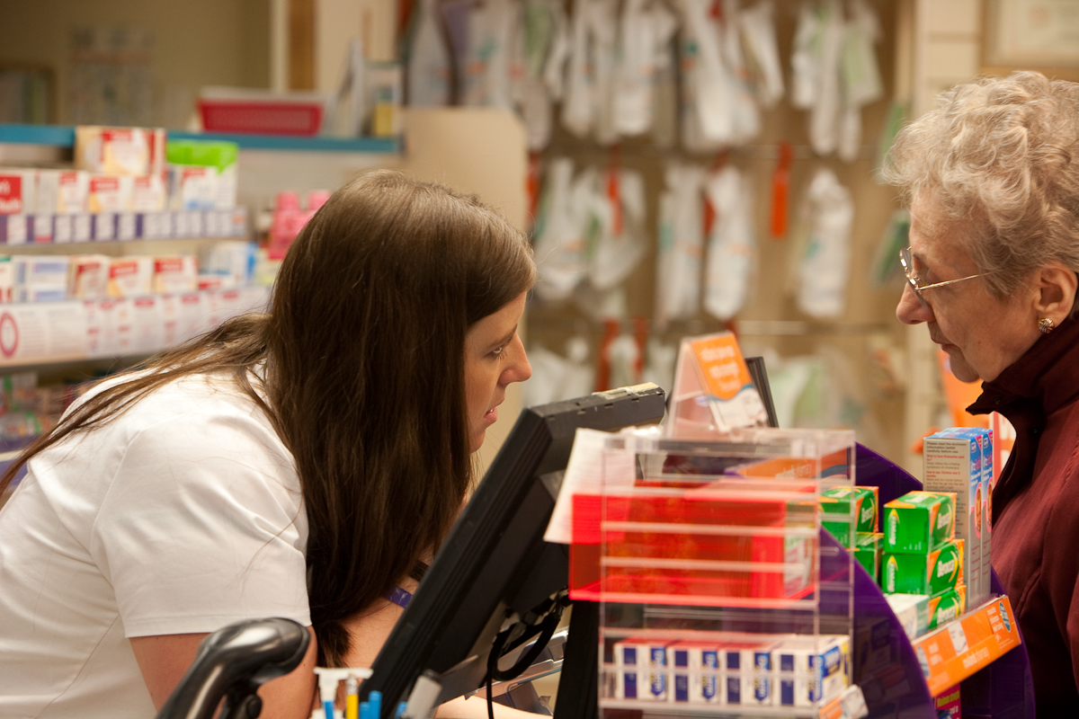
Community Pharmacy: Services provided by your pharmacy team
Trusted, accessible and embedded in local communities. Working together as part of your neighbourhood team.
Local services
These services are developed and commissioned locally and are designed to meet local health needs.
Due to the local variation in the needs of populations, services commissioned locally by local authorities and the Integrated Care Board may vary.
Insert details of local services and which areas they are commissioned. For example:
Barking and Dagenham:
Smoking cessation (LA),
Supervised consumption (LA),
End of life care (ICB)
Havering:
Needle Exchange (LA),
Supervised Consumption (LA),
Stop Smoking Pilot (LA)
Newham:
Condom Provision and STI Screening (Chlamydia and Gonorrhoea) (LA),
Stop Smoking Provision (LA),
Needle Exchange and Naloxone Service (LA),
Latent Tuberculosis Infection Service (ICB)
Community pharmacies are ideally positioned to support neighbourhood-level population health goals and the 10 Year Health Plan ambitions, particularly in:
Reducing health inequalities
Improving prevention and early diagnosis
Easy access to support for acute conditions
Managing long-term conditions
Avoiding unnecessary hospital admissions
Enhancing medicines safety
We help people stay well, get support early and deliver easily accessible, high-quality services
Possible future services
Community pharmacies are ideally placed to play a greater role in local care pathway re-design
Consider the role that community pharmacy can play in particular in supporting cardiovascular disease, long-term conditions, prevention and other medicine-related pathways.
Support with vaccinations – we are ideally placed to deliver a range of adult and childhood vaccinations
Medication reviews – Conditions could include respiratory, diabetes, hypertension, polypharmacy in the elderly.
Independent prescriber (IP) clinics – Examples of clinics include hypertension, respiratory and diabetes clinics. From 2026 all newly qualified pharmacists will also register as independent prescribers. This will provide increased opportunities to utilise prescribers further and to provide more clinics in community pharmacy.
Health screening and blood tests – Example include diabetes, HIV, hepatitis B, hepatitis C, cholesterol testing, HbA1c testing
Include details of other services being discussed locally
Community Pharmacy: the first stop in everyday neighbourhood health

