Slide 1
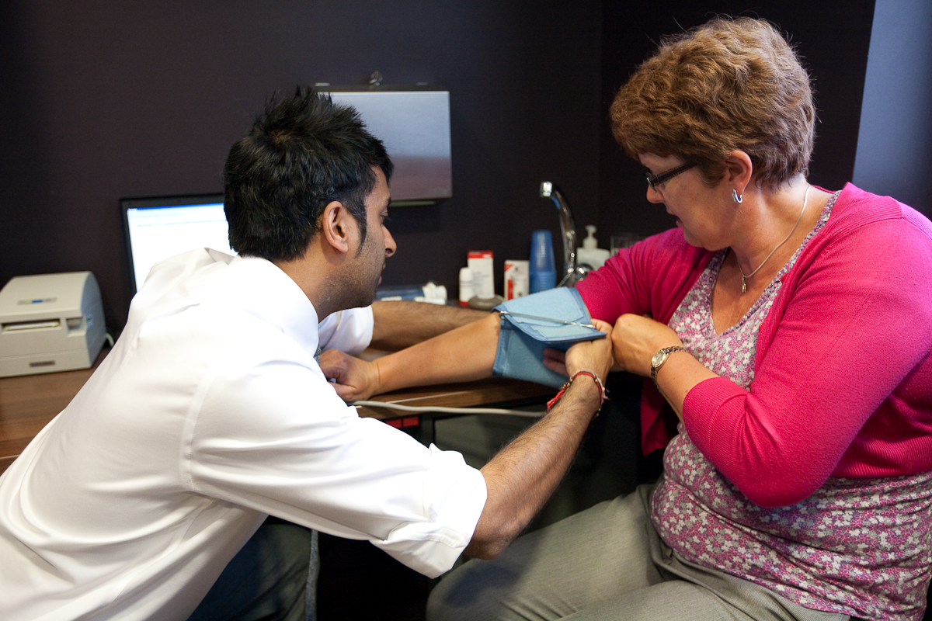
Community Pharmacy: Delivering the CVD Modern Service Framework
Working together enabling prevention, earlier diagnosis, better cardiovascular outcomes and joined up care delivered close to home.
Why this matters:
The CVD MSF aims to
reduce premature
deaths from heart
disease and stroke by
25% over the next
decade through:
Prevention and proactive care
Earlier diagnosis and intervention
Treatment optimisation
Reducing health inequalities
Delivering more care in neighbourhoods
A new CVKM approach to population health
Community pharmacy can support these priorities through its accessibility, clinical expertise and trusted relationships with local people
1. Finding the missing millions
Blood pressure checks through the Hypertension Case-Finding Service
Identifying people with undiagnosed cardiovascular risk factors
Opportunities to support AF, cholesterol, diabetes and kidney disease detection
Reaching people who may not otherwise access healthcare services
Supporting proactive identification before cardiovascular events occur
2. Local intelligence, trusted relationships
Regular contact with patients and families
Identifying adherence challenges and unmet needs
Early awareness of changes in health behaviours
Supporting personalised interventions and targeted support
Sharing local insight to support population health management
3. Prevention at scale, close to home
Lifestyle and behaviour change support
Smoking cessation services
Weight management support
Health promotion and self-care advice
Preventing disease progression through regular engagement
Outreach activity potential
Supporting the NHS shift from treatment to prevention
The Ask for Systems, ICBs and INTs
Include community pharmacy as a core CVD delivery partner
Integrate community pharmacy within CVKM pathways and neighbourhood teams
Use pharmacy services to identify and engage at-risk populations
Invest in community-based prevention, case-finding and medicines optimisation
Harness community pharmacy expertise to improve cardiovascular outcomes and reduce inequalities
4. Driving treatment to target
Supporting adherence to cardiovascular medicines
New Medicine Service interventions
Medicines optimisation and clinical review
Helping patients achieve blood pressure, cholesterol and diabetes targets
Supporting safer, more effective use of medicines
Reducing avoidable cardiovascular complications
5. Tackling health inequalities
No appointment required
Longer opening hours than other primary care providers
Located in communities with greatest need
Trusted by underserved populations
Supporting equitable access to prevention, diagnosis and treatment
Helping reduce variation in cardiovascular outcomes
6. Care closer to home
Accessible clinical support within local communities
Integrated working with primary care and neighbourhood teams
Rapid referral and signposting into wider services
Supporting ongoing monitoring and follow-up
Contributing to neighbourhood-based CVKM care models
Delivering more cardiovascular care outside hospital settings
One system, one team, one shared CVKM ambition

