Slide 1
Community pharmacy: Delivering the CVD Modern Service Framework
Insert your name and LPC

Slide 2
Instructions for LPC use – delete after reading
These PowerPoint slides are fully editable and designed to give you a framework to showcase your local community pharmacy CVD offer to the neighbourhood / place team.
The slides can be tailored for local circumstances if appropriate.
Sub-header slides have been included to accentuate the various ‘offers’. These can be removed if required.
Where possible, include summaries of real-life patient stories / personas to bring content to life.

Slide 3
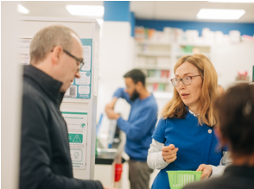

Background
Supporting prevention, earlier diagnosis and better cardiovascular outcomes in every neighbourhood
Community pharmacy:
Is an accessible, trusted and clinically skilled healthcare partner; a true community asset
Is a valuable partner within the system / Integrated Neighbourhood Team that can help deliver the ambitions of the CVD Modern Service Framework
Has shared priorities with INTs: prevention, early intervention, and reducing inequalities, which also align to the CVD Modern Service Framework
Has a key role in listening to and amplifying patient and provider voices

Slide 4
Offer 1
Finding the missing millions

Slide 5
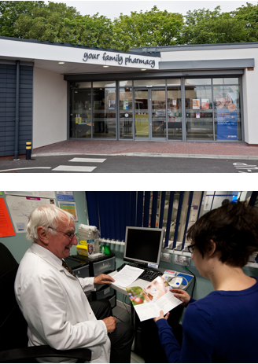
Finding the missing millions
Earlier identification of cardiovascular risk
Opportunistic blood pressure checks through the Hypertension Case-Finding Service
Identification of people at risk of hypertension, atrial fibrillation, high cholesterol and diabetes
Supporting cardiovascular risk assessment and referral into appropriate pathways
Reaching people who may not routinely engage with other healthcare services
Contributing to the MSF ambition of earlier diagnosis and proactive intervention

Slide 6
Offer 2
Prevention where people live

Slide 7
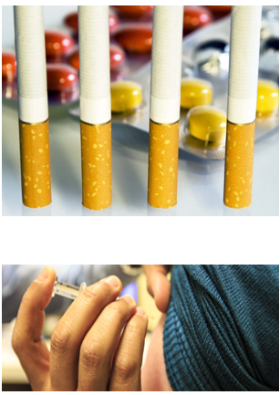
Local intelligence through trusted relationships
Reducing avoidable cardiovascular disease
Opportunistic healthy lifestyle advice
Vaccination and prevention services that keep people well
Smoking cessation support
Weight management support
Self-care and behaviour change conversations
Helping shift the NHS from reactive care towards prevention-focused care

Slide 8
Offer 3
Driving treatment to target

Slide 9
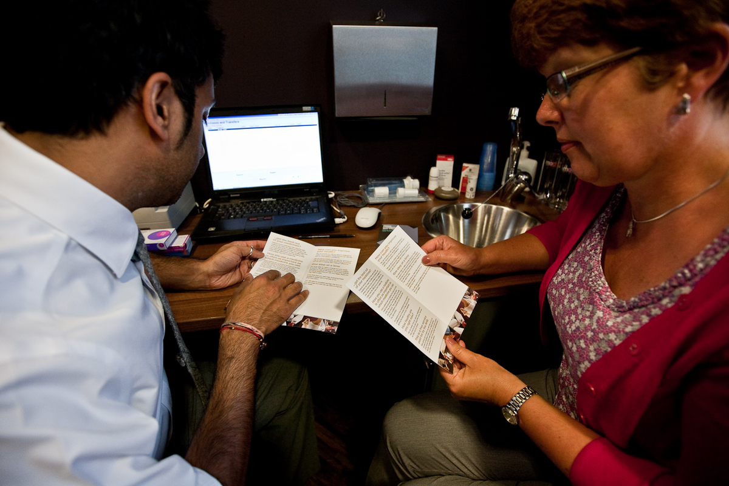
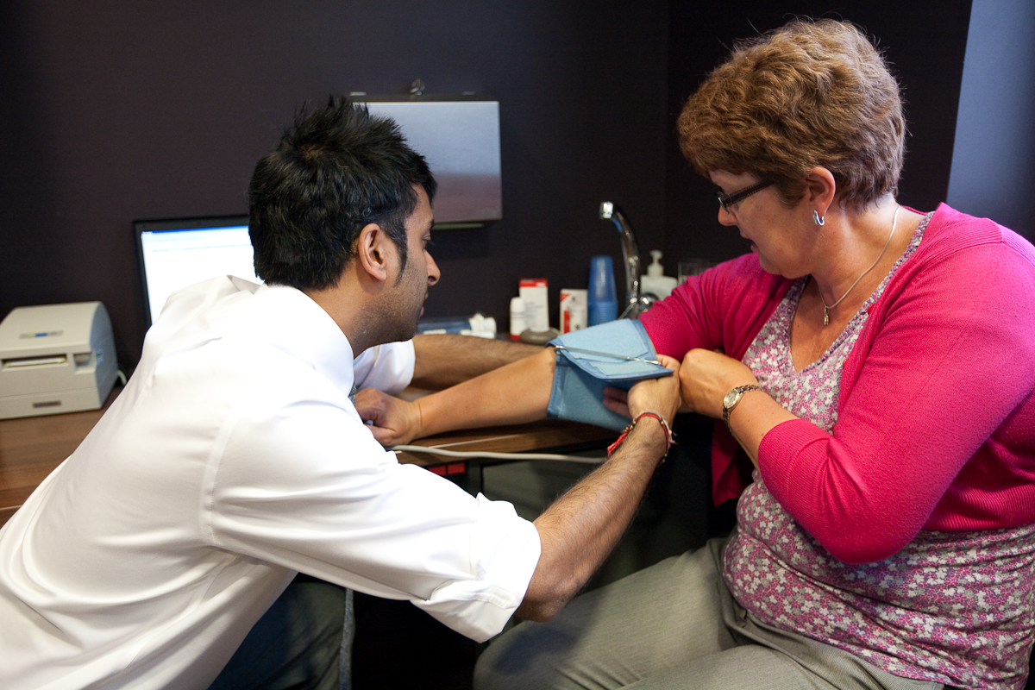
Driving treatment to target
Supporting better long-term condition management
Medicines optimisation and clinical reviews
New Medicine Service support
Improving adherence to cardiovascular medicines
Supporting achievement of blood pressure, cholesterol and diabetes treatment goals
Prescribing pharmacist expertise to optimise treatment pathways
Helping reduce avoidable cardiovascular events and complications

Slide 10
Offer 4
Tackling health inequalities

Slide 11
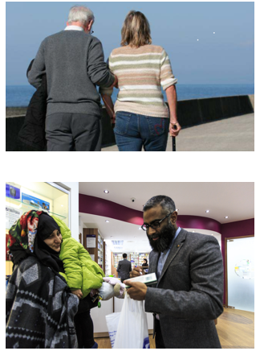
Prevention at scale, close to home
Reaching underserved communities
No appointment needed and convenient opening hours
Located in the heart of local communities
Trusted by disadvantaged and underserved populations
Targeted outreach and case-finding in high-risk communities
Supporting equitable access to prevention, diagnosis and treatment
Helping reduce variation in cardiovascular outcomes across populations

Slide 12
Offer 5
Care closer to home

Slide 13
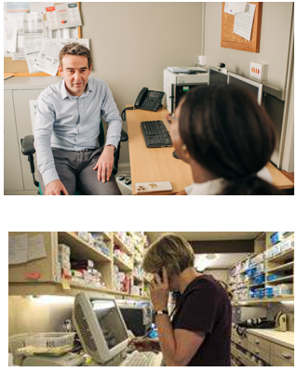
Care closer to home
Delivering neighbourhood-based cardiovascular care
Accessible clinical support without the need to attend hospital
Integration with GP practices and neighbourhood teams
Rapid referral and signposting into other local services
Follow-up and ongoing support for people living with long-term conditions
Supporting delivery of the MSF vision for more care in community settings

Slide 14
Offer 6
A willing and engaged partner

Slide 15
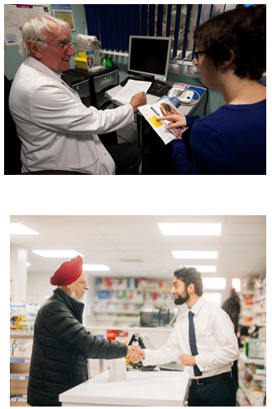
A willing and engaged partner
Supporting local implementation of the CVD MSF
Community pharmacy can help systems deliver:
  Prevention at scale
  Earlier diagnosis and case-finding
  Medicines optimisation
  Long-term condition management
  Reduction of health inequalities
  Better population health outcomes

Slide 16
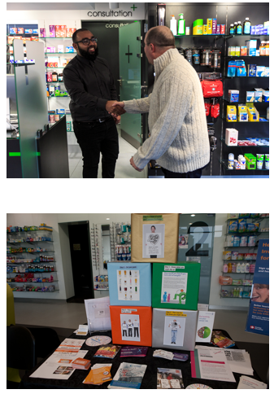
What this means for the ICB / Neighbourhood Team
Include community pharmacy as a core strategic partner
Use pharmacies to identify and engage at-risk populations
Invest in community-based prevention and case-finding
Integrate pharmacy into CVKM pathways
Harness pharmacy expertise in medicines optimisation and prescribing
Work together to improve cardiovascular outcomes and reduce inequalities across local populations

Slide 17
One network, one neighbourhood. One shared ambition to reduce premature deaths from heart disease and stroke by delivering prevention, earlier intervention and personalised care closer to home

