Slide 1
Neighbourhood Health and new contracting models – what this means for Community Pharmacy

Slide 2
What we will cover in this session
An introduction to Neighbourhood Health and Integrated Neighbourhood Teams (INTs)
An overview of new contracting models
Explain why all this matters specifically for community pharmacy
Highlight opportunities, current unknowns and risks
Set out practical next steps, including working with local GP practices

Slide 3
Neighbourhood health and Integrated Neighbourhood Teams

Slide 4
What do we mean by Neighbourhood Health?
Neighbourhood Health is the cornerstone of the 10 Year Health Plan for England
Neighbourhood Health means care and services organised around local populations, putting people at the centre of how health and care services are delivered
In many areas, the local health system is already moving in this direction so this may not be new in your area
It focuses on:
  Prevention and early intervention
  Supporting people with long‑term conditions
  Reducing health inequalities

Slide 5
What do we mean by Neighbourhood Health?
A neighbourhood footprint typically covers 30,000–50,000 people
It should be defined around a natural community (neighbourhoods may have different footprints to current Primary Care Networks)
They are designed to deliver joined‑up, place‑based care, delivered by a ‘team of teams’ made up of primary and secondary care professionals, community services and the voluntary sector, amongst others
Health & Wellbeing Boards to play a key role in defining neighbourhood footprints

Slide 6
What are Integrated Neighbourhood Teams?
An Integrated Neighbourhood Team (INT) is a ‘team of teams’ bringing together:
  GP practices
  Community pharmacy
  Community nursing
  Mental health
  Social care
  Voluntary & community sector
An INT plays a central role in improving health outcomes by working collaboratively to design care around individuals, families and communities, rather than organisational boundaries
INTs will aim to prevent escalation and support people to stay well and independent at home, reducing hospital admissions and long-term care needs
In the future, services may be commissioned at a neighbourhood level, although further NHS guidance on this is awaited

Slide 7
Neighbourhood Health Centres
Neighbourhood health centres (NHCs) are new local ‘one-stop’ health hubs bringing together GP, community, social care and other services
NHCs are designed to make care easier to access, more joined‑up and closer to home; they are part of the strategy to support the neighbourhood health model
In time, NHCs will include wider services like debt advice, employment and family support and other voluntary sector support, and will be open 12 hours a day, 6 days a week
The Government has set out plans to deliver 250 NHCs by 2035
These will comprise a mixture of upgrades to existing buildings and new build centres

Slide 8
New contracting models

Slide 9
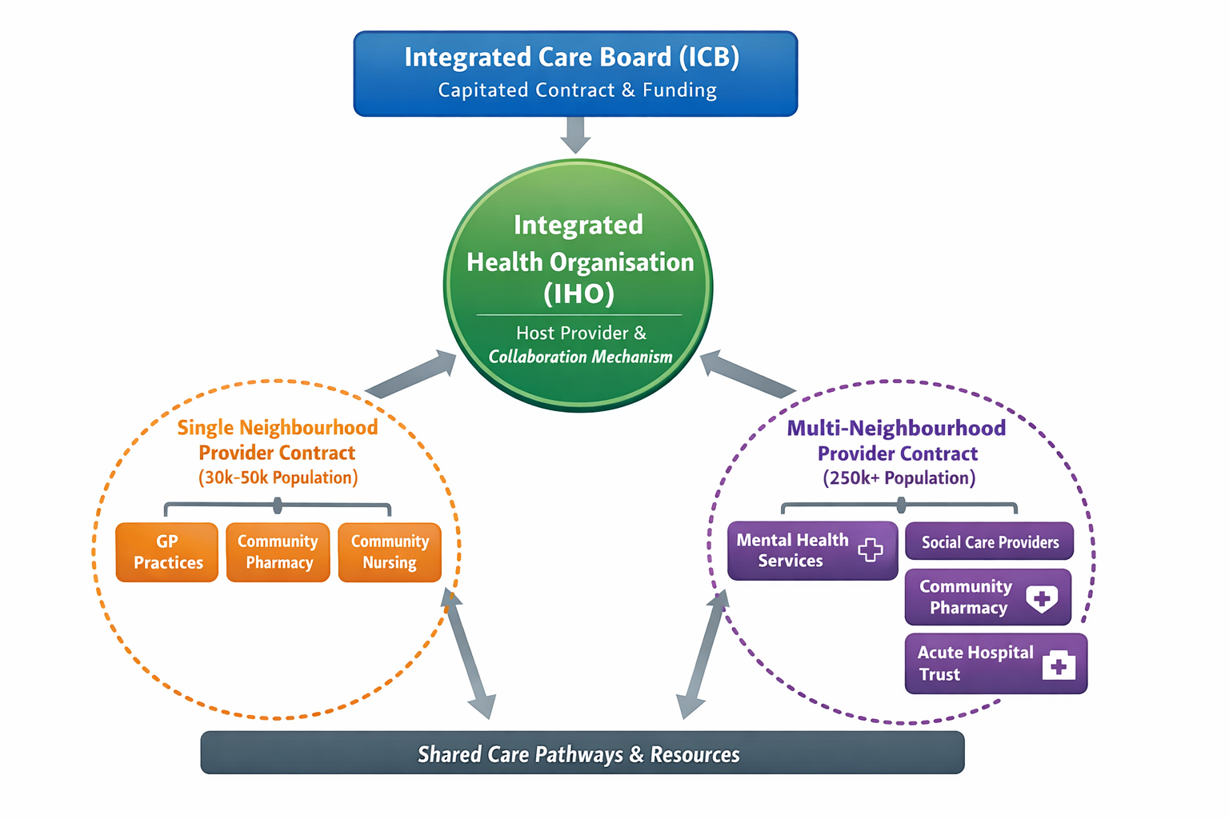
New (proposed) contracting models - overview
Sets outcomes
Issues capitated population contract
Holds capitated budget
Sub-contracts delivery
Runs collaboration mechanisms
Coordination of consistent service delivery across multiple neighbourhoods
Will require sub-contracting or collaborative arrangements with SNPs
Contract will be for enhanced services
SNPs expected to deliver neighbourhood health services outside GMS and PCN-level DES
May include medicines optimisation, prevention and LTC support, community-based interventions

Slide 10
What is an Integrated Health Organisation?
IHOs are integrated delivery models, not new legal entities.
They are built around three core elements:
  A capitated contract from the ICB covering a whole population.
  The provider organisation holds the main contract and sub-contracts partner providers.
  A locally agreed collaboration mechanism, supported by formal arrangements, ensuring shared decision‑making.
Their purpose is to improve population health, reduce inequalities, and shift resources toward prevention and community care.
Typical population size: 250,000-500,000 people (place level); however up to 1-1.5 million in some systems.

Slide 11
Purpose and structure of IHOs
IHOs are intended to address major NHS pressures:
  Rising demand due to ageing population and long-term conditions and need to shift resources toward prevention and community care
  Fragmented commissioning and service delivery and misaligned incentives across organisations
IHOs are likely to be a high‑performing foundation trust, but local agreement with providers is key
Pharmacy providers may be sub‑contracted via other neighbourhood providers rather than directly by an IHO

Slide 12
What are Single and Multi-Neighbourhood Provider Contracts?
Single Neighbourhood Provider (SNP) Contract
Covers a neighbourhood population typically of 30,000-50,000 people
Brings together providers to deliver agreed neighbourhood health services
Focuses on prevention, proactive care and reducing health inequalities
Builds on existing relationships within neighbourhood multidisciplinary teams
Contract holders must have access to the registered patient list
Envisaged to be an evolution of the PCN DES contract
Multi-Neighbourhood Provider (MNP) Contract
Covers a larger footprint, usually multiple neighbourhoods (250,000+ population)
Coordinates delivery of services across a place or locality
Creates greater consistency, scale and efficiency
Likely to be larger providers and may hold and manage contracts on behalf of multiple neighbourhood providers
May take on additional responsibilities, e.g. the medicines budget
National contracts are not in scope – GMS and CPCF continue
There is no new national funding to support these new contracting models

Slide 13
What do these contracts mean for community pharmacy?
We still have more questions than answers – very little mention of community pharmacy in recent consultation
Not yet clear how community pharmacy services ‘fit’ into these contracting models which are very GP focused
Pharmacy providers may be sub-contracted to provide services by SNP / MNP contract holders
Likely to see significant local variation when implemented which may be a challenge to navigate
Potential opportunities in the future for new local service commissioning to meet population health needs and support neighbourhood priorities
There is ongoing commitment for national contracting via the CPCF for the foreseeable future

Slide 14
Community pharmacy’s role in neighbourhood health

Slide 15
Why Community Pharmacy matters in neighbourhoods
Community pharmacy is a core neighbourhood clinical partner, not just a service provider
Community pharmacy offers:
  The most accessible health care advice and services to communities
  Daily contact with local populations – we know our communities
  Advice, education and signposting helping people find the right help more easily
  Prevention and early action – reduces pressure on the wider system
  Clinical care in the community through highly trained pharmacy teams delivering valued services such as Pharmacy First, New Medicine Service, Pharmacy Contraception Service, the Hypertension Case-Finding service and also improving medicines safety

Slide 16
Opportunities for Pharmacy Owners
Potential opportunities include:
  Optimising national Advanced services delivery by integration into neighbourhood-level service pathways in:
    Long-term condition management
    Acute care
    Prevention
Stronger integration with GP practices and PCNs
Improved visibility and influence within local systems – being ‘part of’ rather than ‘done to’
Workforce development and skill mix expansion

Slide 17
The ‘Known Unknowns’
Current uncertainties include:
  Variation between neighbourhoods across Integrated Care Systems
  How consistently pharmacy will be included in INT governance and structures
  Whether funding will follow activity or outcomes and who will control funding
  Commissioning routes
  Digital access to shared records and other digital developments to support integration
  How workloads and responsibilities will shift between commissioners and providers

Slide 18
Risks Pharmacy Owners need to be aware of
Potential risks if pharmacy is not proactive:
  Being seen only as a delivery route, not a clinical partner
  Perceptions and myths about community pharmacy are not remedied
  Unfunded workload expectations by other INT stakeholders
  Decisions being made without pharmacy input
  Increased pressure without system support
  Missed opportunities to align services with neighbourhood priorities

Slide 19
What good looks like for community pharmacy
In a well‑designed neighbourhood model:
  Pharmacy has a clear role and voice
  Work is commissioned, funded and valued
  Data flows support safe, integrated care
  Local relationships are strong and routine
  Pharmacy services align with neighbourhood priorities
  Advanced service delivery by community pharmacy is valued and supported in local care pathways

Slide 20
Why GP relationships are critical
Understanding GP views locally is essential to ensuring pharmacy is included meaningfully
In an ideal world, your local GP practice will be your biggest supporter and advocate for community pharmacy
GP practices will often:
  Lead or strongly influence neighbourhood delivery
  Shape local priorities and pathways
  Control access to shared systems and governance

Slide 21
Call to Action: Start local conversations
What we are asking pharmacy owners to do:
Speak with local GP practices
Ask:
  What do neighbourhoods look like locally?
  How do they see pharmacy contributing?
  What gaps do they need help to fill?
Share learning and intelligence back to the LPC
Don’t assume alignment – explore it. Neighbourhood health is about joined‑up care around a local population; work with GP practices, community services and other stakeholders you already work with to define how community pharmacy can contribute.

Slide 22
How the LPC will support you
The LPC will:
Represent community pharmacy in discussions about neighbourhoods – these may be with the ICB, Place or the neighbourhood directly
Share intelligence and good practice
Support relationship building with other partners
Advocate for funded, sustainable pharmacy roles
Keep pharmacy owners and their teams updated as models evolve

Slide 23
Final message
Neighbourhood Health is:
A significant system change
Potentially an opportunity for community pharmacy
A risk if we are passive and do not seek to be involved and understand local developments
Community pharmacy’s influence and engagement within neighbourhood development will be determined by the conversations we have now. Please seek opportunities to get involved.

